Slide 1
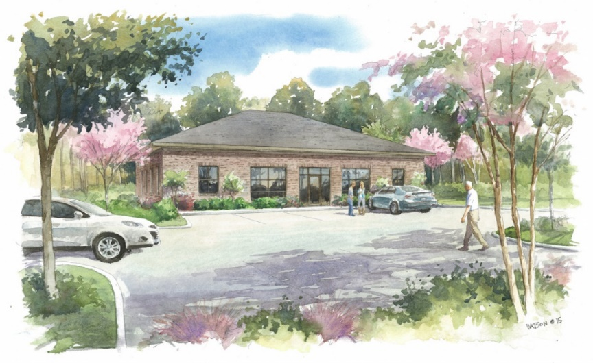



Highway 78 @ Mallard Road Build to Suit Class A Office/Medical Office Space! $15/sqft NNN!
Updated Throughout!
MLS# 30222786
$15 PSF (Annual) / $2,233 - 4,468 (Monthly)
Attention: Agents with Doctor, Dentist, Attorney, and Business Professional Clientele needing Brand New Office Space for Lease: “Owners are ready to Break Ground on New Construction Class A Office/Medical Office Space”. Stress that there is ample parking, and that the building shares the corner of the intersection with the DaVita Dialysis Clinic. Approximately 2 miles from I-26, 5 miles from downtown Summerville, and 2 miles from Pine Forest Country Club.
Proposed Class A Office/Medical Office space on the corner of Hwy 78 and Mallard Road. Build to suit property. Already permitted so owners estimate build out to be approximately 12 weeks as they are very familiar with Commercial Medical/Office Construction. Next door is the DaVita Dialysis Clinic which was built by the owners of this property, so that facade will mirror the new build. Large parking lot is shared with DaVita. Located 1.5 miles off I-26, 5 miles to Downtown Summerville, and is surrounded by growing residential, commercial, governmental, and industrial space. Call Agent for further details.
Scan The QR Code For Complete Details
Haynes Johnson
Mobile - (843) 864-8159
haynes.charlestonproperties@gmail.com
The Boulevard Company, LLC | 35 Broad Street | Charleston, SC 29401 | haynes.charlestonrealestate.properties

