Slide 1
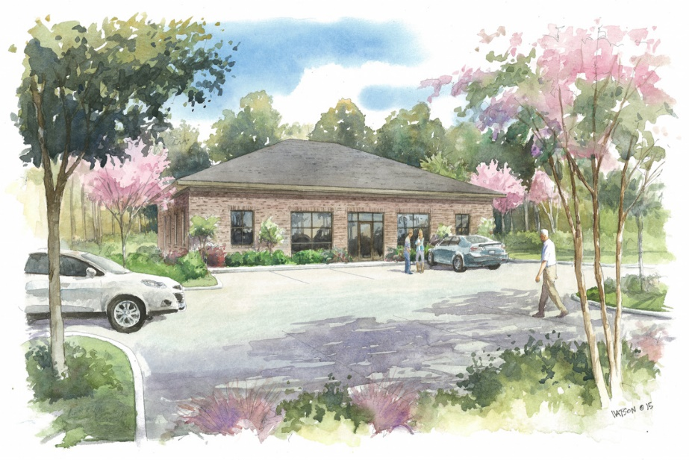
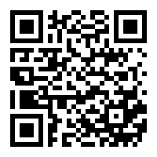


Highway 78 @ Mallard Road
Build to Suit Class A Office/Medical Office Space! $15/sqft NNN!
Updated Throughout!
MLS# 29884713
$15 PSF (Annual) / $2,233 - 4,468 (Monthly)
Proposed Class A Office/Medical Office as a build to suit with a proposed 4 year NNN lease minimum. Owners estimate a Commercial Build Out of around 8 weeks, and they are very familiar with commercial medical/office construction. The facade will mirror the DaVita Dialysis Clinic, which shares the large parking lot with the proposed building. Office is located approximately 1.5 miles to I-26, 5 miles to downtown Summerville, and is caddy-corner to Pine Forest Country Club as the crow flies.
Excellent location for brand new proposed Class A office/Medical Office. Build to Suit (per agreed upon Standard Work Letter, and shell has been approved). 1.5 miles to I-26 via exit 194, and less than 5 miles to downtown Summerville. Brick facade to match DaVita Dialysis Clinic, which is contiguous property across shared parking lot. Residential, Retail, Medical Office, Office, Industrial, and Governmental buildings all within a 2 mile radius.
Scan The QR Code For Complete Details
Haynes Johnson
Mobile - (843) 864-8159
haynes.charlestonproperties@gmail.com
The Boulevard Company, LLC | 35 Broad Street | Charleston, SC 29401 | haynes.charlestonrealestate.properties

