Slide 1


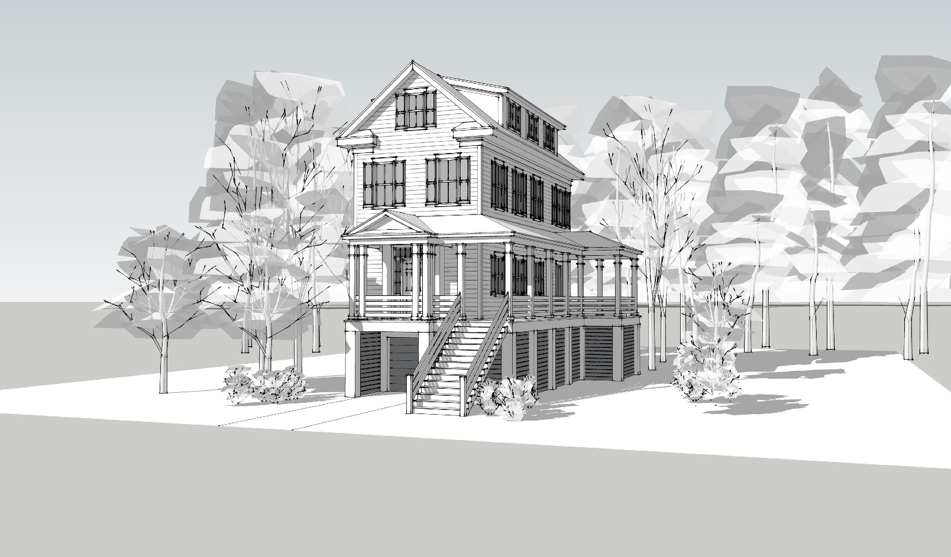
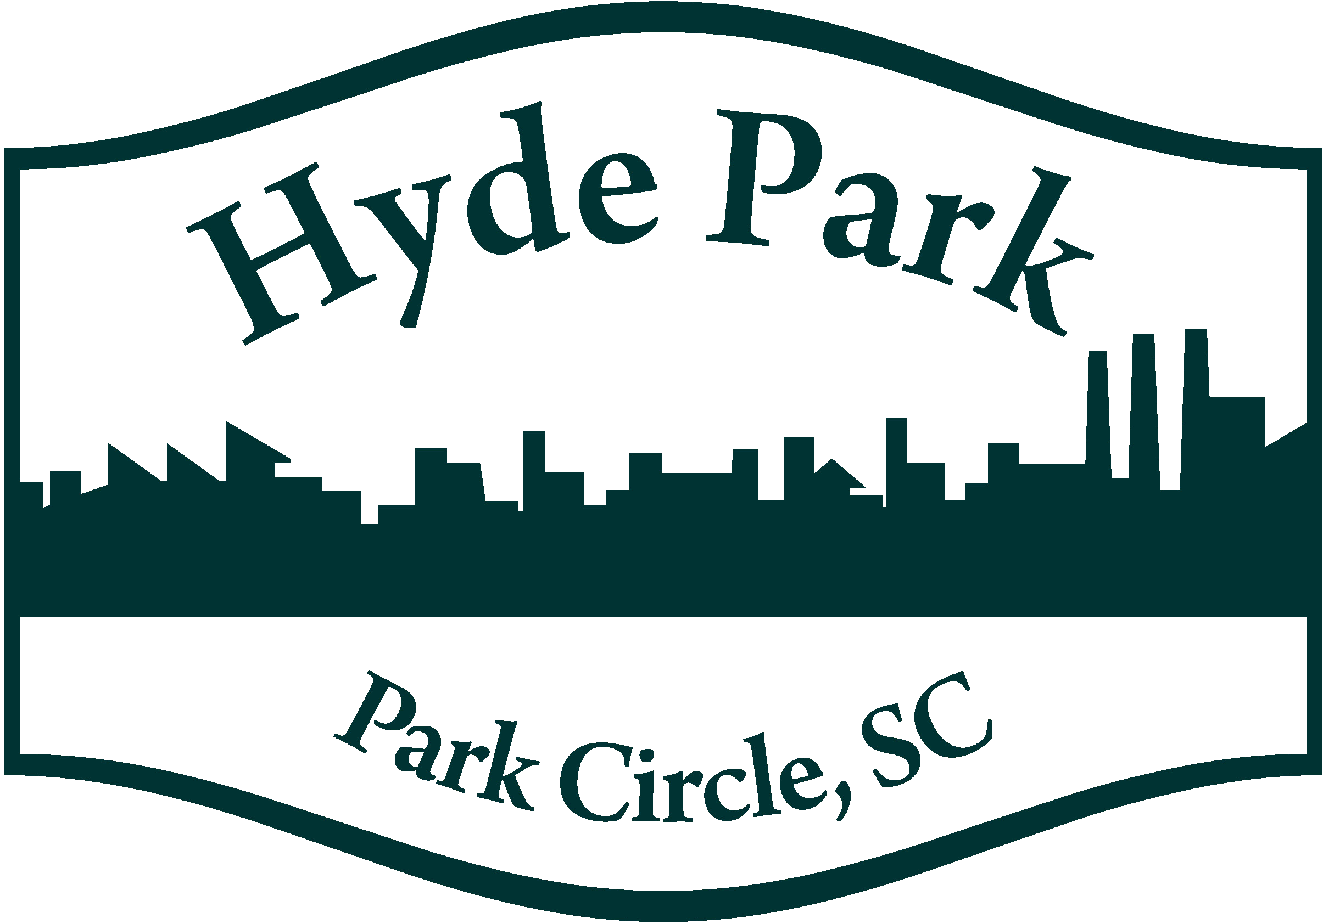
Pre-Construction Invitation Hyde Park Circle
The Nautilus
MLS #15018431
14 Charleston-Style Homes starting in the mid $300s
Special Pre-Construction Pricing
Limited Time Only
For more information, contact Hamilton Horne
hamilton@mattoneillteam.com | (843) 708-0584 | www.mattoneillrealestate.com

