Slide 1

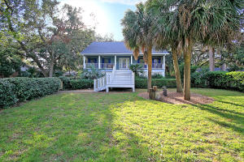
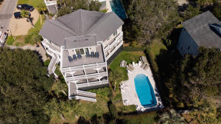
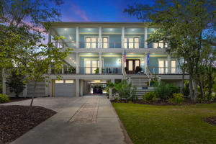
Agent Progressive Open House Lunch on IOP
Wednesday, February 5th from 11-1
There will be a drawing for a $100.00 gift card for attending all 4 homes.
Appetizers
Lunch
17 24th Avenue
MLS# 19026272
$795,000
Ann Whalen
843-224-8696
awhalen@century21properties.com
Century 21 Properties Plus
19 24th Avenue
MLS# 19031518
$768,500
Mason Thurber
843-709-5109
mason@theeverettgroup.net
RE/MAX Pro Realty
Lunch
Dessert
6 45th Avenue
MLS# 19030157
$2,325,000
Joanne Brockway
843-425-8273
jbrockway@kwchs.com
Keller Williams Realty Chas. Islands
5002 Palm Boulevard
MLS# 19027754
$3,200,000
Ann Whalen
843-224-8696
awhalen@century21properties.com
Century 21 Properties Plus

