Slide 1
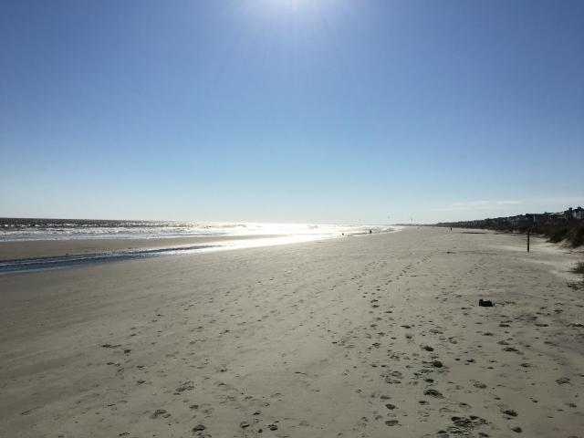
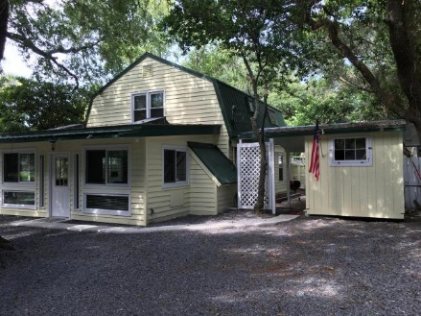
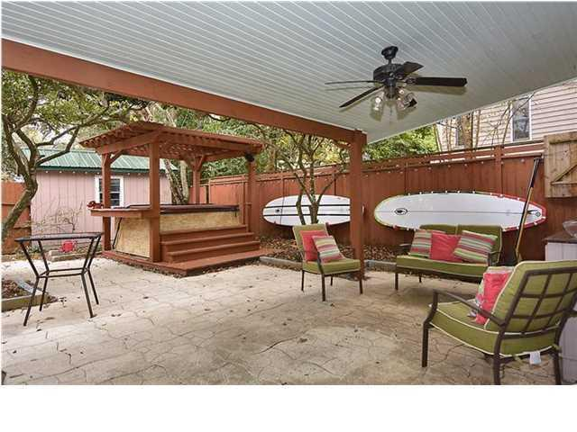
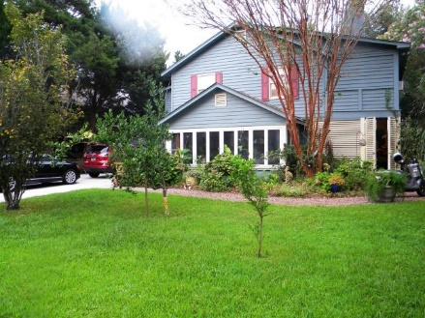
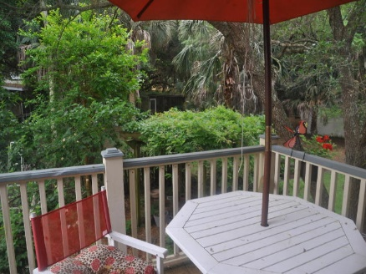
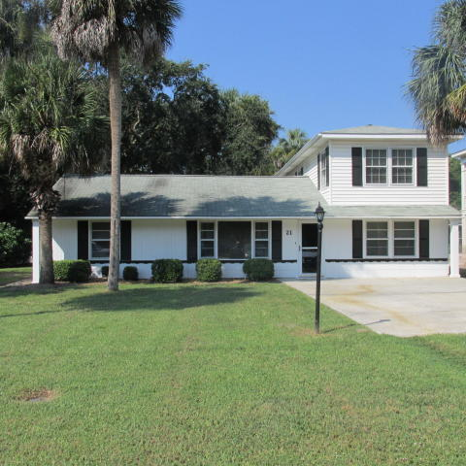
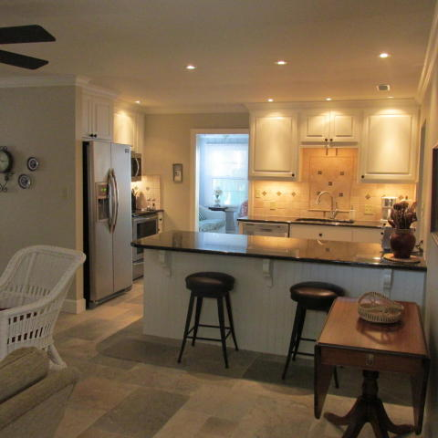
2400 Hartnett Boulevard
MLS# 16003024 - $599,900
Jennifer Nipper
(843) 478-1800 | jen@AgentOwned.com
Isle of Palms
Multiple Open Houses
Sunday, August 21st, 12-4pm
Just Reduced
Just Reduced
2906 Hartnett Boulevard
MLS# 15023524 - $650,000
True Edwards
843-442-6253 | true@trueedwards.com
21 21st Avenue
MLS# 16012055 | $577,000
Angela Jones
(843-883-9300 | angelaj@thejonescompany.org

