Slide 1
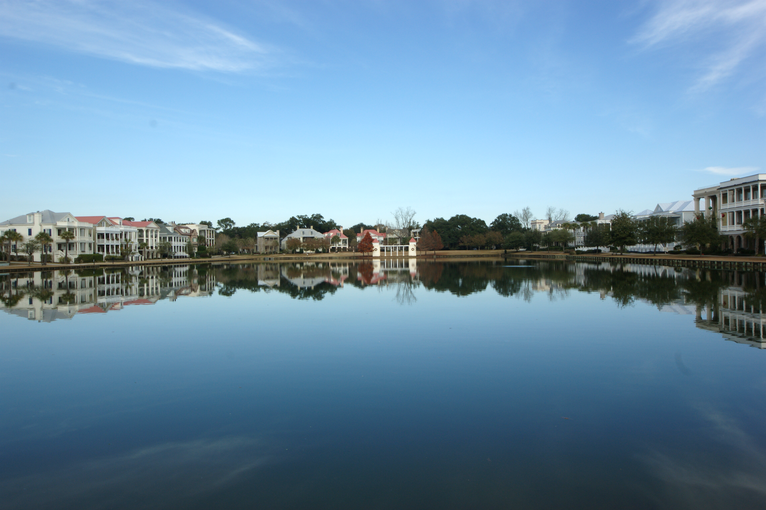
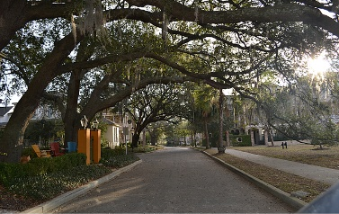
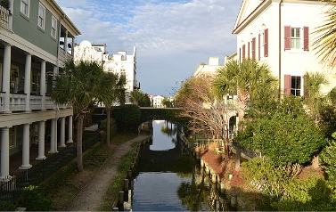
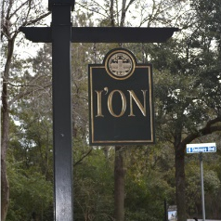
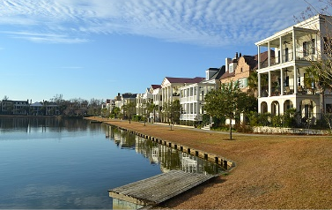
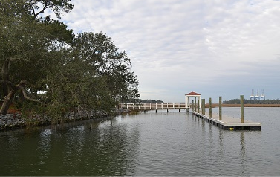

Qualified Buyer Looking for 3-4 Bedroom Home in I’On that is not on the market.
Please call me if you have a Pocket Listing!
Pre-Qualified Buyer Looking in I’On
Robin Phillips
(843) 214-8451
Robin@ThePhillipsRealtyGroup.com

