Slide 1

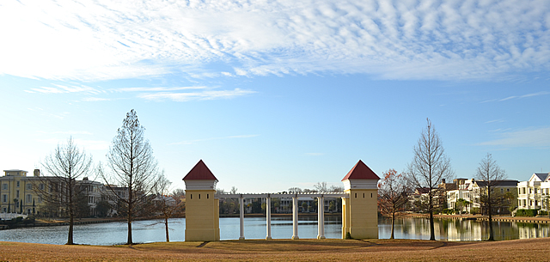



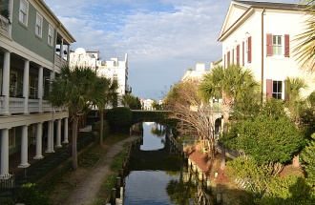



ION BUYER LOOKING FOR A HOME!
ION BUYER LOOKING FOR A HOME!
Newer Home
New Listings or Listings Coming to Market.
3000+ SQFT.
Less than $2M Final Contract Price.
The more updated and contemporary the better.
Please send me your

