Slide 1
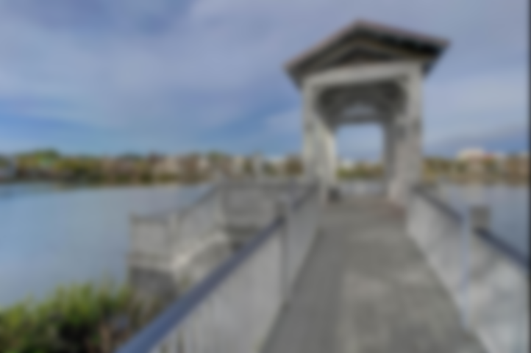
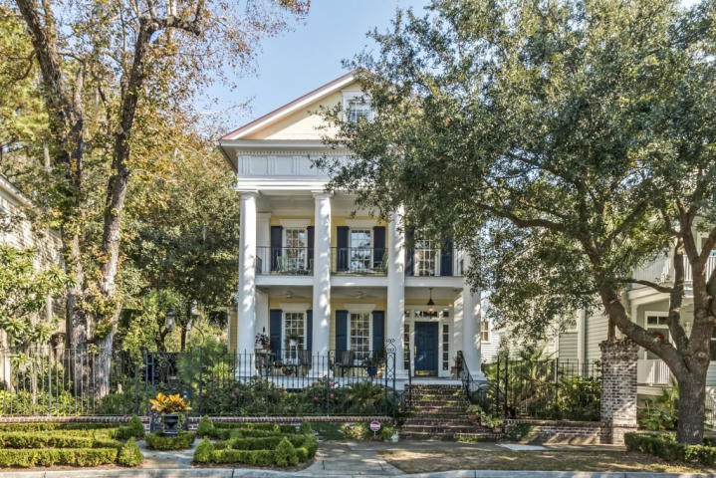
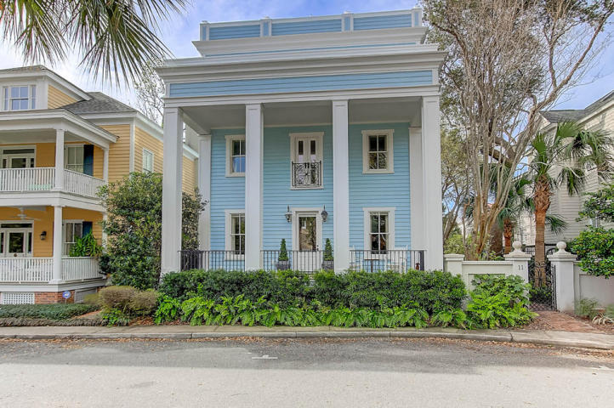
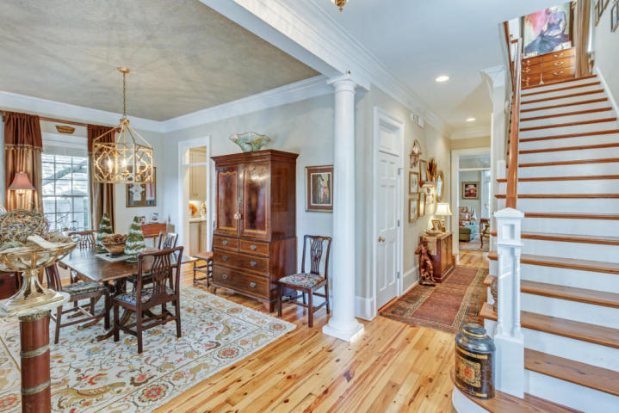
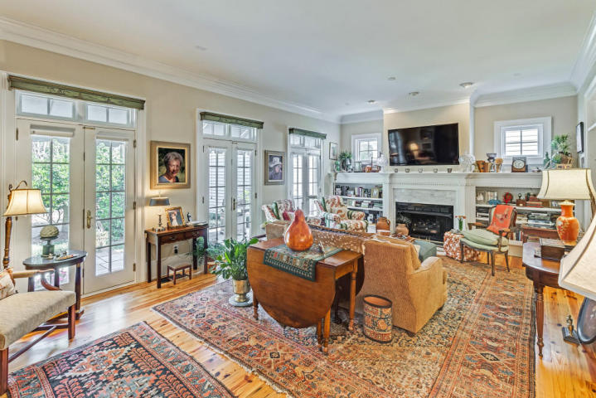
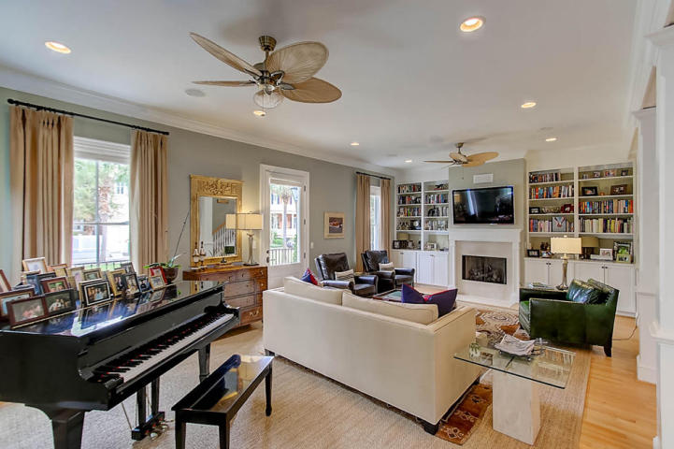
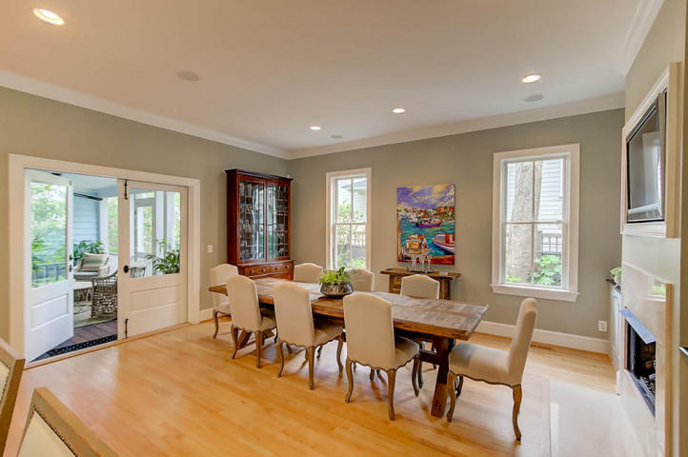
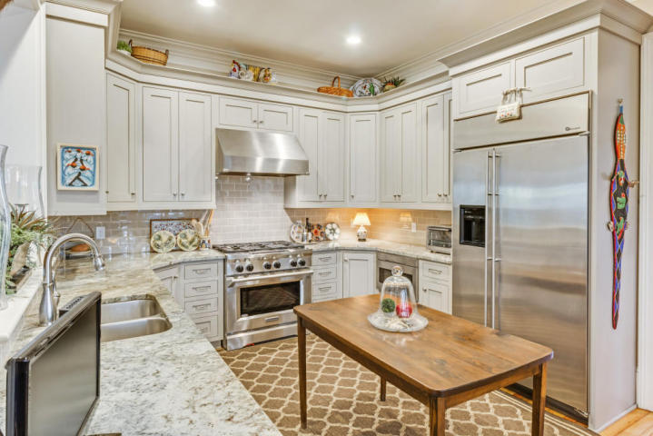
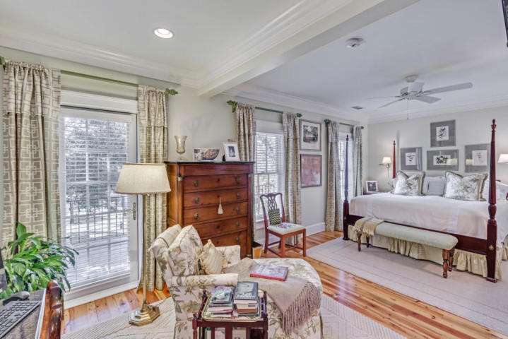
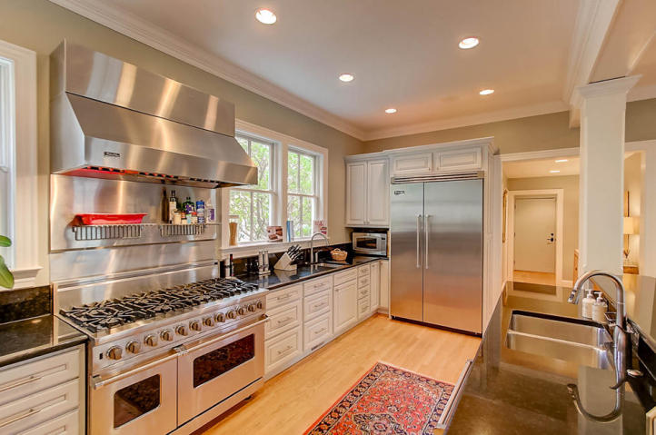
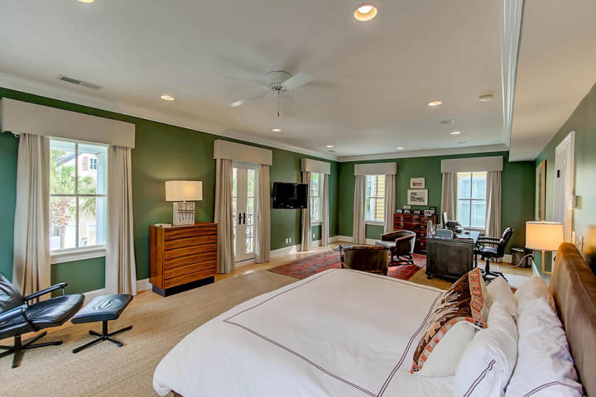
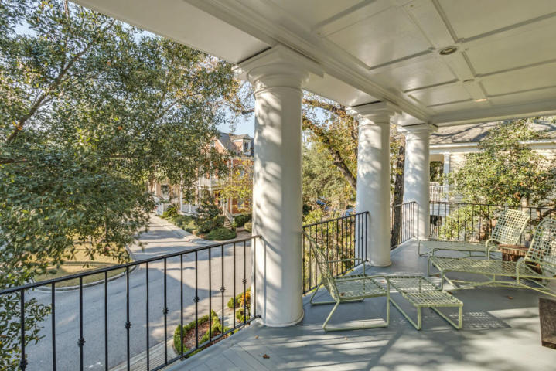
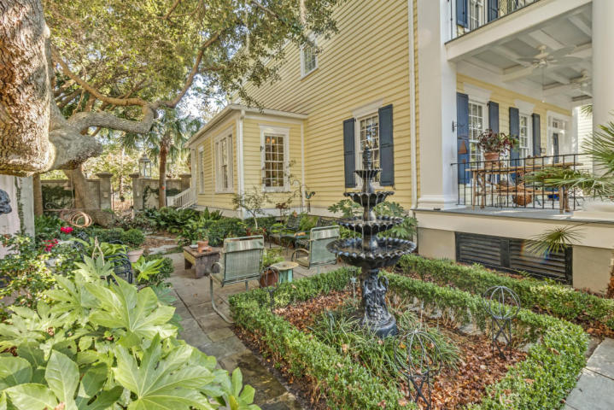
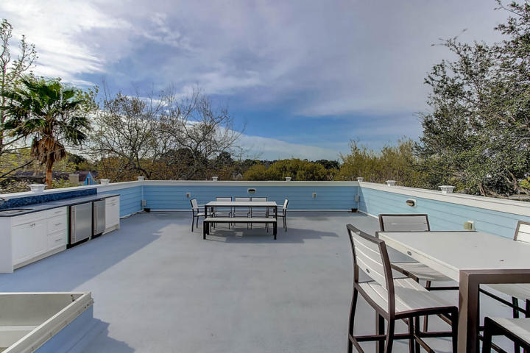
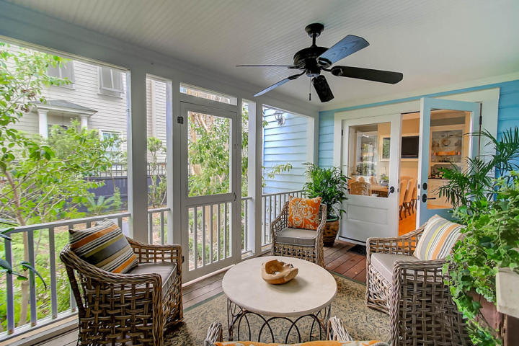


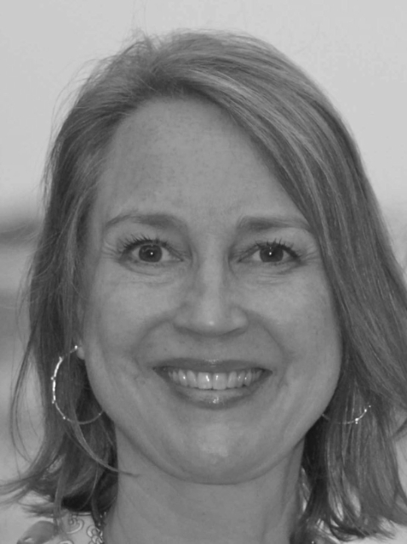
Eastlake @ I’On Open Houses
Light Lunch Will Be Served ~ Tuesday, May 9th ~ 11:30-1
Drawing for 2 Gift Certificates from Abide-A-While - $25 each!
Hamby's Sandwiches
Fruit & Dessert
42 Eastlake Road
MLS# 17011210 | $1,195,000
Andrea Woodfield
(843) 442-7442
andrea@andreawoodfield.com
11 Boathouse Close
MLS# 17007033 | $1,349,000
Jane Smith
(843) 696-7119
janes@carriageprop.com
Andrea Woodfield
Realtor
(843) 442-7442
andrea@andreawoodfield.com
Keller Williams Realty Charleston West Ashley
1180 Sam Rittenberg Ste 105
Charleston, SC 29407
Carriage Properties LLC
19 Exchange Street
Charleston, SC 29401

