Slide 1
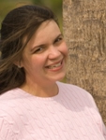

BUYER LOOKING FOR A HOME IN MOUNT PLEASANT
UP TO $650K SINGLE FAMILY HOME
House Hunting!
Buyer is looking for a single family home in Mt Pleasant
up to $650,000
Newer or Updated Preferred
These are Cash Buyers and can Close Quickly
Clients have already seen everything listed in MLS.
Please let me know if you have anything. Thank you!
Carey Nikonchuk
843-276-1701 | cnikonchuk@gmail.com
http://www.palmettoproperty.net
The Brennaman Group | 2200 Belle Isle Ave #102 | Mt. Pleasant, SC 29464

