Slide 1
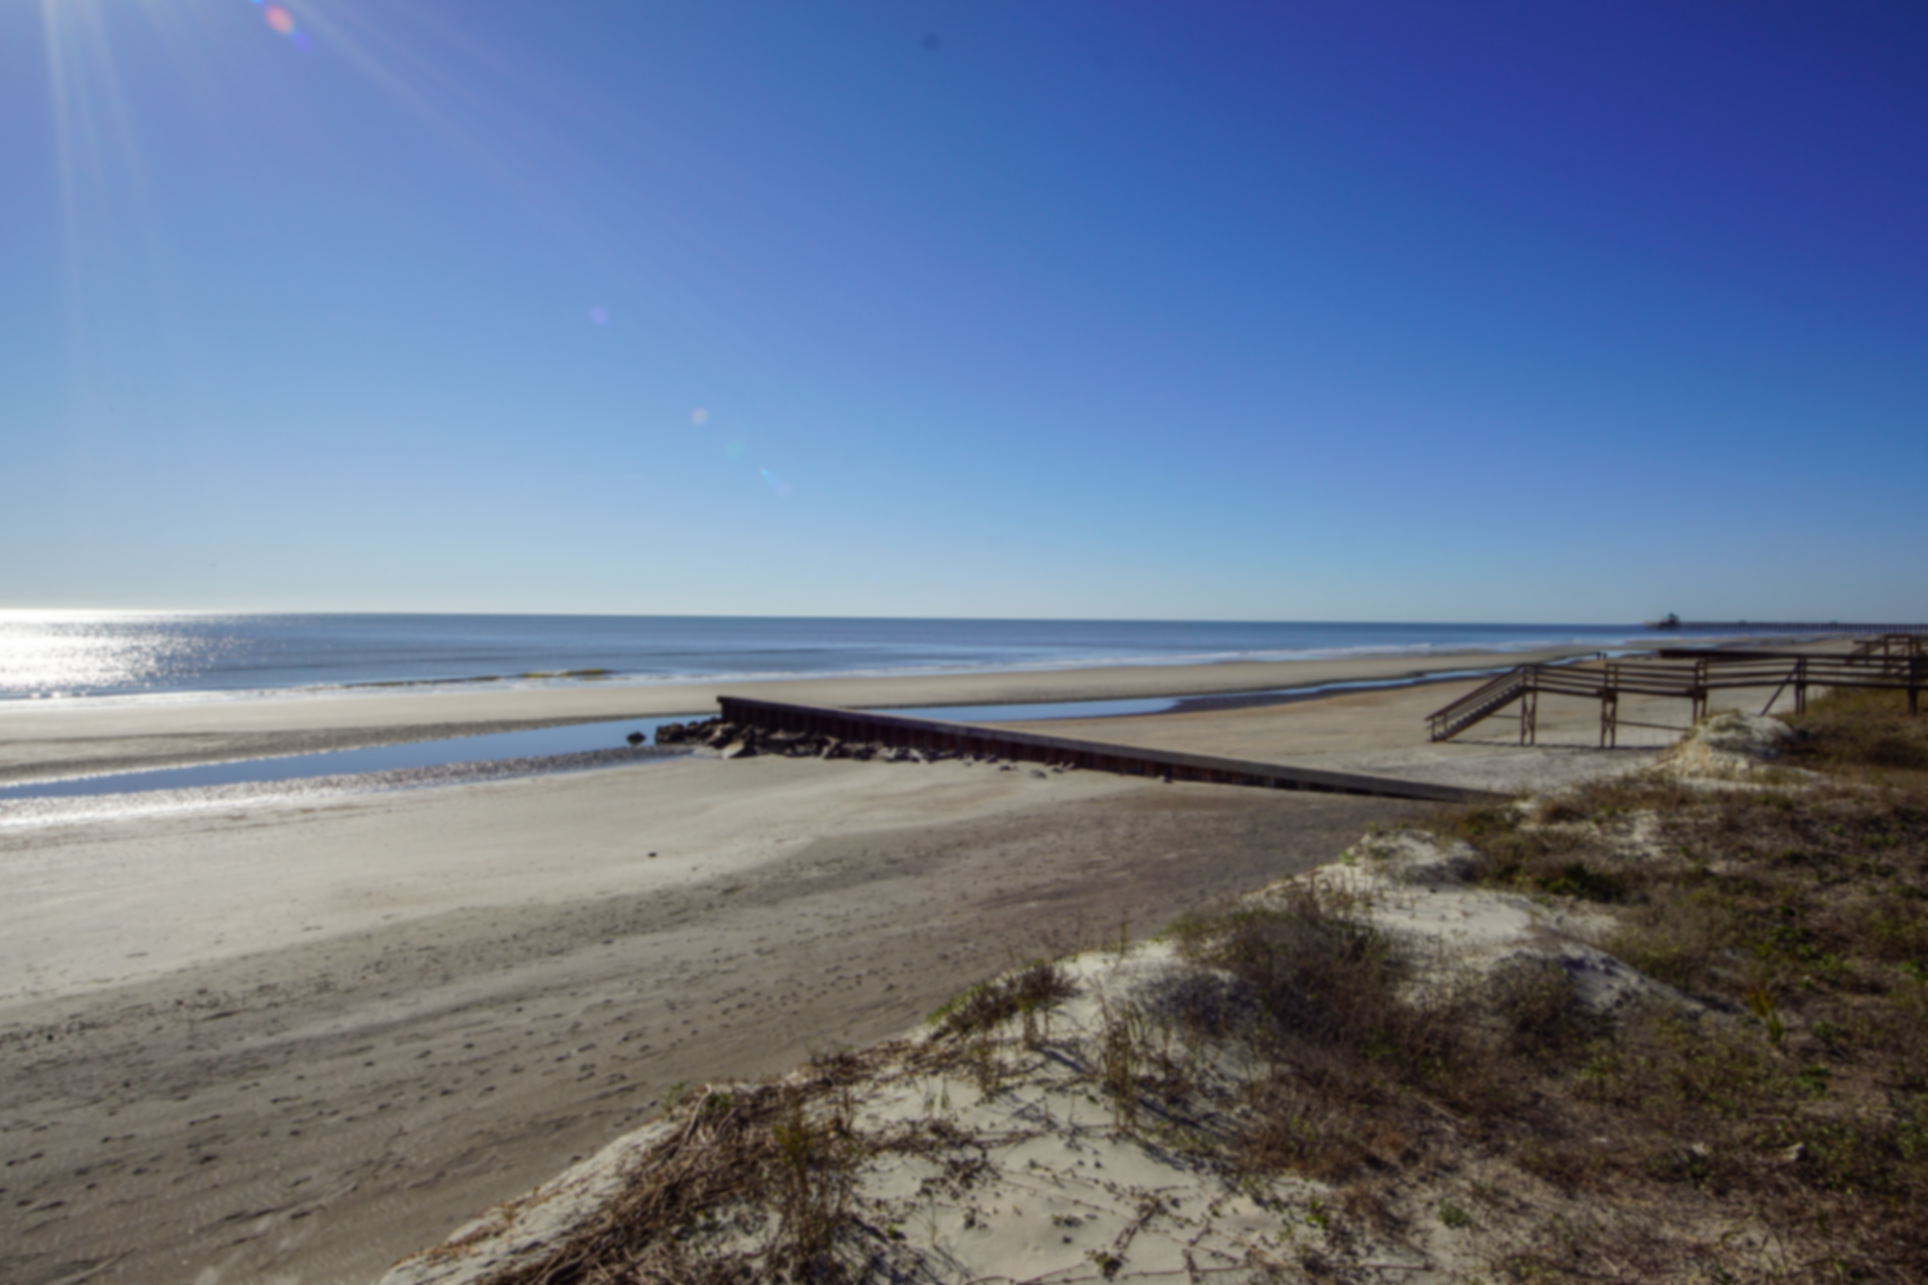

Buyers Looking for…
I am currently working with buyers who is looking for a single family home on IOP or Folly in the $1.5M-2.5M range.
Also looking for an Apartment Complex anywhere in the Greater Charleston are between $10-$12M
If you have a line on a property that matches either criteria, please reach out…we are ready to go!!
Jason Newhauser
843-534-6564
jasonsellscharleston@gmail.com
Coldwell Banker Realty | 55 Broad St | Charleston, SC 29401

