Slide 1
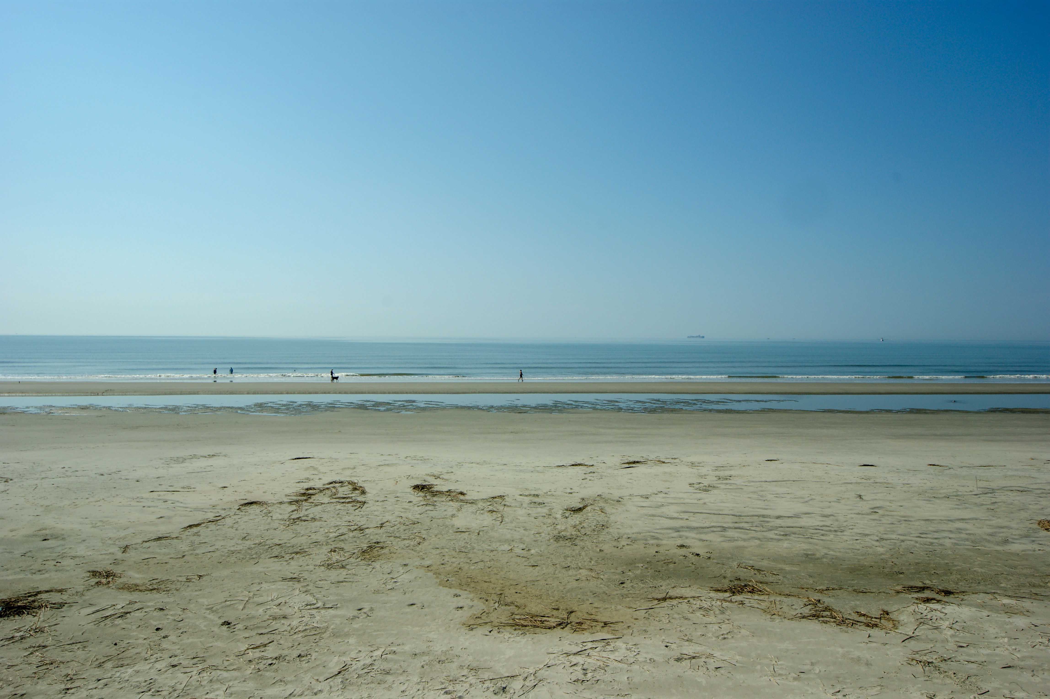


Looking for Beachfront Home or Coastal Property
Cash Buyers looking for Beachfront Home with Outstanding Ocean Views!
#1 Priority is the Ocean view.
Some space/privacy between the neighbors needed.
Up to $4,500,000.
These Buyers are also open to a home with acreage where horses are allowed. Would need to have enough acreage for storing/riding horses on the property and within golf cart/walking distance to the beach.
Open to the coastal areas of Edisto to Awendaw.
Thank you!
Megan Maarouf
843-801-7777
meganmaarouf@gmail.com
Reside Real Estate LLC
155 Wingo Way Unit 421
Mt. Pleasant, SC 29464

