Slide 1
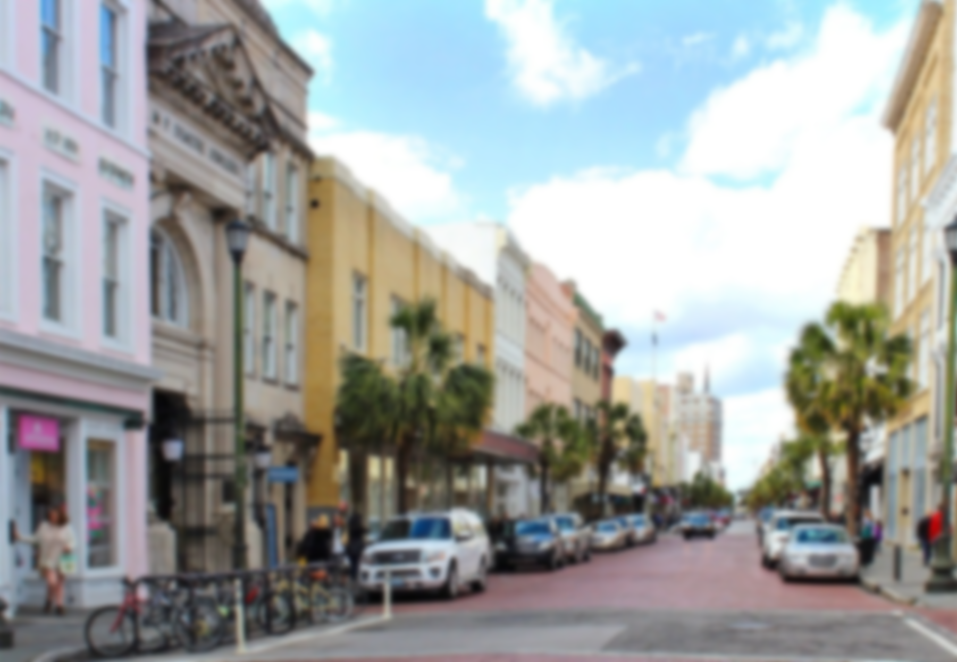


Shoe & Clothing Retailer looking for commercial space downtown Charleston.
Ideally looking on King St, Meeting St, The Market, East Bay or near by.
Needs 1,800 to 3,000 sf depending on location.
Please contact me for more information or if you know of an ideal space coming available in the near future.
Erin Hanhauser
ABR, CNE, CLHMS, SFR, CDPE
Residential & Commercial REALTOR®
843.743.8204
erin@islandhouserealestate.com
Island House Real Estate
8017 Gibbon Street
Daniel Island, SC 29492
www.islandhouserealestate.com

