Slide 1
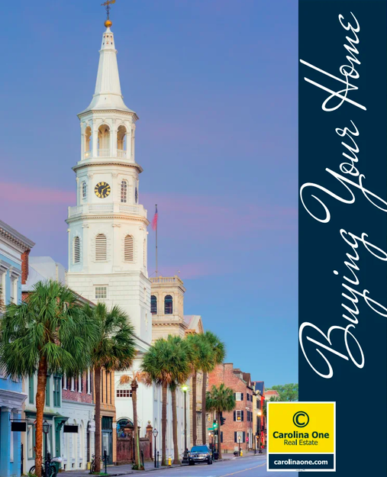
Buyer Needs
I have several buyers looking around the Lowcountry for their dream homes. We have reviewed what’s available in the MLS, but we are hoping you might have something coming to market soon that fits their needs. Please reach out if you know of a property that meets their specific needs.
Client 1 - Downtown 3 bed, 2 bath condo with parking or designated indoor spots under $1.2M
Client 2 - Master down, 3 bed, 2 bath home, >.2 acres, in a subdivision, in need of renovation on Johns Island or Hollywood. They like Stono Ferry, Waterloo, Gift Plantation, but open to others, under $750k
Client 3 - 3 bed, 2 bath home in Shellring, St Thomas Preserve, Belle Hall or Park West under $750k
Client 4 - Johns Island or Wadmalaw, >.4 treed yard, 3 beds, 2 baths, <$600k, No HOA preferred and not in a "cookie cutter" neighborhood :/
Client 5 - Summerville, no HOA, >.3 acres, 3 beds, 2 baths, <300k
Client 6 - Looking for vacant land in an existing neighborhood for my builder client looking to build a spec home, lot price <300k and home value could be $1.2 or higher
Kimberly Chambers
843.371.9047 | kim.chambers@carolinaoneplus.com | www.findcharlestonareahouses.com
Carolina One Real Estate

