Slide 1
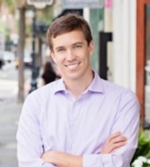


Need Kiawah River Estates Home ASAP
Client looking for
Kiawah River Estates
Up to $1,300,000
Cash Buyer
Would prefer view of golf course/river/pond
Client has seen all that is currently on offer in the MLS. Hoping you might have a listing about to come on-line.
If so, please call me!!
Kelly Snyder
(843) 457-5951
kelly.snyder@agentownedrealty.com
AgentOwned Charleston Group
902 Savannah Hwy
Charleston, SC 29407-7802

