Slide 1
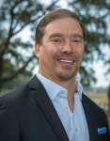
South Mt. Pleasant Home Needed
I have a client looking for a SFH in South Mt. Pleasant up to $2M
Preference would be 4 bedrooms, 2.5+ baths with a yard.
If you have anything that is coming soon, please let me know
Justin Jureka
843-290-3272
jjureka@carolinaoneplus.com
http://www.justinjureka.com/
Carolina One Real Estate
191 Rutledge Ave
Charleston, SC 29403

