Slide 1
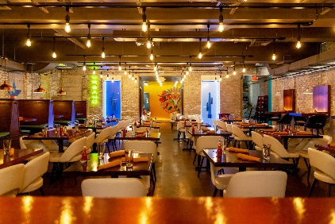
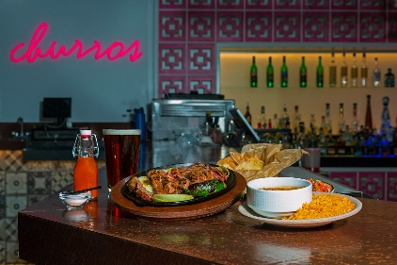
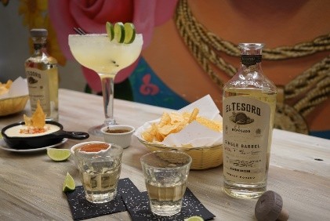
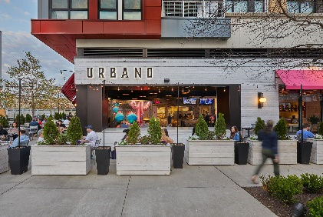


In Search Of Prime Restaurant Site
Looking for approximately 5000 square foot, full-service restaurant site in Charleston Historic District, the Neck area, or Mount Pleasant. Visibility is desired. Parking and outside seating options are a plus.
Will sign an NDA if it is off-market opportunity for existing use. Site that needs repurposing/conversion to be a restaurant could be considered if permitting process is not overly burdensome.
"Common Plate Hospitality Group" has hired us and is looking to expand HERE! Please reach out with options. Thank you.
Planning site tours for late April - please send info.
Tim Rogers
843-412-2221
tim@thepeninsulaco.com www.thepeninsulaco.com
The Peninsula Company, LLC
106 Pitt Street
Mount Pleasant, SC 29464

