Slide 1
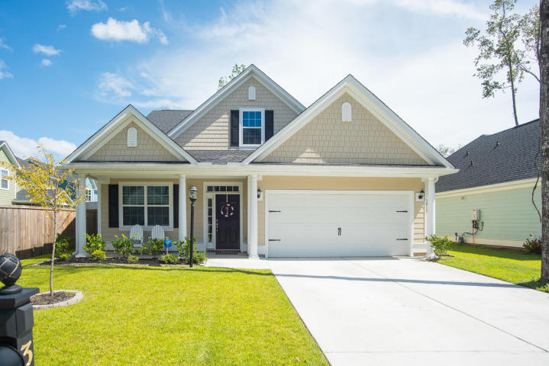
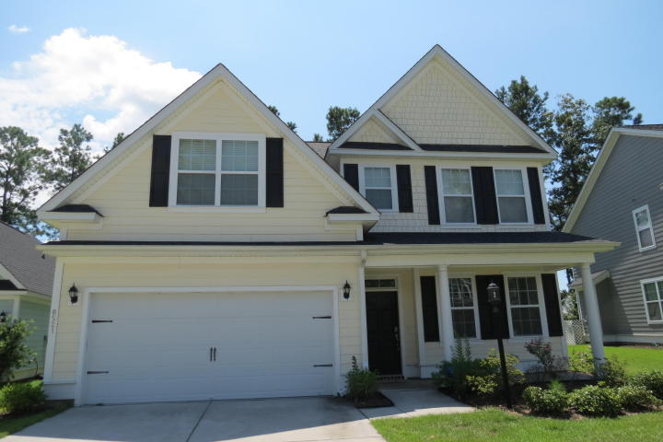
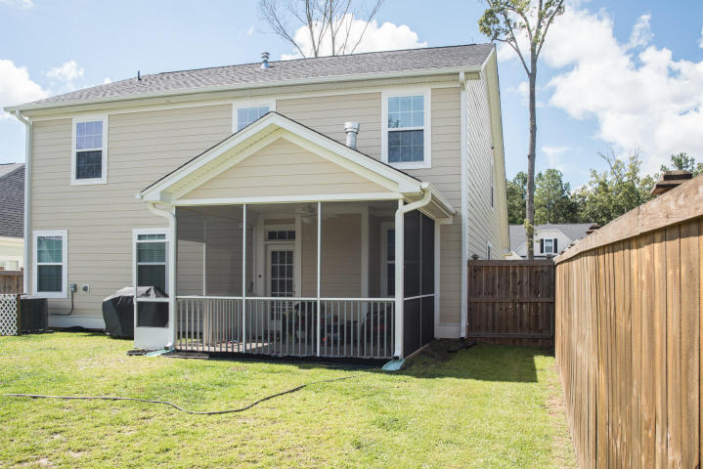
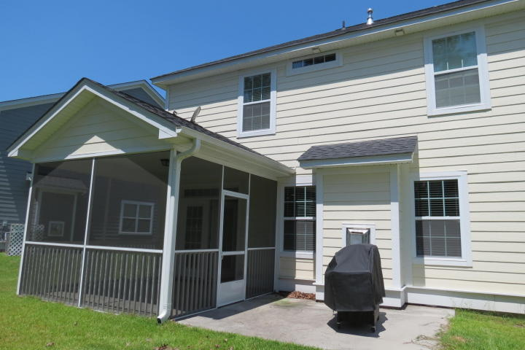


3812 Bonnecrest Lane
MLS# 16021935
$290,000
Indigo Palms Dual Open House
This Sunday ~ October 30th ~ from 2-4
New Bright & Shiny Listing!
8521 Majestic Street
MLS# 16022376
$274,900
Carey Nikonchuk
(843) 276-1701 M
cnikonchuk@gmail.com
www.palmettoproperty.net
Zelda Bryant
(843) 330-7507 M
zeldabryant@gmail.com
www.wowcharleston.com

