Slide 1
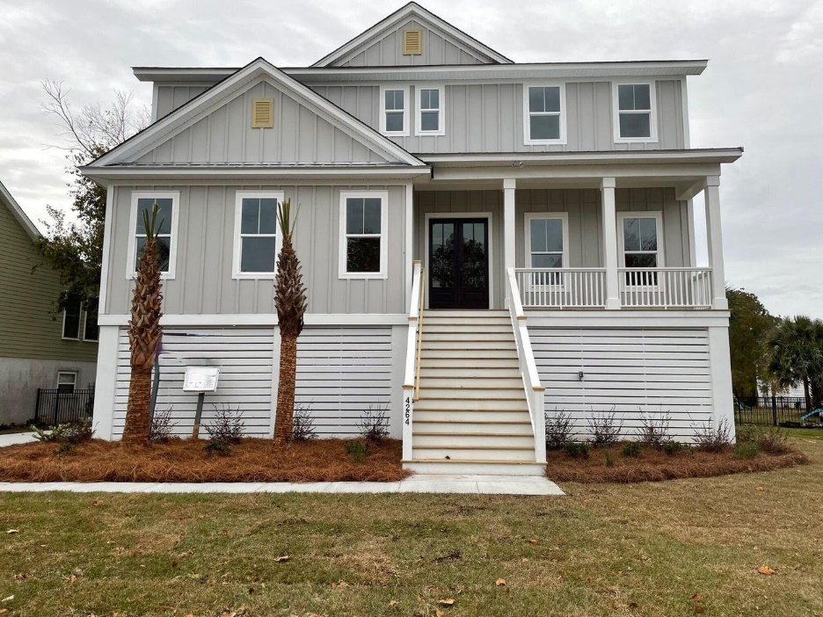
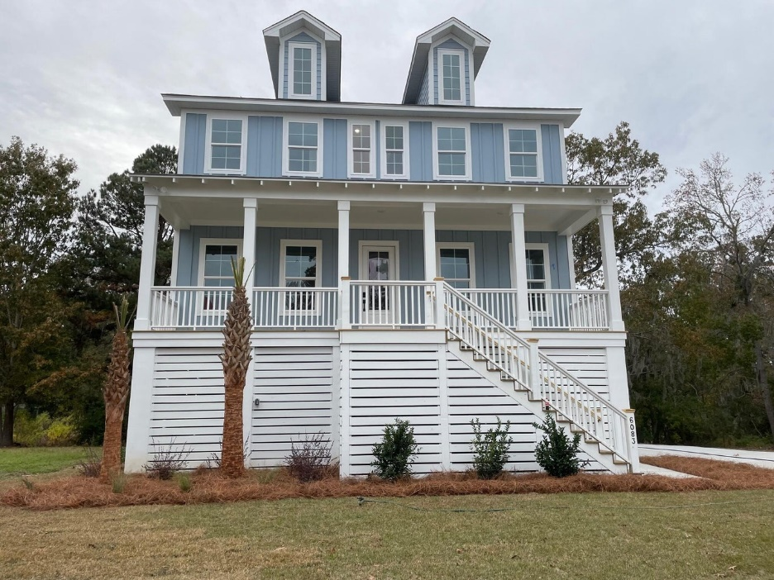


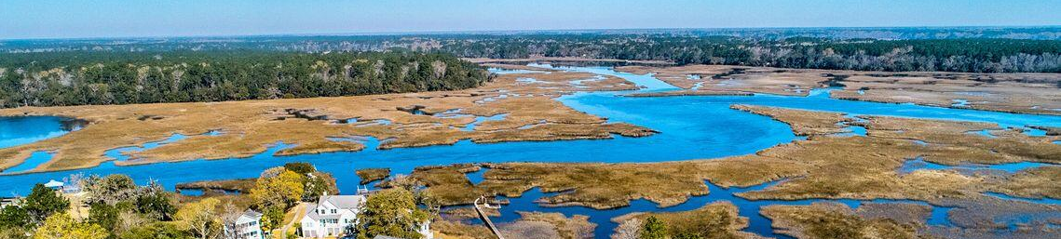

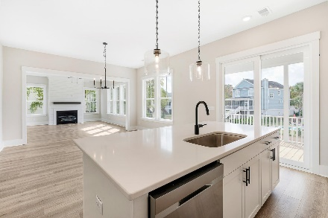
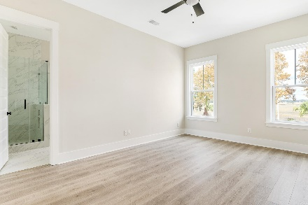
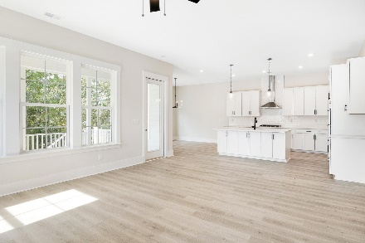
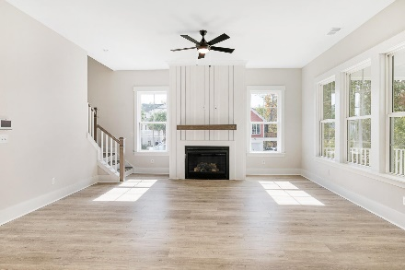
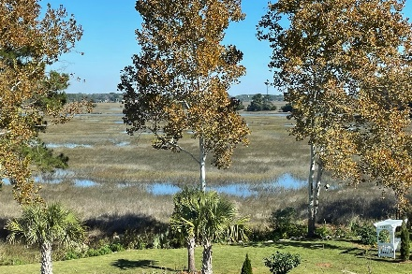
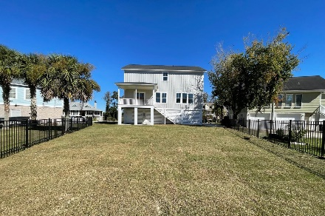
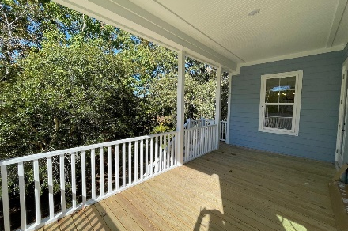
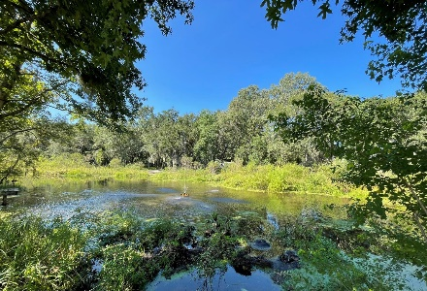
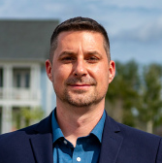
Agent Luncheon Thursday 11:30 - 1:30
2 Brand New Homes Just Completed West of the Ashley
Move In Ready! 2 houses down from Community Dock! New Construction in Waterfront Neighborhood. Just 5 minutes to the heart of West Ashley, Jacobs Point offers Creekside living with a Deepwater Community Dock. This is truly a Boater's Paradise with waterways flowing to the Edisto, Stono, and Wadmalaw Rivers, with Kiawah's world class Beachwalker Park only a few dozen miles east. Highlights include a Downstairs office and upstairs loft. Over 2,500 square feet of designer selections include stainless steel appliances, a gourmet kitchen with hood and large island, quartz countertops, and beautiful wide plank flooring. Enjoy copious amounts of garage storage with this elevated home.
Open House
Sat 10-12 & Sun 10-12
4264 Jacobs Point $799,000
4 Bed | 3 Bath | 3,125 SF
6083 Jacobs Point $769,900
4 Bed | 3 Bath | 2,540 SF
Move In Ready! New Construction in Waterfront Neighborhood. Just 5 minutes to the heart of West Ashley, Jacobs Point offers Creekside living with a Deepwater Community Dock. This is truly a Boater's Paradise with waterways flowing to the Edisto, Stono, and Wadmalaw Rivers, with Kiawah's world class Beachwalker Park only a few dozen miles east. Highlights include a Downstairs Owner's Suite and Private Office and a Huge Upstairs Loft. Over 3,000 square feet of designer selections include stainless steel appliances, a gourmet kitchen with hood and large island, quartz countertops, and beautiful wide plank flooring. Enjoy copious amounts of garage storage with this elevated home.
CLICK HERE TO RSVP
Matt Kimes
843-860-1669 | mattkimeshomes@gmail.com
www.mattkimeshomes.com
Anna Allen | 843-743-6261 | aallen@hqhome.com
HQ Real Estate LLC | 852 Lowcountry Blvd; Ste 100A | Mt. Pleasant, SC 29464

