Slide 1

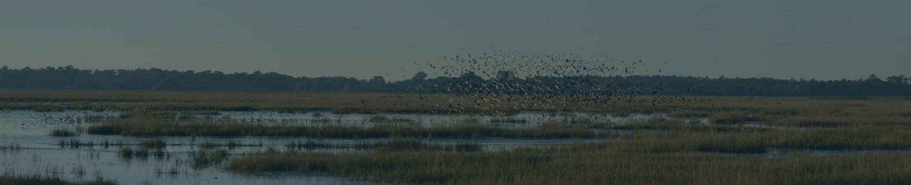

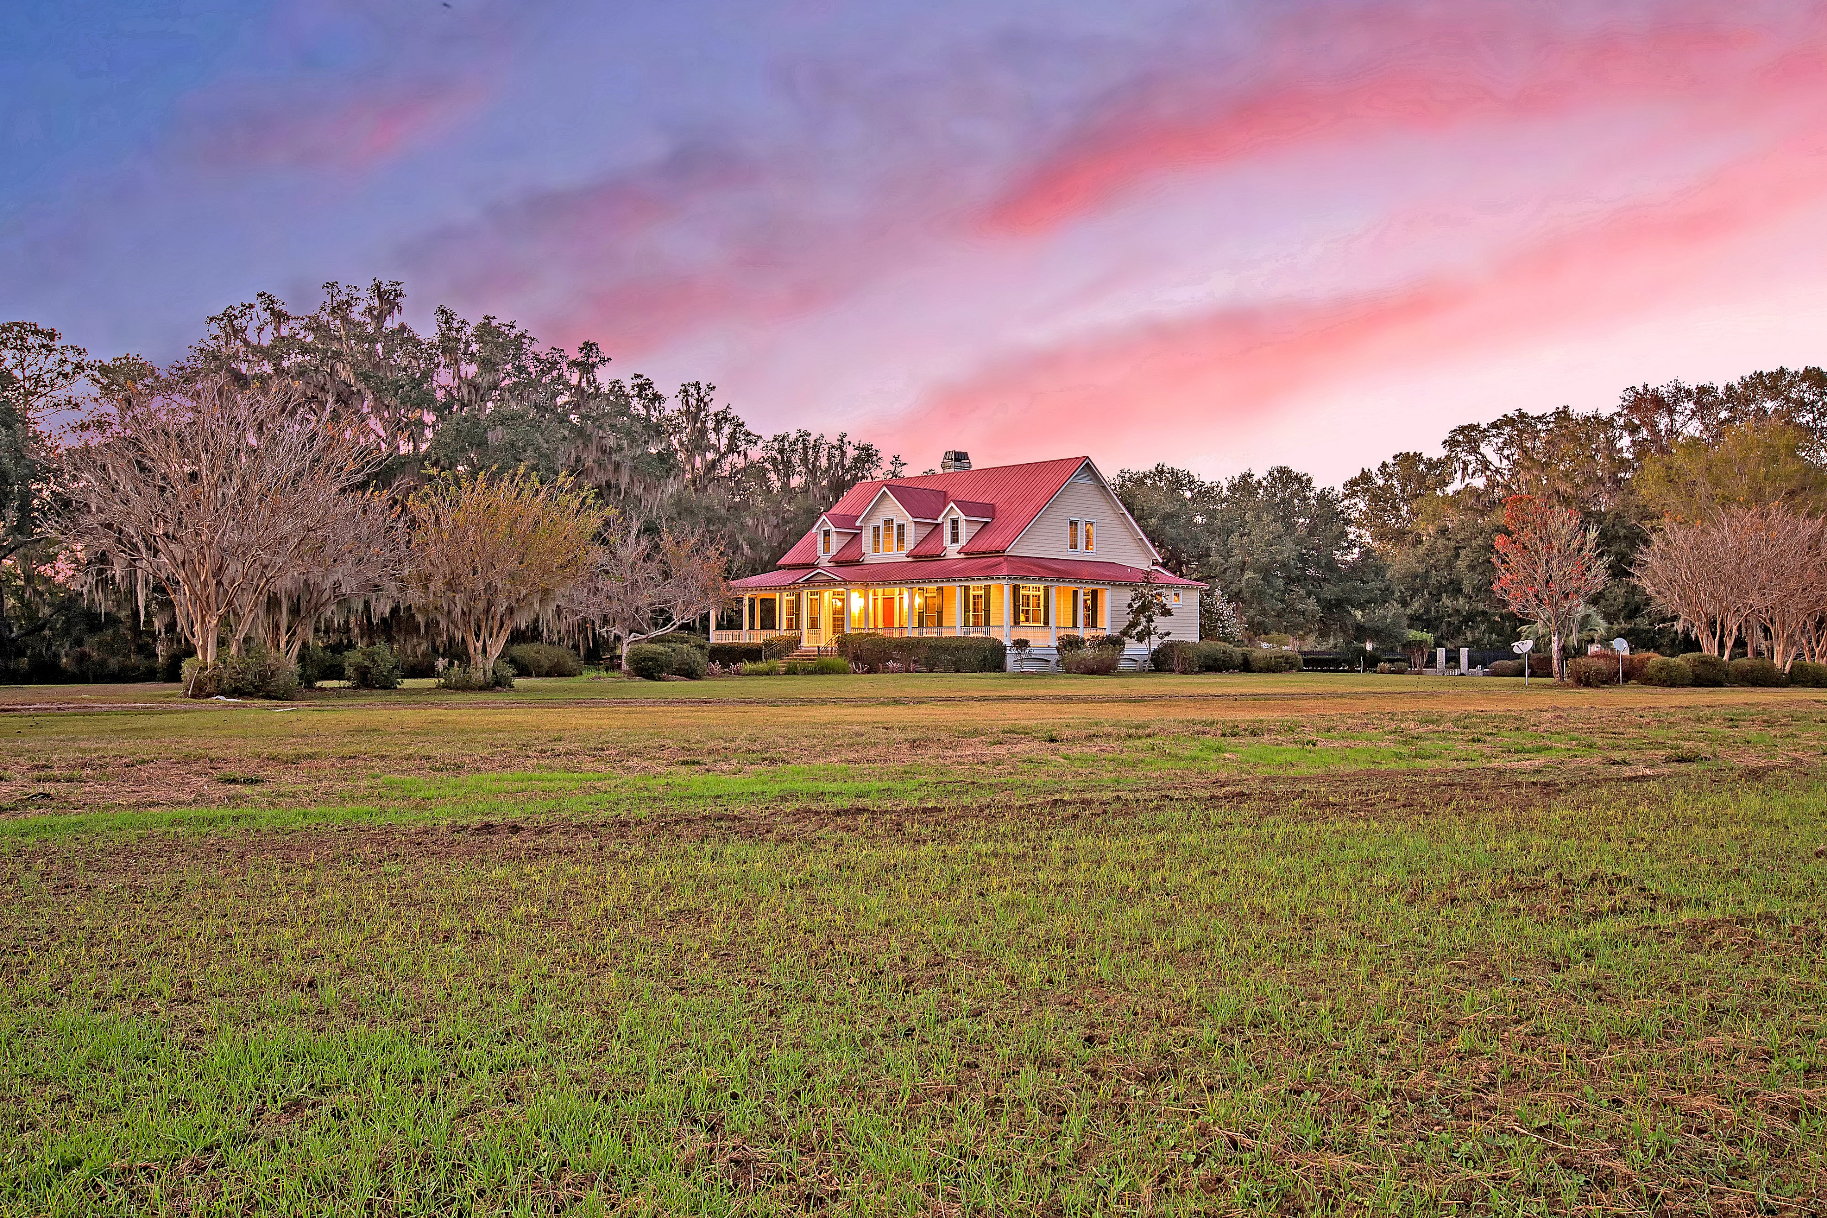
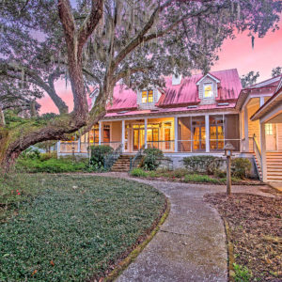
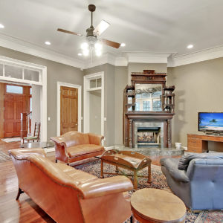
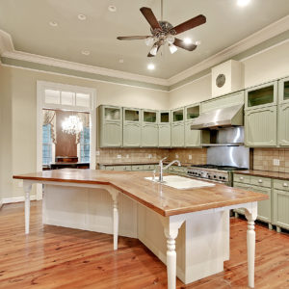
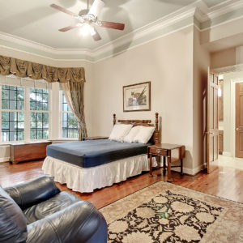
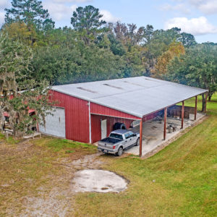
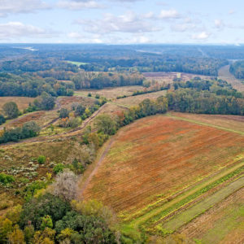
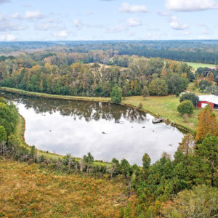
DOUGLAS CUTTING
(843) 534-3911
dcutting2@gmail.com
Jericho Plantation
193 Cotton Hall Road ~ Yemassee, SC 29945
MLS# 18033118 ~ $2,700,000
Jericho is a 315 acre ACE Basin farm surrounded by historic plantations. It has large classic Lowcountry home surrounded by mature live oaks, ample closed and open storage facilities, fish pond, dove fields, hardwood and pine timber, and well over 150 acres of fields. Most of the fields are surrounded by mature hardwood hedgerows, giving the farm its justifiably natural, seasoned feel. It is well-located amongst waterfowl and has the right soil and open-ground layout for duck impoundments. Jericho is loaded with wild turkey, deer, and doves and could also make a suitable small quail preserve. Jericho has no conservation easement in place.

