Slide 1

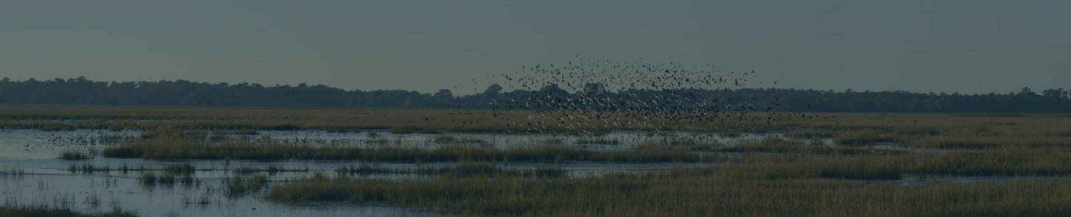

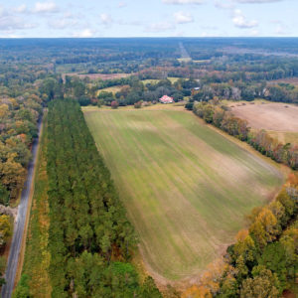
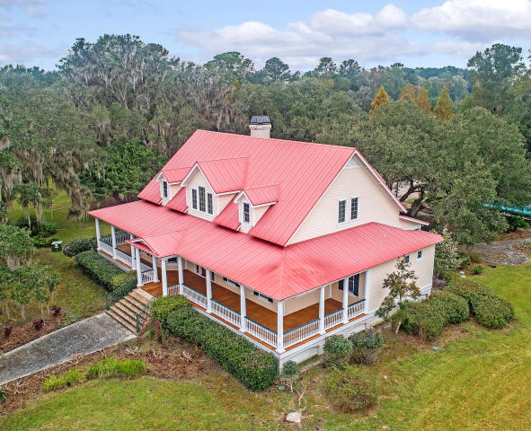
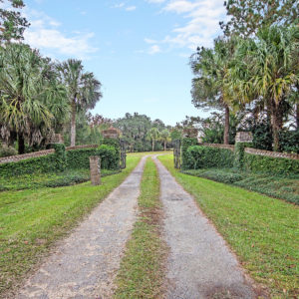
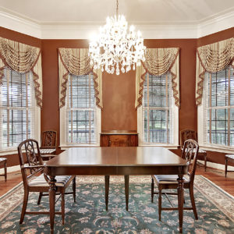
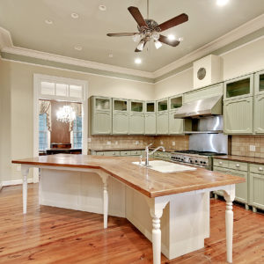
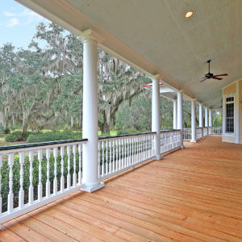
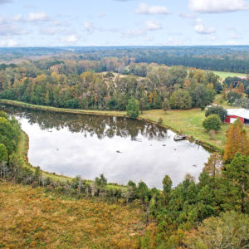
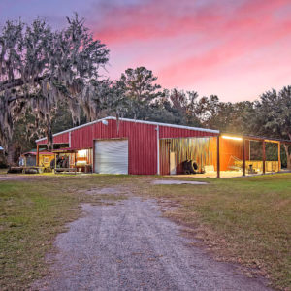
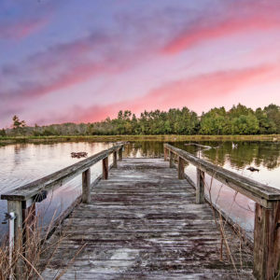
DOUGLAS CUTTING
(843) 534-3911
dcutting2@gmail.com
bluewingproperties.com
Jericho Plantation
193 Cotton Hall Road ~ Yemassee, SC 29945
MLS# 18033118 ~ $2,700,000
Jericho is a 315-acre ACE Basin farm surrounded by historic plantations. It has a large Lowcountry home surrounded by mature live oaks, ample storage facilities, fish pond, dove fields, hardwood and pine stands, and well over 150 acres of fields. Tucked into the back of one field is a secluded grove of massive live oak and pecan trees. Based on several centuries-old maps, this is most likely the site of the original Jericho Plantation, built by the Hutson family and burned by Sherman. Most of the fields are surrounded by mature hardwood hedgerows, giving the farm its justifiably natural, seasoned feel. It is well-located for waterfowl and has the right soil and open-ground layout for duck impoundments. Jericho is loaded with wild turkey, deer, and doves and could also make a suitable small quail preserve. Jericho has no conservation easement in place.

