Slide 1
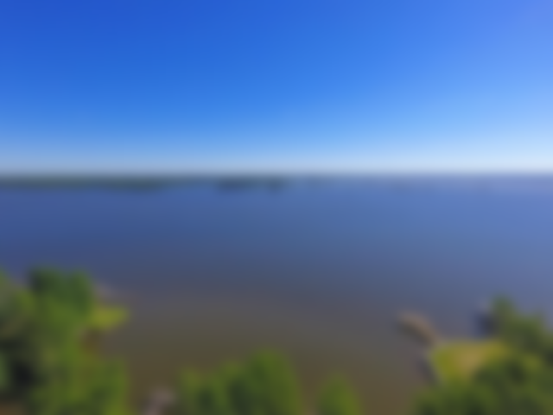
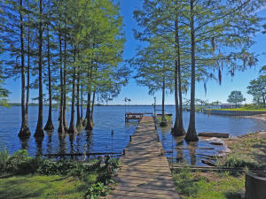
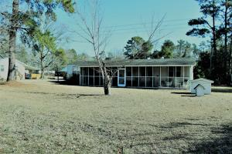
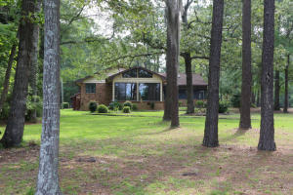
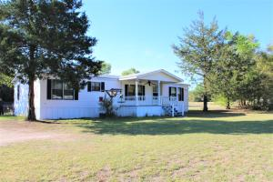
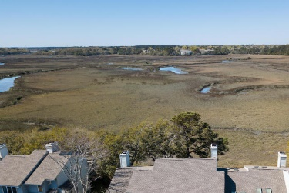


Lake Marion Listings Recently Reduced
Waterfront
Waterview
771 Stumphole
Elloree, SC 29047
MLS# 17015213 Now $240,000
12989 Hwy 260 Manning, SC 29102
MLS# 18003328
Now $55,900
This home sits on Big Water of Lake Marion only 1 hour from Charleston by car and 6 hours by boat. Make this is your vacation home or your full time home.
The home has a 12x80 rear porch over looking the lake and the 26' pool. Enjoy sunrises on the lake while drinking your morning coffee. Seen by appointment only.
Pond Front
Lake Area
1 Santee Lakes Elloree, SC 29047
MLS# 16016447 Now $300,000
231 Garden Lane
Elloree, SC 29047
MLS# 18010457 Now $65,000
Lake Homes Realty, LLC
Elloree, SC 29047
www.SCLakeLife.com
Kristie Anderson
(803) 387-9459
kristie@sclakelife.com

