Slide 1
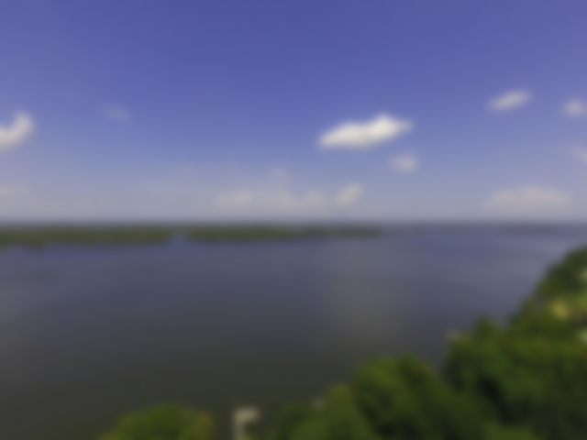
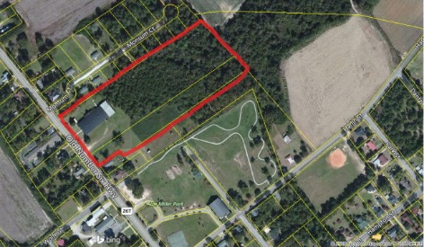
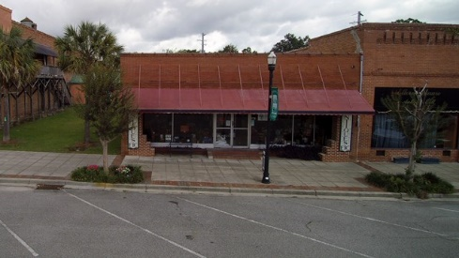
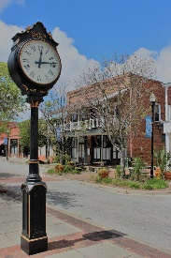
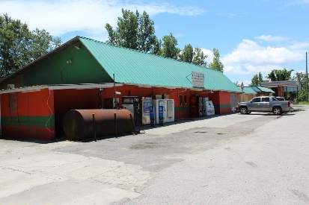
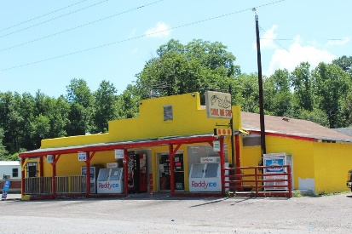
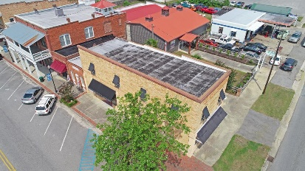

Lake Business Opportunities
6081 Old Number Six Hwy
Elloree, SC 29047
Listing No. P127838A ~ $349,900
2726 Cleveland St
Elloree, SC 29047
Listing No. P141257A ~ $119,000
2720 Cleveland Street
Elloree, SC 29047
Listing No. P143844A ~ $140,000
3789 Highway 45 Unit B
Pineville, SC 29468
Listing No. P144457A ~ $699,000
1268 Trojan Rd
Cross, SC 29436
Listing No. P144483A ~ $300,000
6420 Old Number Six Hwy
Elloree, SC 29047
Listing No. P144145A ~ $220,000
For more info on each of these opportunities, please click here:
https://navicamls.net/displays/?n=256&i=1384677&k=W2ILQAU25S9G
Lake Homes Realty, LLC
Elloree, SC 29047
www.SCLakeLife.com
Kristie Anderson
(803) 387-9459
kristie@sclakelife.com

