Slide 1
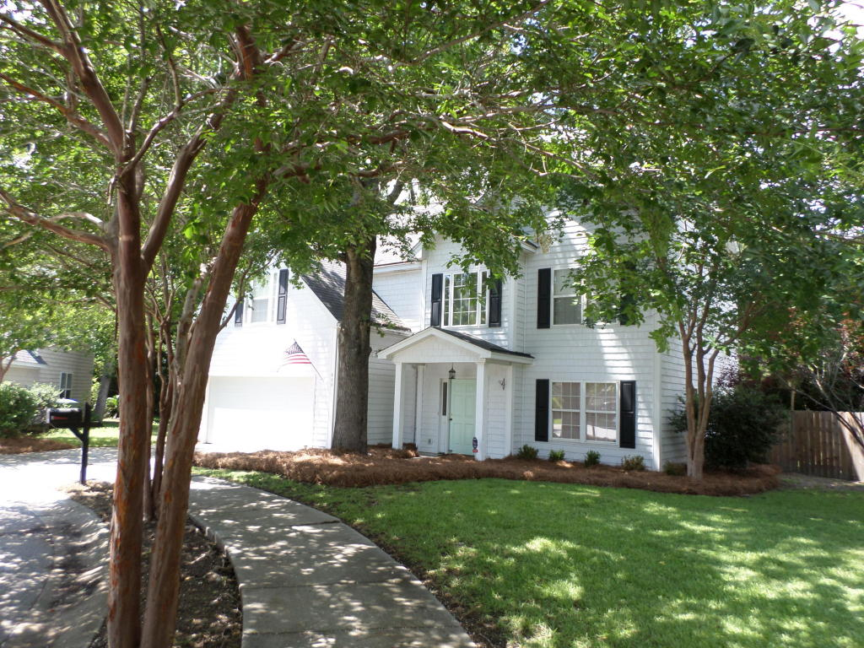
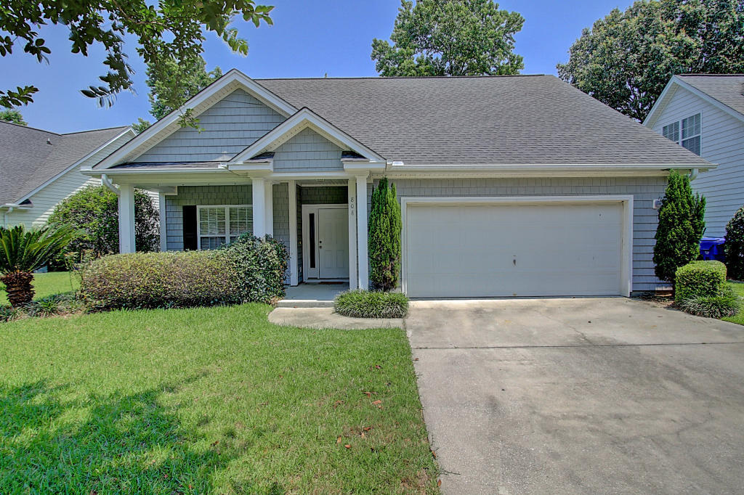
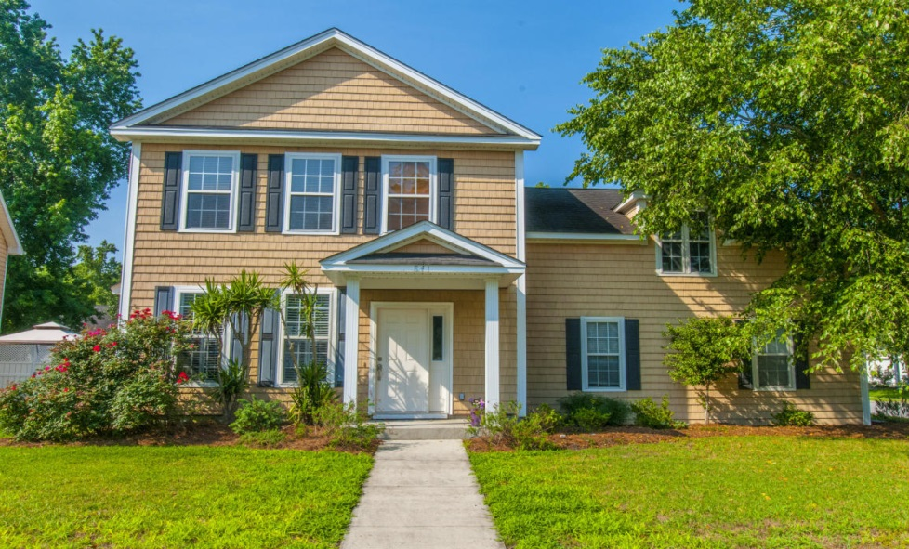
Agent Open House in Lawton Harbor.
Three great homes!
800 Heyward Cove-$369,500
MLS#16017787
808 Heyward- $350,000
MLS#16016211
Thursday,
July 14 from 11:30AM-1:00PM
Light Lunch served !
841 Affirmation Blvd- $350,000
MLS #16015994

