Slide 1
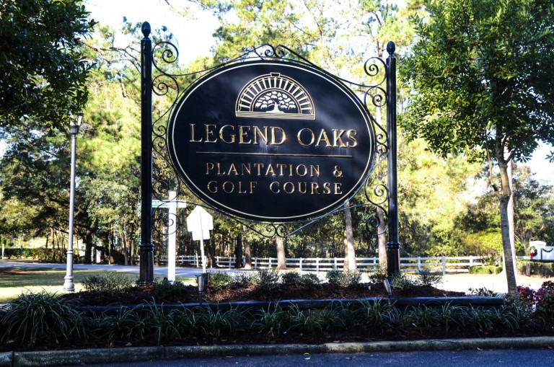
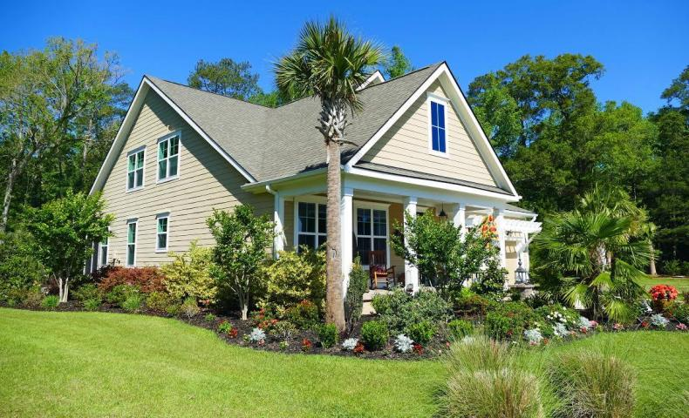
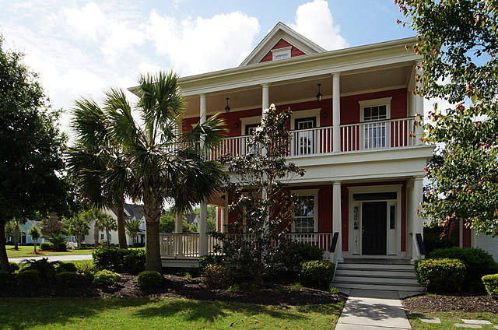
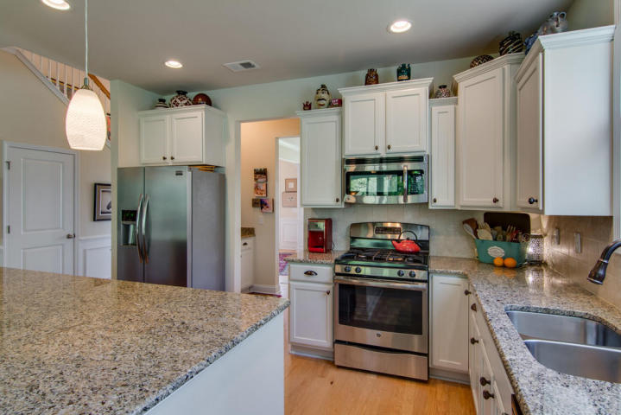
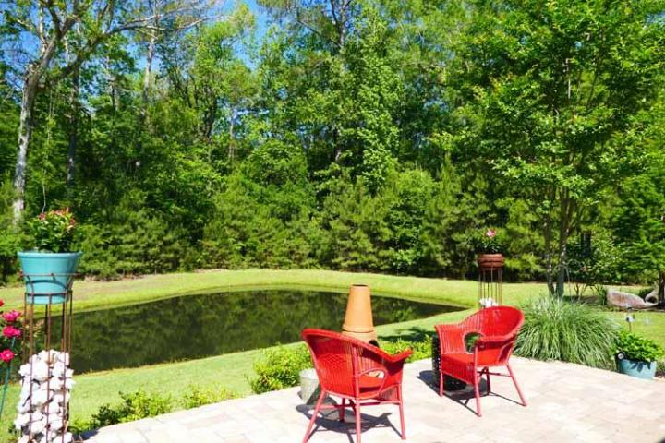
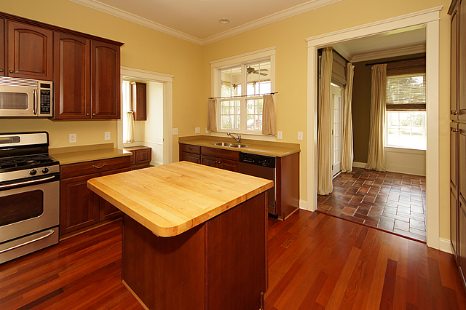
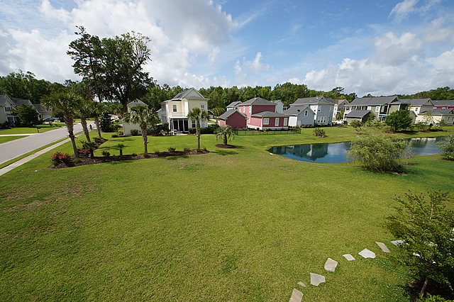
The Club at Legend Oaks Open Houses
Thursday, June 8^{th,} from 11-1
~ Light lunch will be served ~
Drawing for 2 $25 gift cards
156 Silver Cypress Circle
MLS# 17012708 | $439,000
Laurie Loparo
843-442-1290
laurieloparo@gmail.com
Golden Bear Realty
101 Heart Pine Circle
MLS# 17012290 | $320,000
Jim Hamilton
843-270-4337
jim@prattandco.com
RE/MAX Pro Realty

