Slide 1
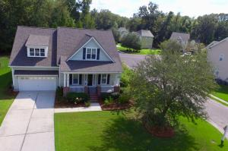
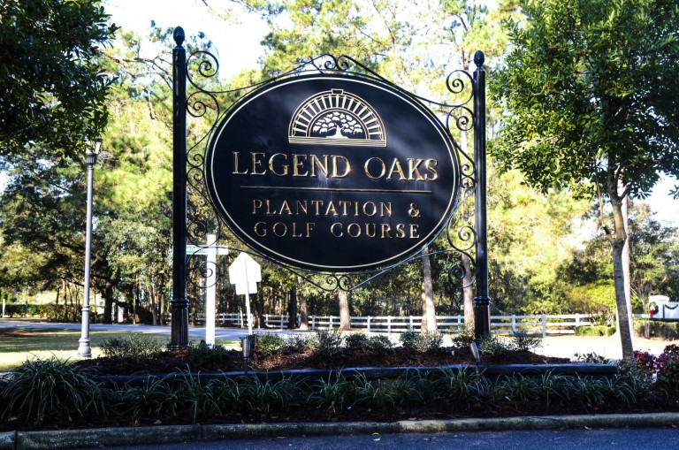
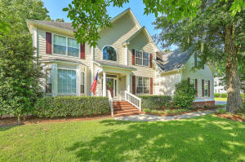
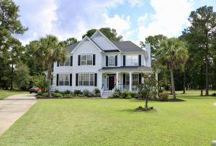
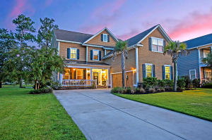
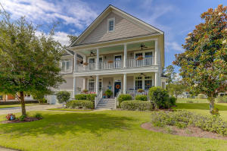
OPEN HOUSE FOR FIVE GREAT HOMES IN LEGEND OAKS PLANTATION SUNDAY OCTOBER 21ST FROM 1-4 PM Also open to the general public!!!!!
120 Blackwater Drive
4/3.5/3263
MLS# 18024721
$385,000
Randy Espeseth
Carolina Elite Real Estate
1233 Out of Bounds Dr
5/2.5/3200
MLS# 18015875
$372,000
Sally McLemore
Century 21 Properties Plus
1507 Pondside Court
4/3/2952
MLS# 18025401
$389,000
Bryan Hammond
Brand Name Real Estate
125 Silver Cypress Circle
5.3/3725
MLS# 18024691
$448,000
Suzy Torres
Carolina One Real Estate
301 Silver Cypress Circle
4/3.5/3152
MLS# 18020923
$406,000
Susan Heyer
Carolina One Real Estate

