Slide 1

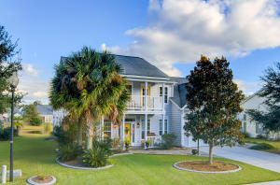
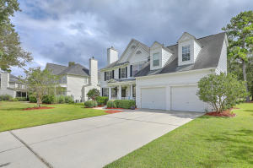
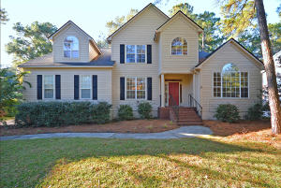
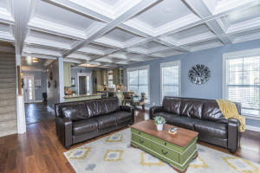
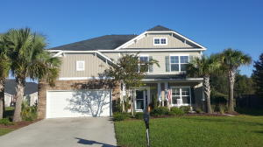
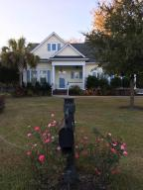
Legend Oaks Multiple Office Agent Open House
Tuesday, Dec 12th 12:00 -1:30
Plenty of great food at each home!
104 Back Tee Cir
MLS 17029644
$359,899
Numerous upgrades to this beautiful 4/2.5 home on pond, downstairs master bedroom!
Presented by Behren Kittrell of Charleston Flat Fee Real Estate
1407 Peninsula Pointe
MLS 17027411
$339,000
Traditional style 4/2.5 home on a half acre lot with golf course and pond!
Presented by Sally McLemore of Century 21 Properties
318 Clubview Road
MLS 17030587
$379,000
Spacious 5 bedroom home overlooking the 9th green!
Presented by Jeff Bowers RE/MAX Pro Realty
119 Carriage Ride Ln
MLS 17030653
$355,000
Stunning 4 bedrooms, 3 1/2 baths plus a loft area, Master Suite on 1st floor! Presented by Susan Nicholson, Carolina One Real Estate
105 Elena Court
MLS 17027895
$340,000
Incredible 5/3.5 home tucked away in a quiet cul-de-sac!
Presented by Marie McKillop Brand Name Real Estate
192 Carolinian Dr
MLS 17031832
$305,000
Beautiful custom built 5/3.5 home with study and sun room is one-of-kind!
Presented by Sharon Gnau of Realty ONE Group Coastal

