Slide 1
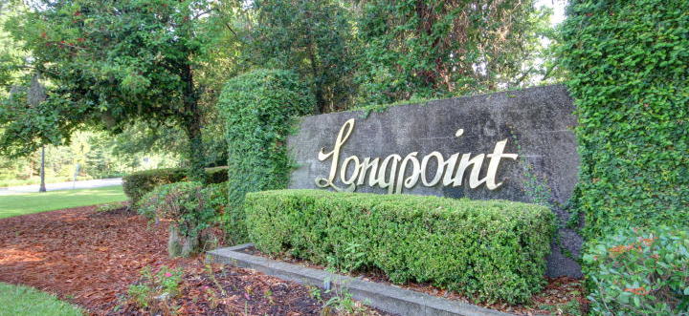
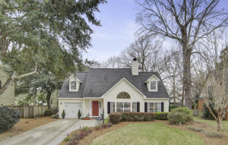
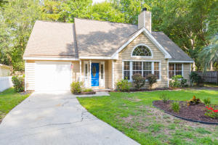
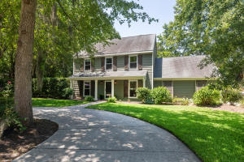
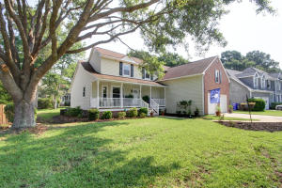
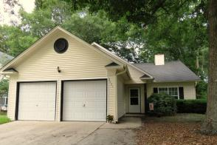
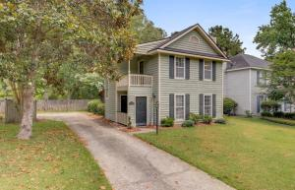
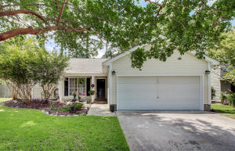
Longpoint Agent Open Houses
Thursday July 18th ~ 11a-1p
Drawing for $50 Gift Card - must visit all homes on tour
$100 Gift Card, Food, Beautiful Homes!
11:30-1:30 3429 Toomer Kiln and 1805 Two Cedar
11:30-12:45 3590 Toomer Kiln
439 Springfield Road
MLS# 19005882
$475,000
Lori Claussen
843-224-8506
loric@nvrealtygroup.com
NV Realty Group
1946 Tison Lane
MLS# 19020103
$410,000
Bill Barnhill
843-364-6903
bill@billbarnhill.com
Keller Williams Realty
453 Mount Royall Drive
MLS# 19018872
$469,000
Donna Webb
843-469-1110
donnaleighwebb@gmail.com
Dunes Properties
2036 Middleburg Lane
MLS# 19019519
$475,000
Geri Lipps
843-810-8398
glipps@carolinaone.com
Carolina One Real Estate
2021 Arundel Place
MLS# 19015460
$350,000
Laurie Loparo
843-442-1290
laurieloparo@gmail.com
Carolina One Real Estate
540 Castle Hall Road
MLS# 19009520
$334,900
Behren Kittrell
843-870-3549
behrenk@scflatfeerealty.com
Charleston Flat Fee
348 Kingston Lane
MLS# 19018266
$319,000
Carol Campo
843-906-7933
carolcampo@kw.com
Keller Williams Realty

