Slide 1
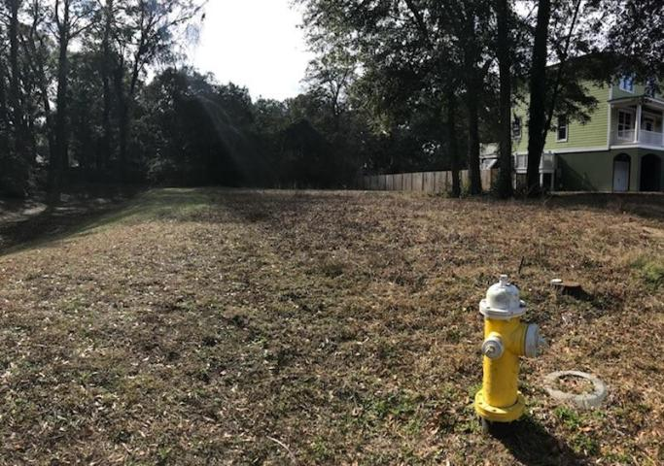
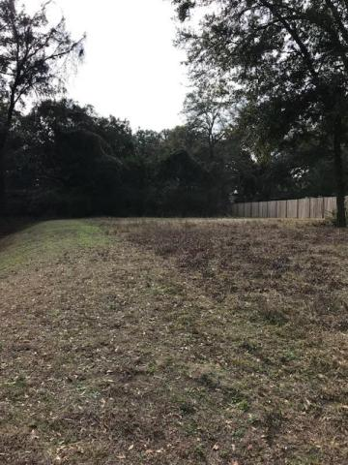


High Lot in
Wonderful Neighborhood
Lot 15 Canopy Cove
Carolina Oaks at Lighthouse Point
Charleston, SC 29412
MLS# 18001636
$205,000
Michael Dew
O 843-769-5100
M 843-870-7000
michaeledew@gmail.com
www.michaeldewrealestate.com
0.25-acre vacant lot in
Carolina Oaks on James Island.
AgentOwned Charleston Group
902 Savannah Hwy
Charleston, SC 29407
Real Estate ● Mortgage Insurance ● Business Brokerage

