Slide 1
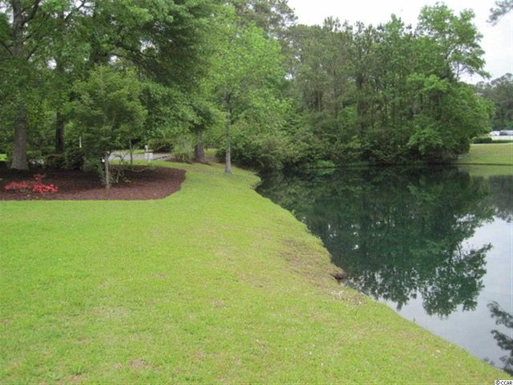
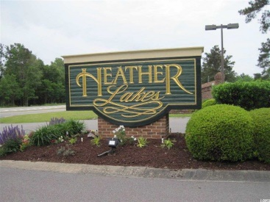
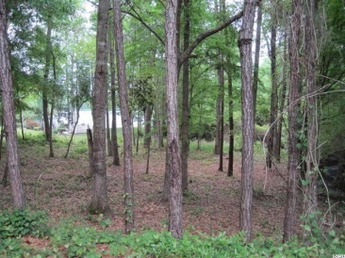
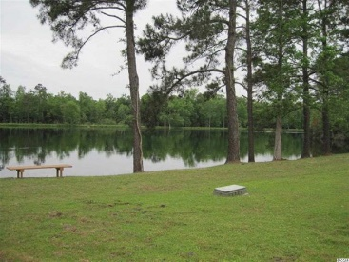
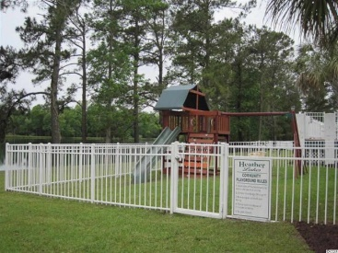
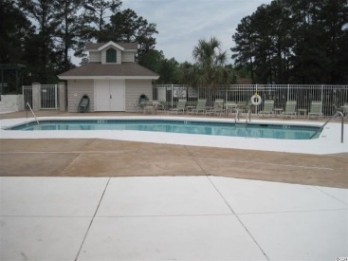
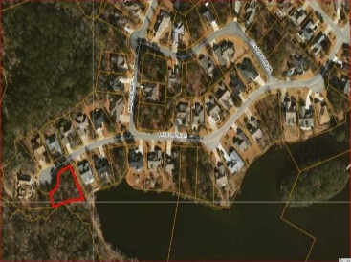


Lot 200 Lake Vista Drive Little River, SC 29566 MLS# 1408728 $32,900
Lakefront Residential Lot. Price Reduced to $32,900!
LAND IN LITTLE RIVER
Beautiful large residential lake front lot on cul-de-sac in Heather Lakes. Build your dream home in this wonderful community and enjoy the community center with outdoor pool and jacuzzi, or have a gathering on the outdoor deck with outdoor fireplace overlooking the lake. There is a children's playground along with walking paths and picnic areas surrounding the lakes. Walk out your backyard to fish on the lake or take a walk on the adjacent nature trail. Heather Lakes is in a desirable location on the South Carolina/North Carolina border near the intracoastal waterway in the amazing Myrtle Beach area, which offers over 100 world class golf courses, over 500 restaurants, endless entertainment, shopping and miles of beautiful wide sandy beaches!
Julie Blethen | jazblethen@hotmail.com | (843) 564-8539
Wilkinson & Associates ERA Powered, 9652 North Kings Highway, Myrtle Beach, SC, 29572

