Slide 1
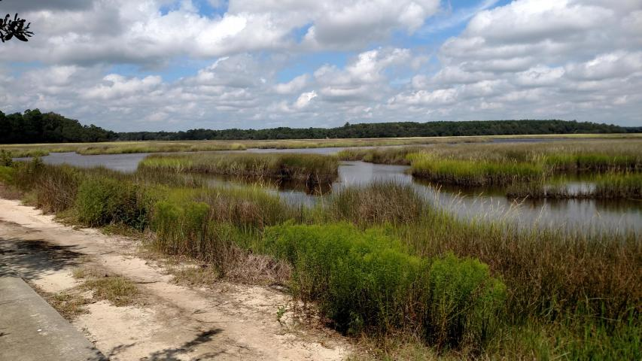
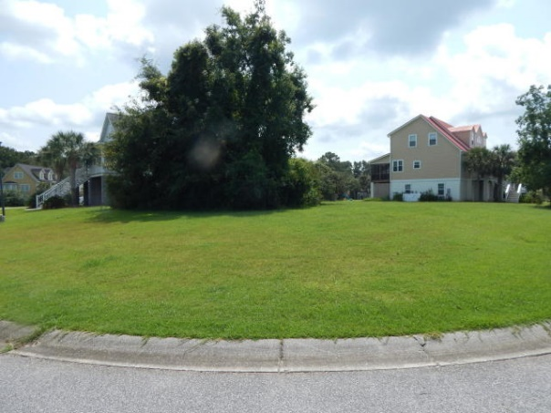
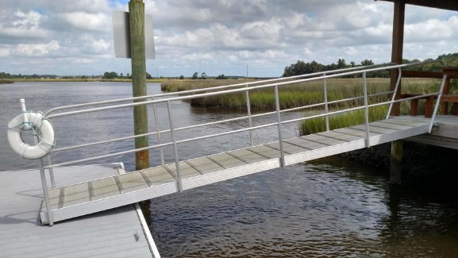
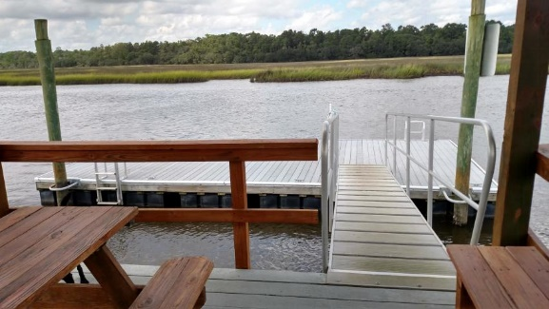

Lot 34 Jacobs Point Blvd Jacobs Point Hollywood, SC 29470 MLS# 18025607 $70,000
New Grass Is In!
Incredible Below Appraisal Lot!
Yee Haw! New grass is in!
This is an opportunity to secure a beautiful undervalued lot in a gorgeous subdivision. There is a community dock and boats can be launched from Limehouse Launch just up the creek from the dock, as well. The subdivision is just minutes from mall shopping and golf and the beach. Please note that all homes need to be elevated and at least 2,000 square feet.
Carolina One Real Estate
2713 Highway 17 North
Mt. Pleasant, SC 29466
Terry Hamlin
(843) 830-3946
terry@thamlinproperties.com

