Slide 1
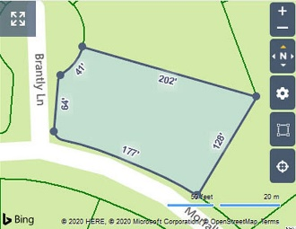
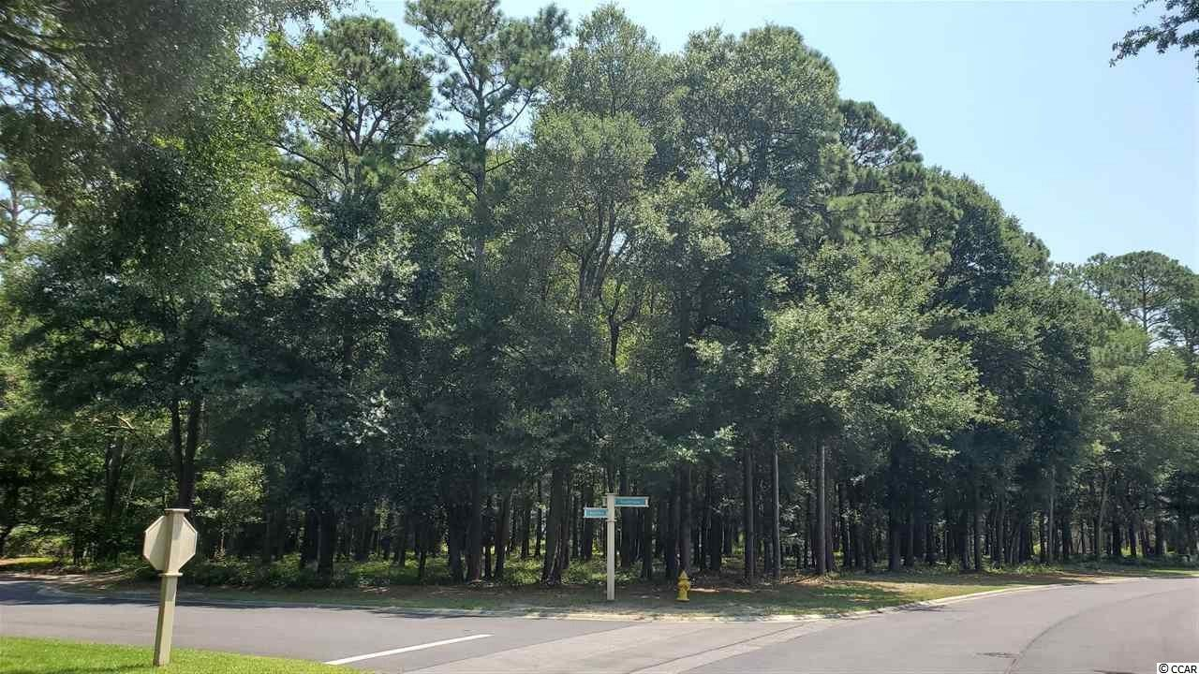
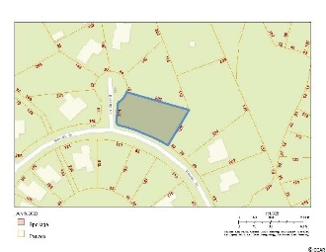
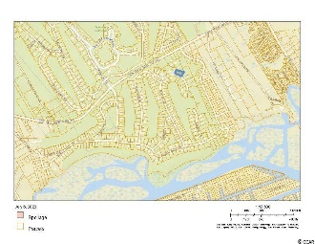
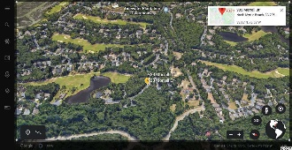
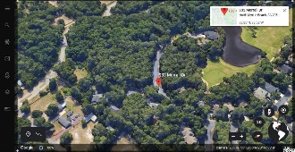
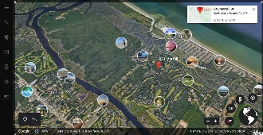
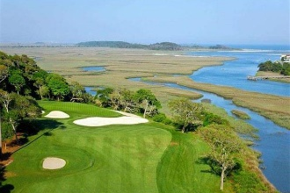
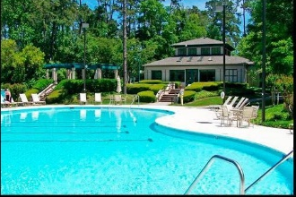
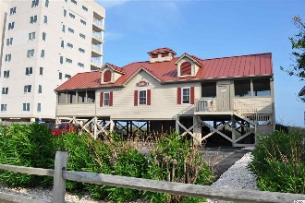


Build Your
Dream Home
Lot 737 Brantly Ln
Tidewater Plantation ~ North Myrtle Beach, SC 29582
MLS# 2013990 ~ $99,900
IMPRESSIVE, SINGULAR, HALF-ACRE, SECLUDED AND WOODED CORNER LOT ON TWO PRIVATE CUL-DE-SACS IN THE PREFERRED BLUFFS OF TIDEWATER PLANTATION RESORT! Tidewater Plantation is a golf/Intracoastal Waterway/beach community. The Bluffs Section adjoins the Cherry Grove Marsh and peaks at the Atlantic Ocean. This lot is situated on two pine and hardwood cul-de-sacs, one bordering the 14th hole of world-class Tidewater Golf Course, with its picturesque, signature lakefront. The other backs up to buffered wetlands with a peaceful view that will remain protected from development. Golf course lots may not be fenced, so this huge private lot has many possibilities for enhanced enjoyment, including fencing, pool, hot tub, lanai, secret garden and the like, with the approval of the Design Review Board. Other restrictions may apply. The lot lends itself, too, to a big, side-loading garage. Long-term rentals only (of 6 months or more) are allowed on the Bluffs side; so, at this compelling price, flex-building options and low HOAs and taxes, this amazing, rare residential lot is an excellent investment as well as being desirable for building a vacation or permanent home. No flooding ever! There is no time frame to build. Tidewater-approved contractor list available. Approximately 1/2-acre lot: There is about 282 ft. of dual road frontage and a depth of up to 202' on this 21,344-sq.-ft.-property. THE BLUFFS OF TIDEWATER IS BEING RAPIDLY BUILT OUT. You must view! In addition to golf and being in an ICW community, Tidewater boasts many other rich, upscale amenities, including owners' beach cabana on the Cherry Grove Beach named the 11th best in the nation, pools & spas, clay & hard-surface tennis courts, pickle ball, bocce, horseshoes, amenities center, fitness center, driving range and putting green, 24-hour gated manned security, and clubhouse with bar & restaurants. There is even a complimentary gated storage yard for boats, campers, recreational vehicles and the like. The on-site, convenient HOA building has rooms for business and other meetings and events and a lending library. There are many clubs and activities year round. In Tidewater, you can do it all, or just relax in the luxurious Tidewater lifestyle. The Bluffs of Tidewater is contiguous along the Cherry Grove Inlet where the Atlantic Ocean rolls into the marsh. This lot, therefore, is highly sought after by the builder, investor or soon-to-be home-owner who desire to acquire an extraordinary golf/ICW/beach property at today's market prices to be built later. Tidewater itself is on a tree-lined road to oceanfront Anne Tilghman Boyce Coastal Reserve, a nature conservancy, including Waties Island, with access for managed recreational use. Tidewater, a historic plantation, is on an elevated peninsula of live oaks and southern pines between the Intracoatal Waterway and the Cherry Grove Inlet to the Atlantic Ocean. The plantation also preserves the unique look of its own origins. It is close to the beach, shopping, entertainment, medical services, outstanding schools and parks and access to major highways. The jewel in the crown of the development is that private owners' beach cabana on the wide, white sands of the Cherry Grove Beach, just a few minutes drive. This charming lot enjoys a lovely, indigenous peaceful environment, along with the excellent reputation of the Tidewater Golf Course, the Pebble Beach of the East. Tidewater Plantation, in one of the U.S.'s top-10 beach towns, North Myrtle Beach, truly reflects a "way of life." Do not let this singular lot get away. Welcome to the best of the beach in the Bluffs of Tidewater Resort.
Connie Ross-Karl
702-306-2643
conniesross@aol.com
Deborah Collins
843-424-9013
dctidewater@yahoo.com
NEW WAY PROPERTIES MYRTLE BEACH

