Slide 1
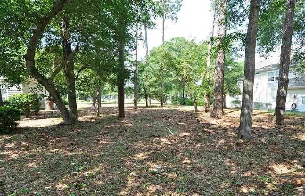
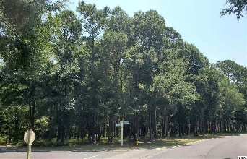
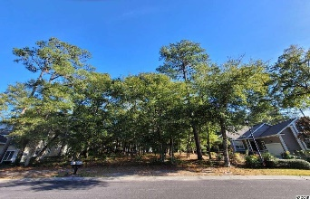
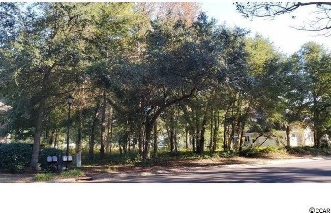

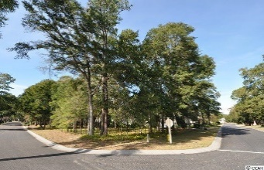
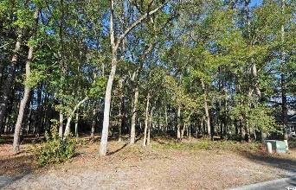

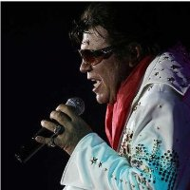
Lots Of Lots, All Under $100,000, Creating A New Standard
Of Luxury Living On The Grand Strand & No Flooding Ever!
Variety Of Highly Desirable Lots In The Preferred Bluffs Of Tidewater Plantation,
No Time Frame To Build, Golf Course & Large Private Enclaves Up To An Acre!
MLS# 2005056 4905 Buck's Bluff Dr., Golf Lot 519 Quarter-acre: $99,999
On the second hole, one and only TEE to GREEN full-view golf-course lot now available in the prestigious Bluffs of world-class Tidewater Plantation Resort!
Breathtaking!
Video Tour: https://www.youtube.com/embed/giCd7NPZP5g
MLS# 2013990 TBD Brantly Ln., Lot 737 Wooded, About Half-acre: $89,900
This unique lot is situated on two pine and hardwood cul-de-sacs, one bordering the 14th hole of world-class Tidewater Golf Course, with its picturesque, signature lakefront. The other backs up to buffered land with privacy. Very rare beauty with lots of options to build.
Video Tour: https://www.youtube.com/embed/gRwYDmr3N1k
MLS# 2020137 TBD Gilbert Dr., Lots 567/568 Private Third-acre+: $90,500
The Bluffs Section adjoins the Cherry Grove Marsh and peaks at the Atlantic Ocean. This highly desirable double-lot is situated approximately one block from the Cherry Grove Marsh and bordering a secluded wooded area in the rear that will not ever be built on.
Video Tour: https://www.youtube.com/embed/Qsyl5MJEVBM
MLS#2020137 907 Heshbon Dr., Golf Lot 547 Third-acre+: $92,500
This wonderful lot is situated on upscale Heshbon Dr., approximately 1/2 block from the Cherry Grove Marsh, bordering the 11th hole and overlooking the green of world-class Tidewater Golf Course. This is one of the few buildable lots left on Heshbon; you can hear the ocean from this magnificent lot location.
Video Tour: https://www.youtube.com/embed/HFuWnCCIHms
MLS# 2026458 5029 Buck's Bluff Dr., Corner Lot 803 Third-acre: $99,999
This rare, easily buildable level, rectangular lot is situated on prestigious Buck's Bluff Dr., near where the Atlantic Ocean rolls into the Cherry Grove Marsh across the street and bordering near the 14th hole of world-class Tidewater Golf Course. Approximately 1/3-acre: 153' x 97' x 147' x 79' with an impressive 153 ' of frontage on Buck's Bluff Dr.
Video Tour: https://youtube.com/embed/IR29DrmlQEQ
MLS# 2101726 938 Morrall Dr., Private, Large-ACRE-Lot 804/805: $99,999
This charming double lot enjoys a lovely, indigenous peaceful environment, along with the excellent reputation of the Tidewater Golf Course, the Pebble Beach of the East. Tidewater Plantation is located in one of the U.S.' top-10 beach towns, safe, popular and still-affordable North Myrtle Beach. Welcome to the one of the best of the best BIG lots still available to build at the Beach!
Video Tour: https://www.youtube.com/embed/pfr8WeVOetU
Deborah Collins
843-424-9013
dctidewater@yahoo.com
Connie Ross-Karl
702-306-2643
conniesross@aol.com
Ronnie Nichols
Realtor
Broker in Charge
NEW WAY PROPERTIES MYRTLE BEACH

