Slide 1
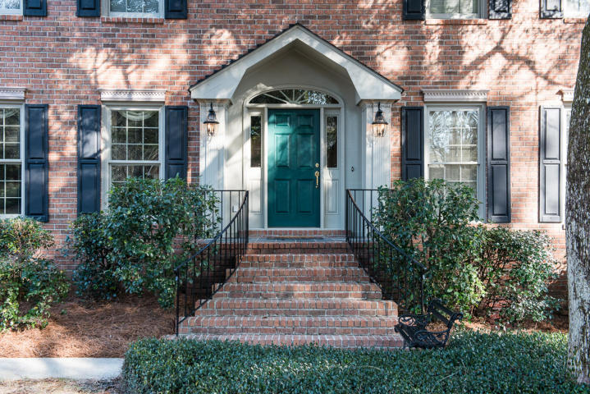
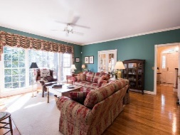
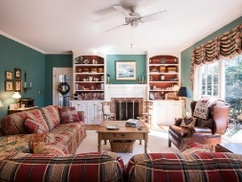
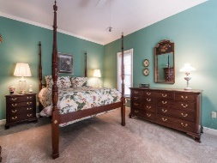
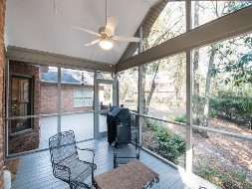
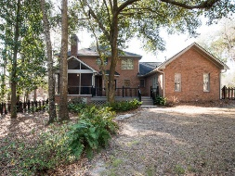
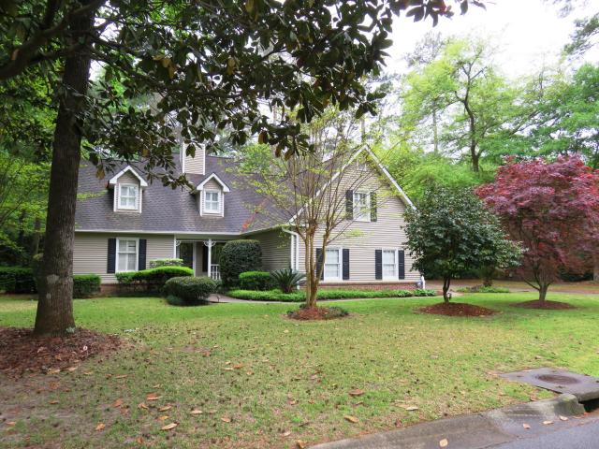
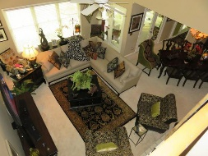
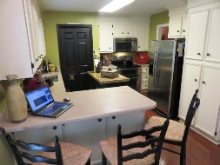
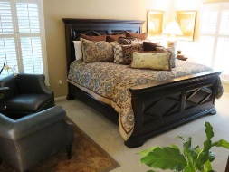
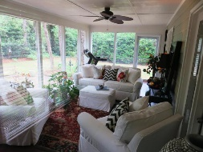
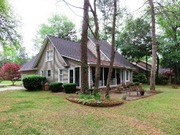

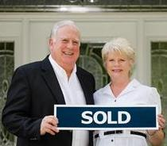
102 Hutchinson Lane Summerville, SC 29483 MLS# 16003845 Just Reduced to $589,900 5 Bedrooms 3 ½ Baths 4,012 sf
Two Great Homes in Gadsden Estates
113 Quinby Street
Summerville, SC 29483
MLS# 16010307
$369,900
4 Bedrooms
2 1/2 Baths
2,761 sf
Tommy & Lynne Lovett Tommy - (843) 442-1276
Lynne - (843) 697-0491
tlovett@carolinaone.com lynne.lovett@carolinaone.com
www.tommylovettrealestate.com
Carolina One Real Estate
628 Long Point Rd.
Mt Pleasant, SC 29464-3032

