Slide 1
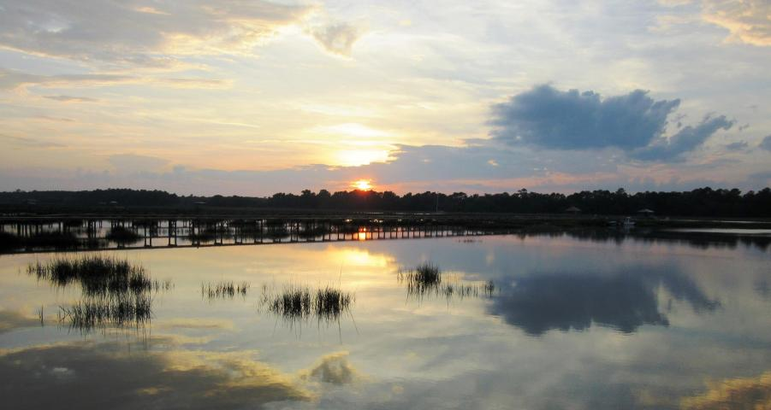
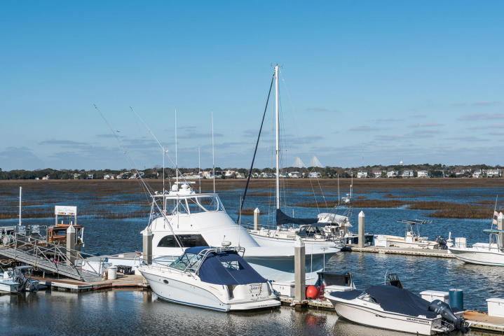
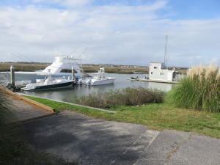


2616 Bohicket Road Fair Oaks · Johns Island MLS# 16005802 · $775,000
Take Your Pick From 3 Waterfront Listings
1627 Marsh Harbor Lane Marsh Harbor · Mount Pleasant MLS# 16004260 · $997,900 Boat slip also available for sale!
B 20 Tolers Cove Marina Tolers Cove · Mount Pleasant MLS# 16010853 · $120,000
Tommy & Lynne Lovett Tommy - (843) 442-1276
Lynne - (843) 697-0491
tlovett@carolinaone.com lynne.lovett@carolinaone.com
www.tommylovettrealestate.com
Carolina One Real Estate
628 Long Point Rd.
Mt Pleasant, SC 29464-3032

