Slide 1
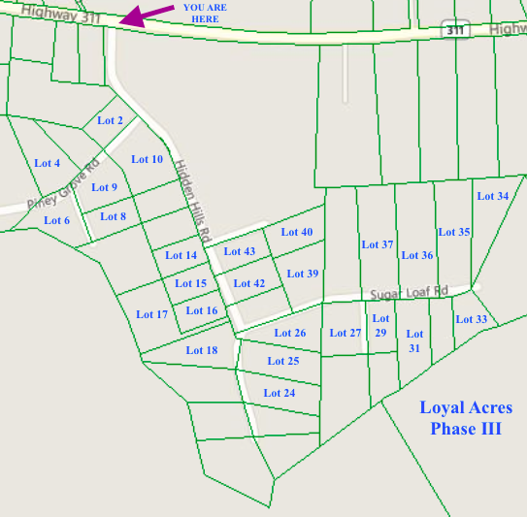
Build your dream home in a gated community near the Volvo Manufacturing campus!
Lots available located a in serene gated community, Loyal Acres Phase III, in Cross, SC, less than 15 miles from the entrance to the new Volvo Manufacturing Facility. Close proximity to beautiful natural surroundings. Just 3 miles from Lake Moultrie, 8 miles from Lake Marion, 16 miles from Francis Marion Nation Forest.
MLS# | Address | Lot Size | Price |  | MLS# | Address | Lot Size | Price
16028994 | 114 Hidden Hills Road | 1+ | $26,900 |  | 16029026 | 503 Sugar Loaf Lane | 1+ | $29,900
16029012 | 118 Hidden Hills Road | 2+ | $37,900 |  | 16029027 | 504 Sugar Loaf Lane | 1+ | $30,900
16029014 | 130 Hidden Hills Road | 0.5+ | $27,900 |  | 16029028 | 507 Sugar Loaf Lane | 1.5+ | $37,900
16029015 | 133 Hidden Hills Road | 0.5+ | $25,900 |  | 16029029 | 511 Sugar Loaf Lane | 0.5+ | $22,900
16029016 | 134 Hidden Hills Road | 0.5+ | $22,900 |  | 16029030 | 512 Sugar Loaf Lane | 2.5+ | $49,900
16029017 | 137 Hidden Hills Road | 0.5+ | $25,900 |  | 16029031 | 515 Sugar Loaf Lane | 1+ | $31,900
16029039 | 138 Hidden Hills Road | 0.5+ | $27,900 |  | 16029032 | 516 Sugar Loaf Lane | 2.5+ | $49,900
16029018 | 144 Hidden Hills Road | 1.5+ | $37,900 |  | 16029034 | 520 Sugar Loaf Lane | 2+ | $51,900
16029020 | 145 Hidden Hills Road | 1.5+ | $36,900 |  | 16029035 | 523 Sugar Loaf Lane | 0.5+ | $26,900
16029021 | 149 Hidden Hills Road | 1.5+ | $35,900 |  | 16029036 | 524 Sugar Loaf Lane | 1.5+ | $40,900
16029022 | 308 Piney Grove Road | 1.5+ | $29,900 |  | 16029038 | 405 Sweet Birch Trail | 1+ | $30,900
16029024 | 201 Spicey Cove Trail | 1+ | $27,900 |  | 16029040 | 0 Hidden Hills Road | 2+ | $37,900
16029025 | 205 Spicey Cove Trail | 0.5+ | $23,000 |  | 16029023 | 200 Spicey Cove Trail | 1+ | $28,900
Heather Spraker
O (386) 631-1363
heather@armadarealestate.org

