Slide 1
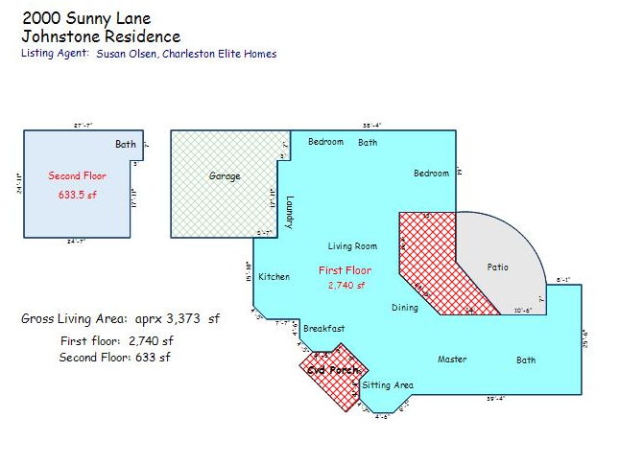
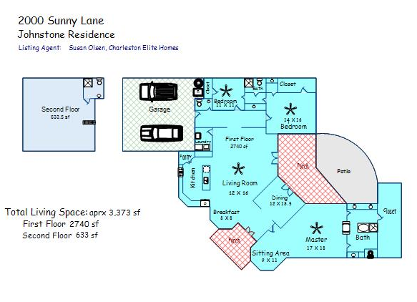
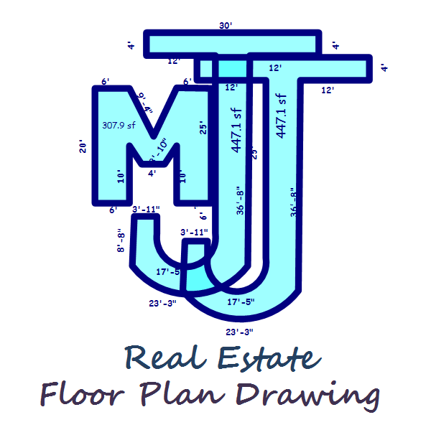
10% Holiday Discount Available Order one of our Detailed Plans by 12/31/15…
Have you home measured by 01/31/16 …
And you get 10% off your order
_______________________________________
Check out my website below for information on what types of house plan drawings I offer, and see samples below.
Please call me for any other information you may need.
Thanks! Mischelle
Mischelle (Lesemann) Johnstone
MJJ Real Estate Plan Drawing
843-303-2161
www.mjjplandrawing.com

