Slide 1
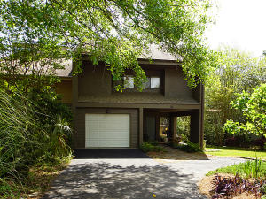
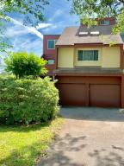
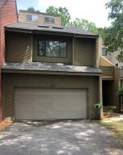

Marsh Cove Broker's Open Houses
Saturday 2-4pm
Some light refreshments will be served. Visit all three and your name will be entered to win a $50 gas card. Thanks for your support. This is a beautiful neighborhood with some of the coolest townhomes in Charleston!
35 Arabian Drive
MLS# 19010648 | $324,000
Jennifer Robinson
843-442-1145
jrobinson@carolinaone.com
Carolina One Real Estate
41 Arabian Drive
MLS# 19012254 | $314,900
Stephanie Deaton
843-743-4219
sdeaton@palmettost.com
Palmetto State Properties & Assoc
43 Arabian Drive
MLS# 19010651 | $293,000
Chris Garvin
843-270-7667
cgarvin63@gmail.com
Elaine Brabham & Assoc
Carolina One Real Estate
195 W Coleman Blvd
Mt Pleasant, SC 29464
Jennifer Robinson
(843) 442-1145
jrobinson@carolinaone.com

