Slide 1
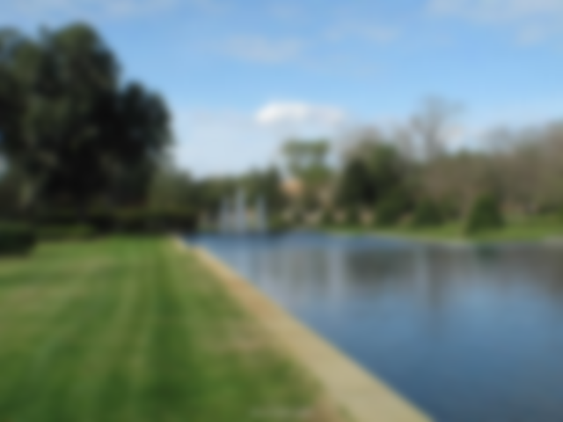
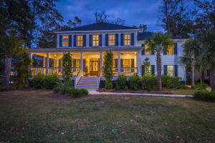
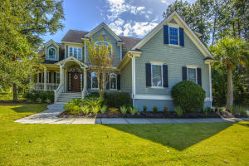
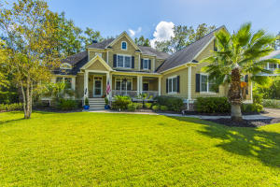
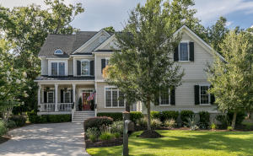
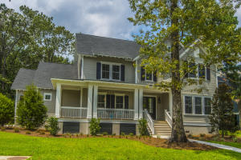
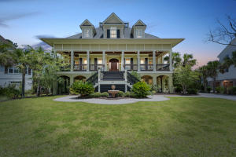
Masonborough at Park West
Open House Tour
2109 Malcolm Road
MLS# 17031843 | $800,000
Melodie Smith
Carolina One Real Estate
843-408-5067
melodie.smith@carolinaone.com
1564 Capel Street
MLS# 17027297 | $740,000
Stuart DeVault
Carolina One Real Estate
843-754-1769
stuart@carolinaone.com
Saturday, Feb 3rd from 1-3
6 Custom Homes in Exclusive Masonborough from $719,000- $1,335,000
2300 Middlesex Street
MLS# 17027791 | $825,000
Keith & Kim Pruitt
Carolina One Real Estate
843-270-5677
keithpruitt@carolinaone.com
1527 Capel Street
MLS# 17019974 | $719,000
Chris Pouyat
ERA Wilder Realty
843-364-7755
pouyat.relo@gmail.com
1733 W Canning
MLS# 16030558 | $765,000
Kerri Mahoney
Coastal Premier Prime Properties
843-607-2087
kmahoney@coastalpremierprimeproperties.com
2192 Beckenham Drive
MLS# 18000277 | $1,335,000
Courtney Delfino
BHHS Carolina Sun Real Estate
843-425-7303
cdel2@comcast.net

