Slide 1
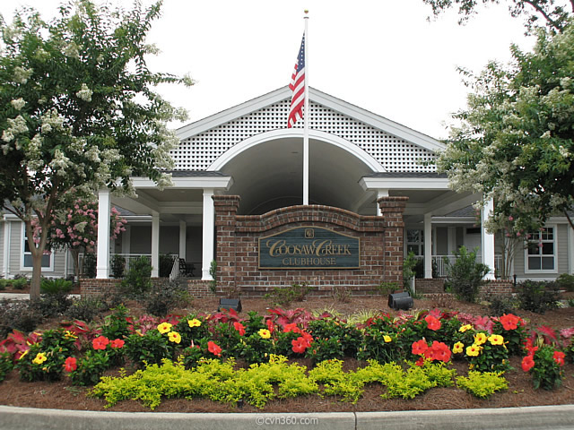
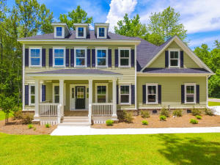
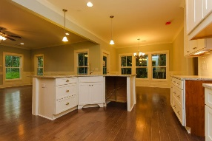
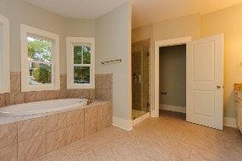
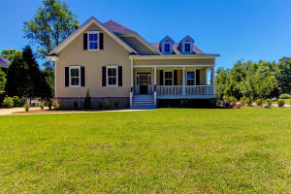
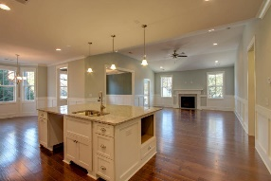
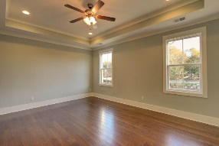
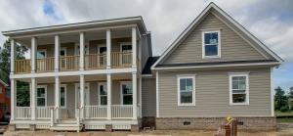
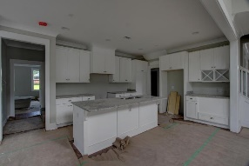
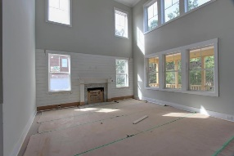


Live in Coosaw Creek with no fees for 3 years!!
All New Construction Homes!
$4,500 Coosaw Creek Initiation Fee Paid by Builder!
ALL Membership & HOA fees paid by builder for 3 years!!
8612 Mcchune Court
MLS# 17014518
$474,990
5 Bedrooms
3 1/2 Baths
3,350sf
4125 Club Course Drive
MLS# 17014515
$474,990
5 Bedrooms
3 1/2 Baths
3,382sf
4185 Magnolia Court
MLS# 17014516
$514,990
5 Bedroom
3 Baths
3,264sf
Larry & Kathy Mazalatis
Larry Cell 843-693-0529
Kathy Cell 843-693-0159
Office 843-871-9133
AGENTOWNED PREMIERE GROUP | 1800 TROLLEY RD | SUMMERVILLE, SC 29485

