Slide 1
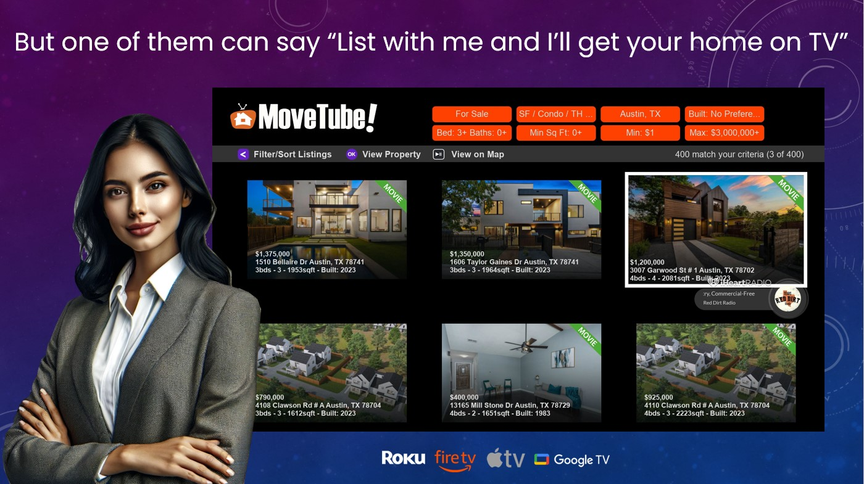
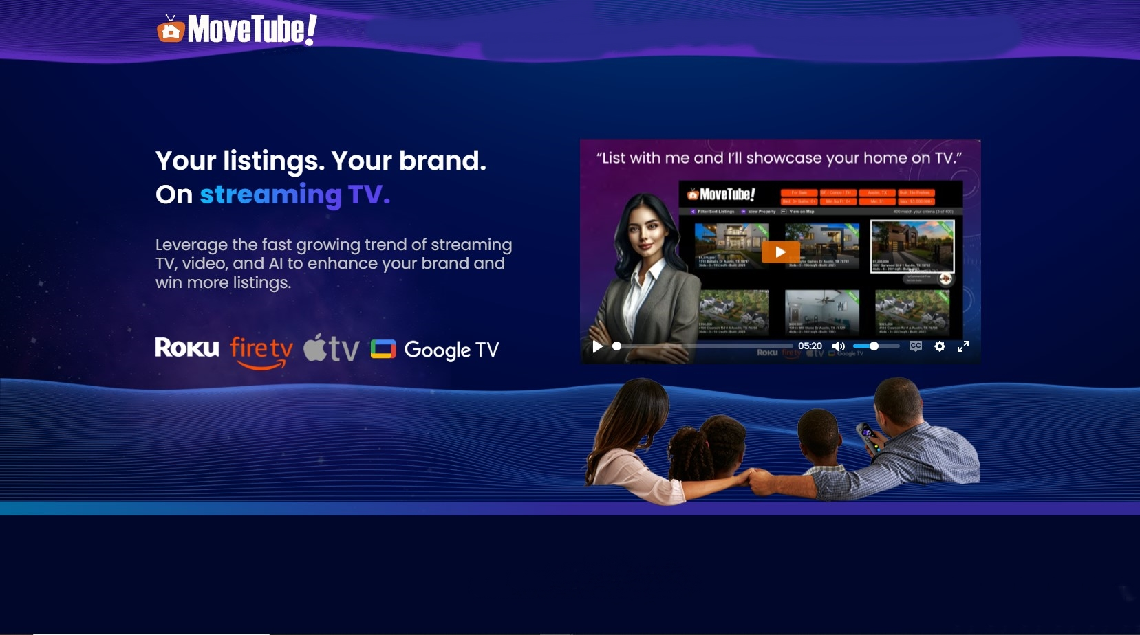
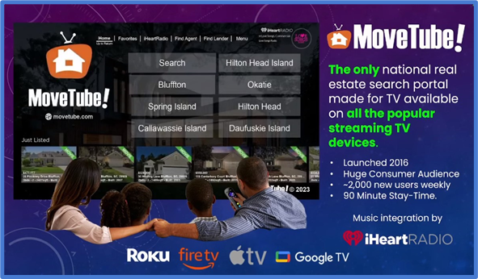


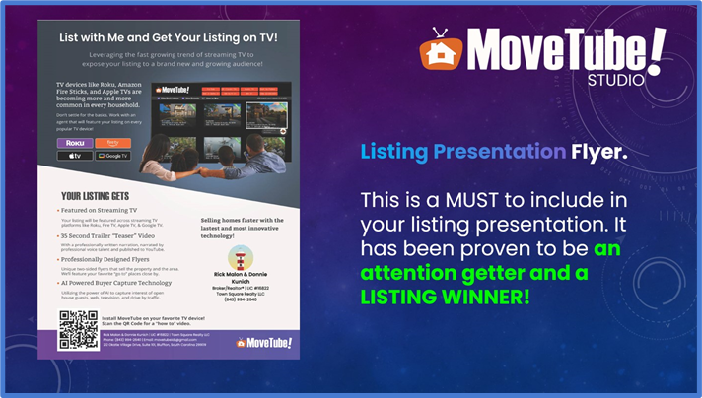
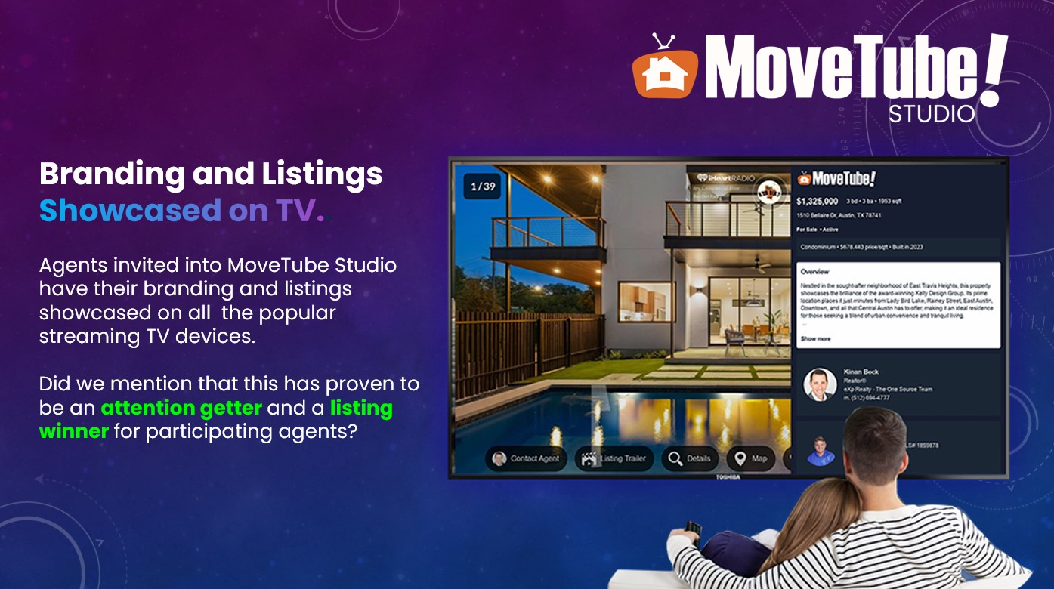

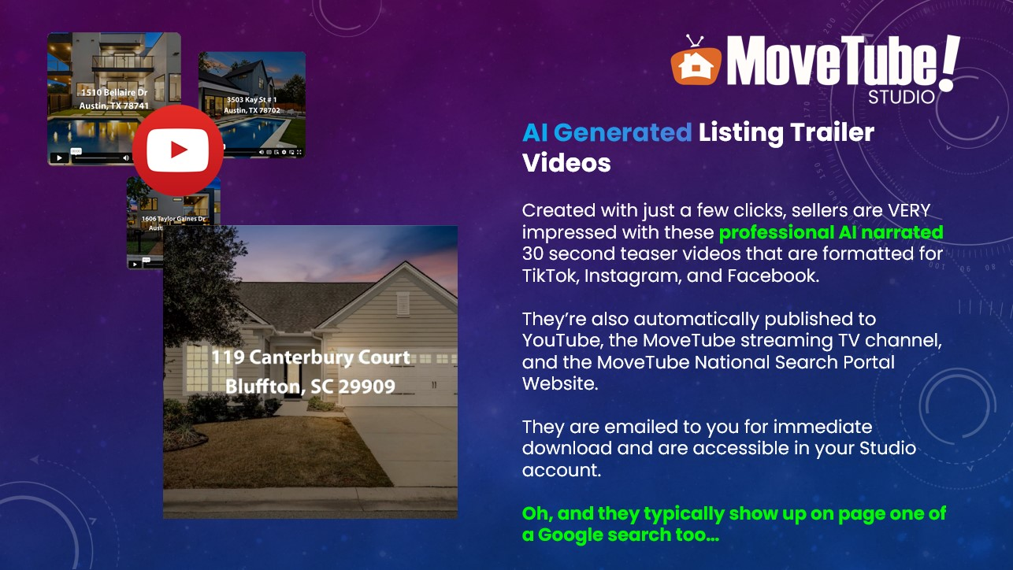
Hey there, real estate agents! 🏡🔑 Looking to win more listings and boost your brand? MoveTube has got you covered! 📺📲 With MoveTube, you can showcase your listings on TV, share them on social media with cookie branding, and even upload videos to market your services. Best part? It's all FREE! 🆓 Don't miss out on this incredible opportunity to take your real estate game to the next level. Sign up for MoveTube today! 🎉

