Slide 1
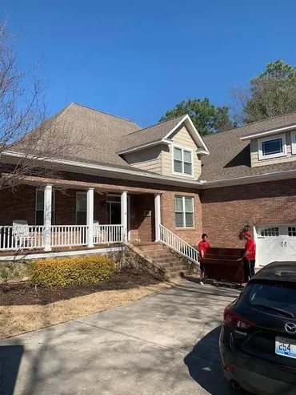
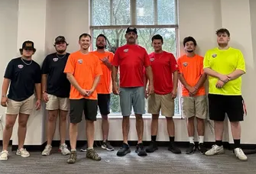
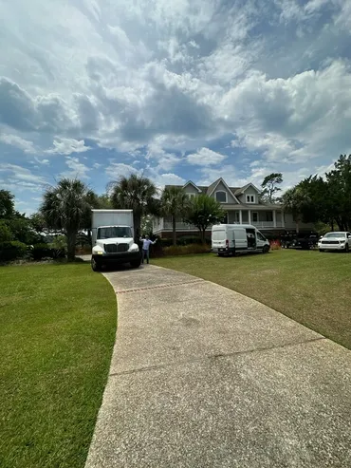
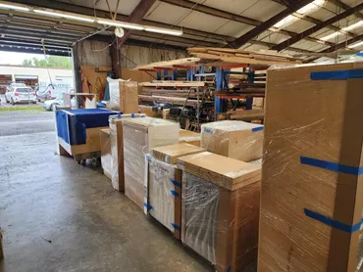

10% Off Booking If You Mention This Ad
30 Years of Providing Professional Moving Services in Mount Pleasant, Charleston, and Surrounding Areas
Junk Removal Services
Residential Moving/Office Relocation
Freight Receiving, Delivery And Warehousing
Nationwide Hotel FF&E Service
Free In-home Estimate
Mount Pleasant Movers offers a comprehensive range of moving and storage services, including full-service residential moves, packing, crating, shipping, and LTL. Our dedicated team of 2 to 10 men can handle local moves, long-distance moves, loading and unloading of pods, and packing/unpacking. We also provide climate-controlled storage solutions to ensure the safety of your belongings.
Mount Pleasant Movers
(843) 303-4150
ffemover@gmail.com
mtpleasantmovers.com

