Slide 1
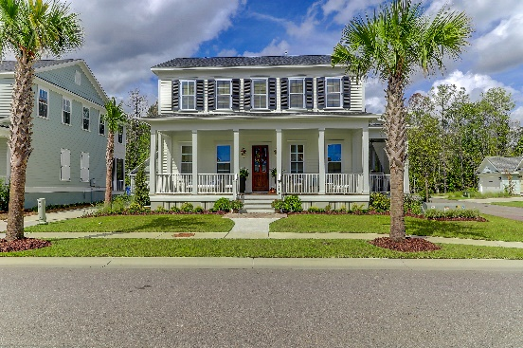
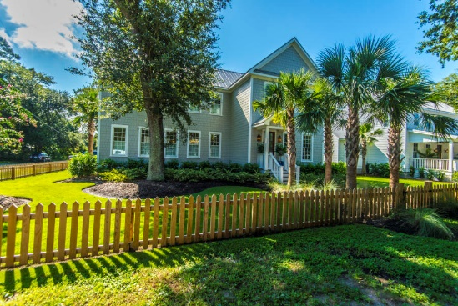
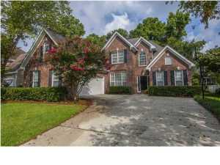
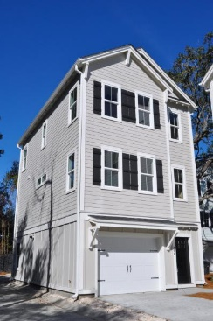
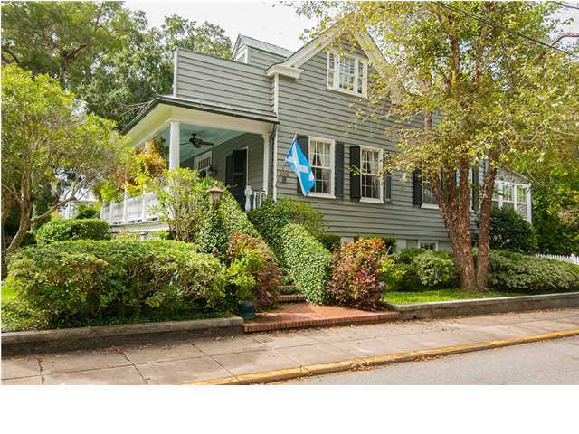
Mount Pleasant Progressive Open House Tour
THURSDAY OCTOBER 4
10-Noon
$100 Gift Card Drawing
3590 Backshore Drive 2,952SF
4/3.5
$735,000
Geri Lipps
843-810-8398
glipps@carolinaone.com
761 McCants Drive
2,948SF
4/3.5
$1,285,000
Posey Haynie
843-478-0120
phaynie@carolinaone.com
1317 Old Ivy Way
2,684SF
4/2.5
$535,000
Lisa O’Keefe
843-442-7968
lisa@theroettgerteam.com
966 Warrick Oak Lane 1,850 SF
3/3.5
$565,000
The Hunnicutt Team
843-270-0292
ed@edhunnicutt.com
409 Church Street
4,270 SF
4/3.5
$2,500,000
Nancy Hoy
843-224-3588
nhoy@carolinaone.com
** Must Attend All 5 Homes And Leave Business Card To Qualify For Gift Card Drawing **

