Slide 1
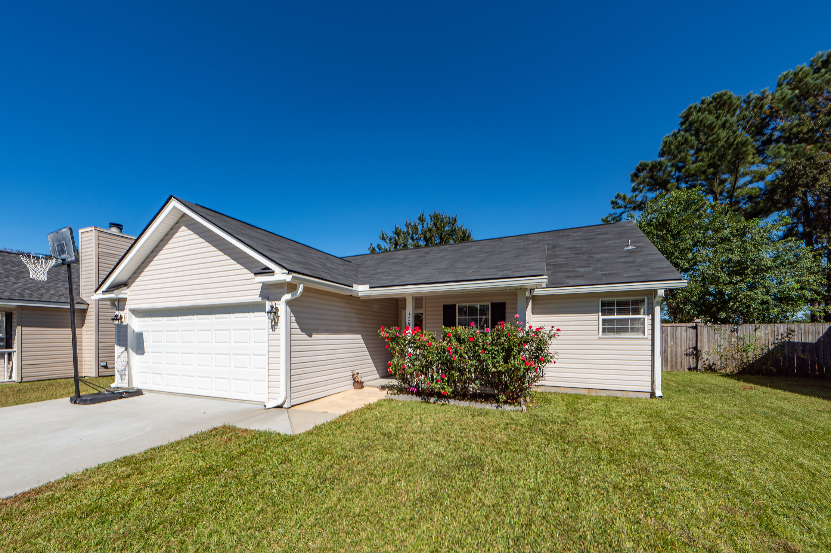
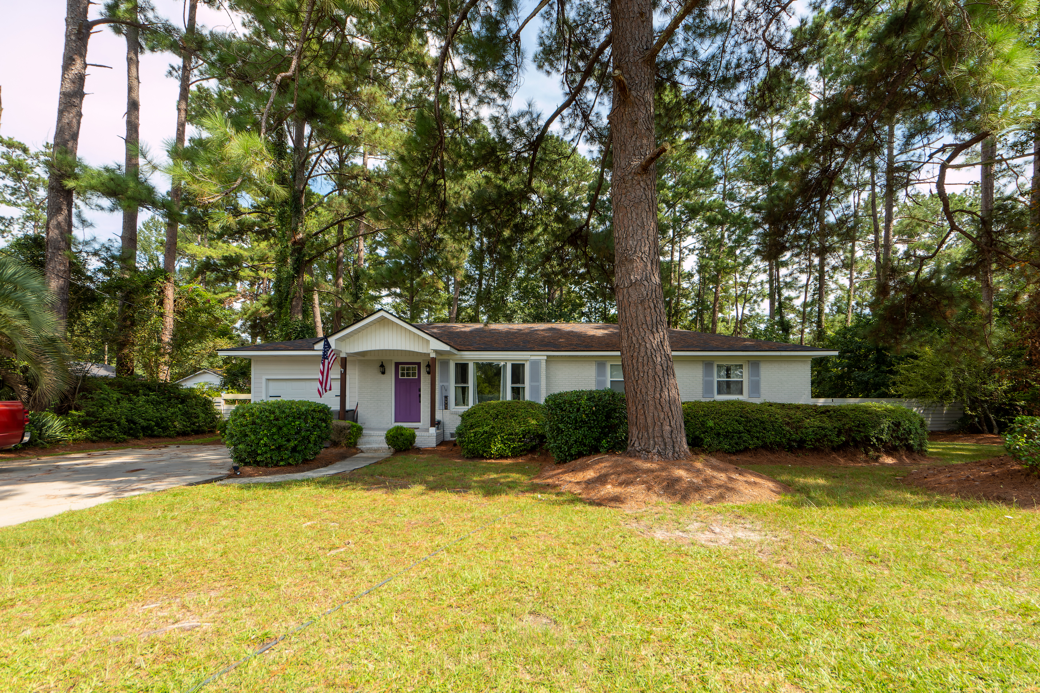
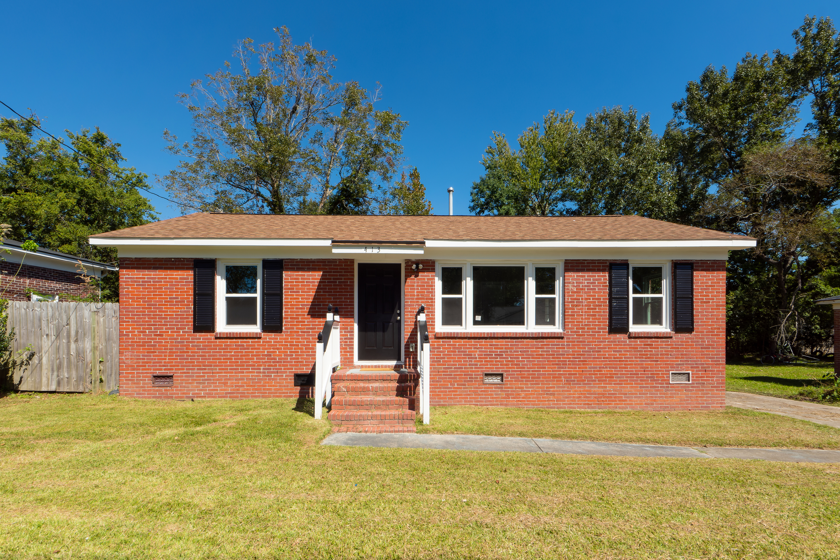
3 “Must Move” Properties
Do you have a client looking for a quick close deal?
108 Wilton in Devon Forest
3BR/2BA $280K.
Need a contract this weekend due to home sale contingency
MLS Listing | Virtual Tour
402 Park St in St. George.
HUGE lot, 3BR/2BA and is updated. Meticulously cared for by previous owner that owns a hardware store.
MLS Listing | Virtual Tour
413 Sarah Drive in Goose Creek. 3BR/1BA ONLY $235K.
FULLY UPDATED as well as encapsulated crawlspace.
MLS Listing | Virtual Tour
Billy Simons
843-352-3408
info@billysimons.com
Trident Real Estate LLC
672 Marina Dr, Charleston, SC
www.billysimons.com

