Slide 1
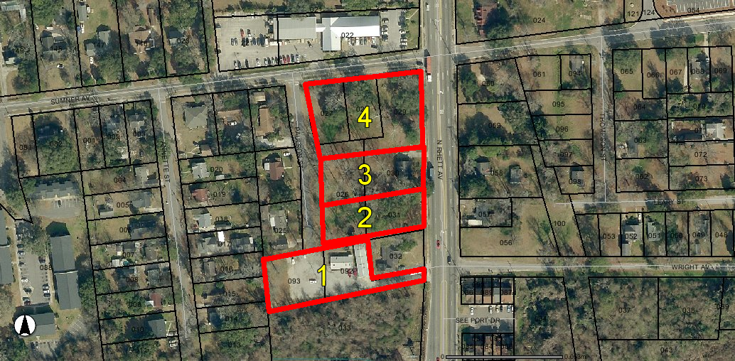
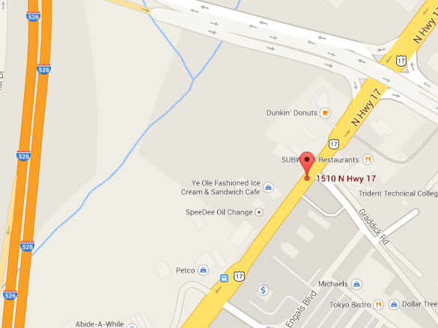
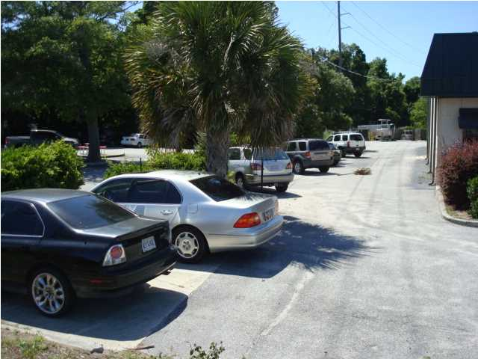
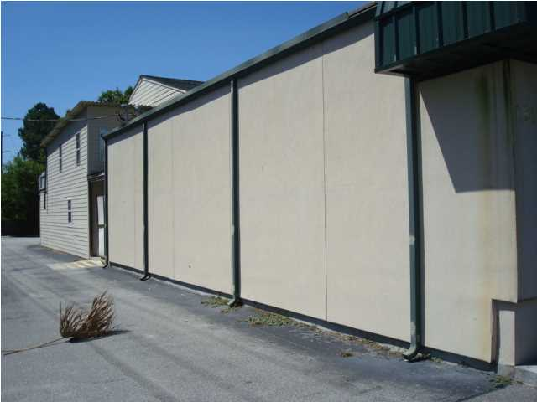
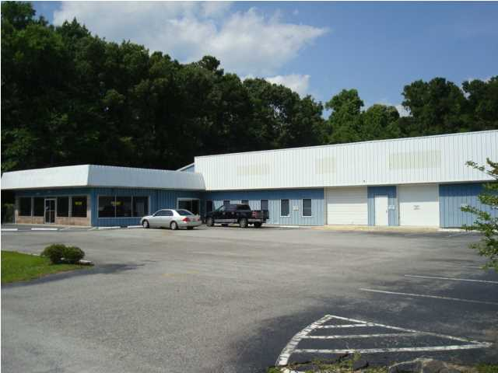

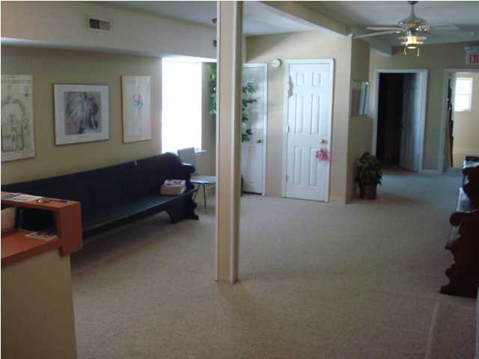
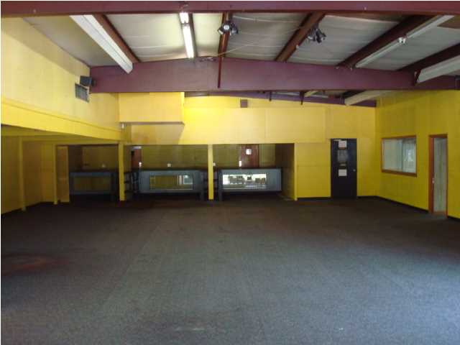
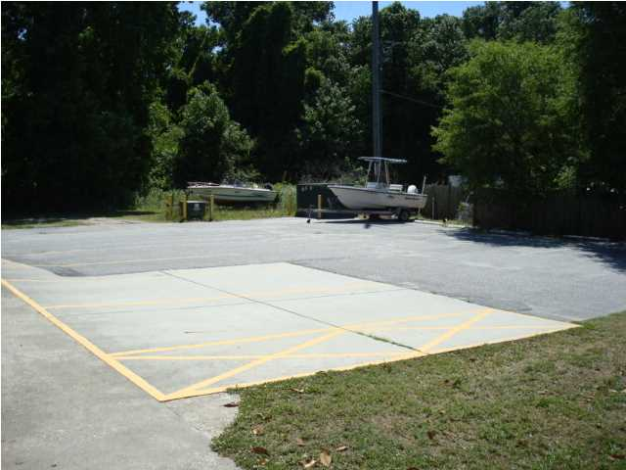
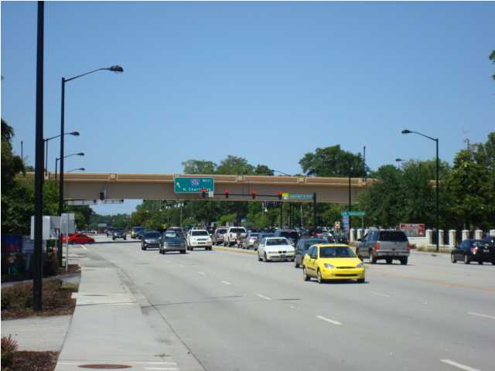
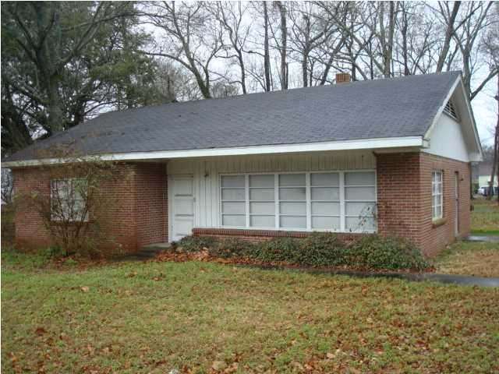
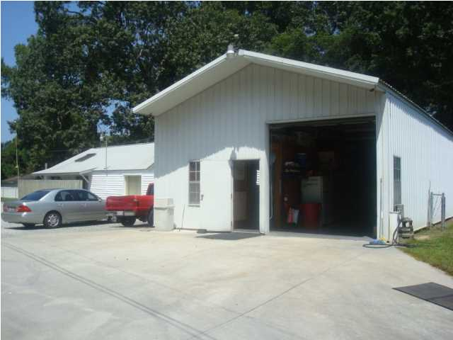
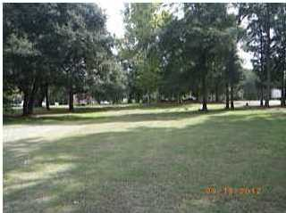
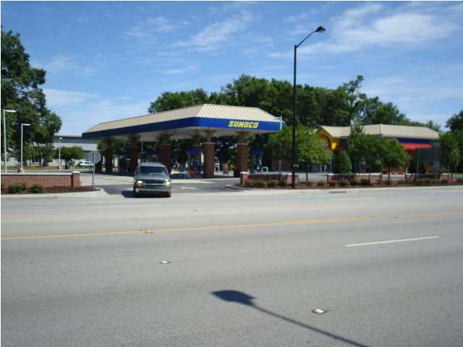
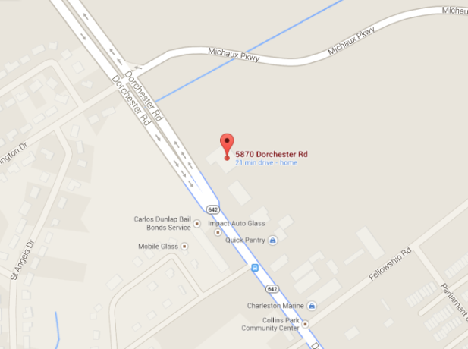
N Rhett Ave, N Charleston, SC 29406
A DEVELOPER'S DREAM AT I-526 & NORTH RHETT
3 Lots – 2.5 Total Acres
SUMNER AVE
$1,100,000
Lots 1,2, & 4 / 2.5 Acres
Warehouse & 2 Houses
N RHETT AVE
Under
Contract!
Property lines as highlighted are approximate
MLS# 1414148
13,300 sq. ft.
Lot 1 5469 N Rhett Ave MLS# 1500629 House & Warehouse $450,000 ~ 0.80 Acres TMS# 471-03-00-092/093 | Lot 2 5479 N Rhett Ave MLS# 1500630 $250,000 ~ 0.55 Acres TMS# 471-03-00-031 (and a portion of -026)
Lot 3 5481 N Rhett Ave MLS# 1500631 $275,000 ~ 0.57 Acres TMS# 471-03-00-030 (and a portion of -026) | Lot 4 5491 N Rhett Ave MLS# 1500632 $495,000 ~ 1.14 Acres TMS# 471-03-00-029/028/027 (and a portion of -026)
Sale - $895,000 | Lease - $6,000/Mo
SOLD!
Location...Location...Location...It doesn't get any better than this for price...Location and Size. Some owner financing available. This is a developer's dream!...Develop...Build to suit or simply hold and let the value increase. This property has a total of over 1,000 feet of road frontage on North Rhett, Sumner, and Paulson directly across from Seacoast Church at the intersection of I-526 and N. Rhett. Where else can you find 2.5 acres at an interchange of I-526 for this price? This property can be subdivided and consists of both B-1 and B-2 zoned property. (Includes 7 separate TMS#'s which totals over 2.5 acres)... Property includes a separate house and a 1900 sq. ft. warehouse…MOTIVATED SELLER!
Rick Willis
843-327-3017
Rick@RickWillis.com
The Group, LLC

