Slide 1

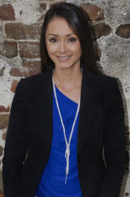

Charleston Property Experts is looking to hire 2-3 smart, driven and talented real estate professionals with a deep knowledge of the market. We are interested in new or experienced real estate agents looking to increase their production. Our business is growing faster than we can handle and we have an excess amount of leads to share. If you are ambitious and team oriented then we want to talk to you! If you are interested reply via email and answer the following questions:
How many years in the business?
Current ytd closings? Specify how many buyer and seller.
What is your 2017 transaction goals?
Need More Leads?
The D'Elia Group
843-352-2124
bdelia@mycharlestonproperty.com
www.findhomesincharlestonarea.com

