Slide 1
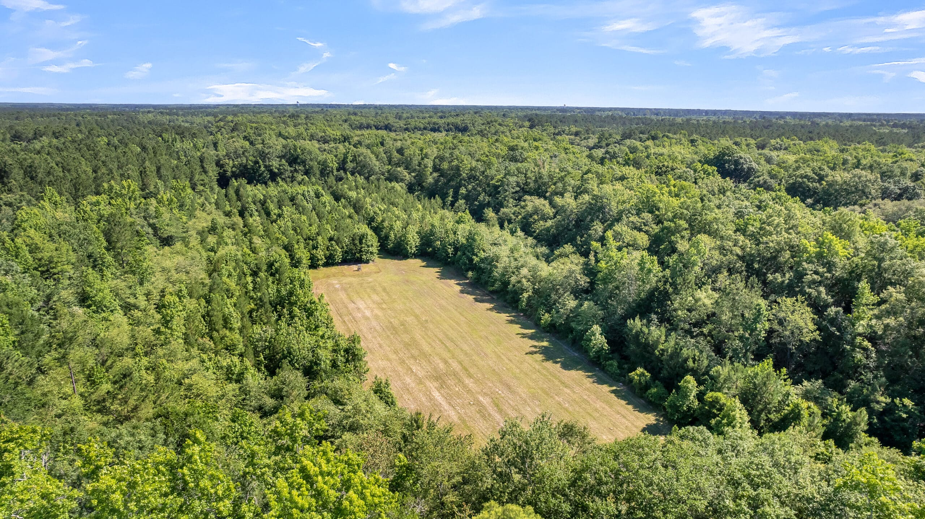

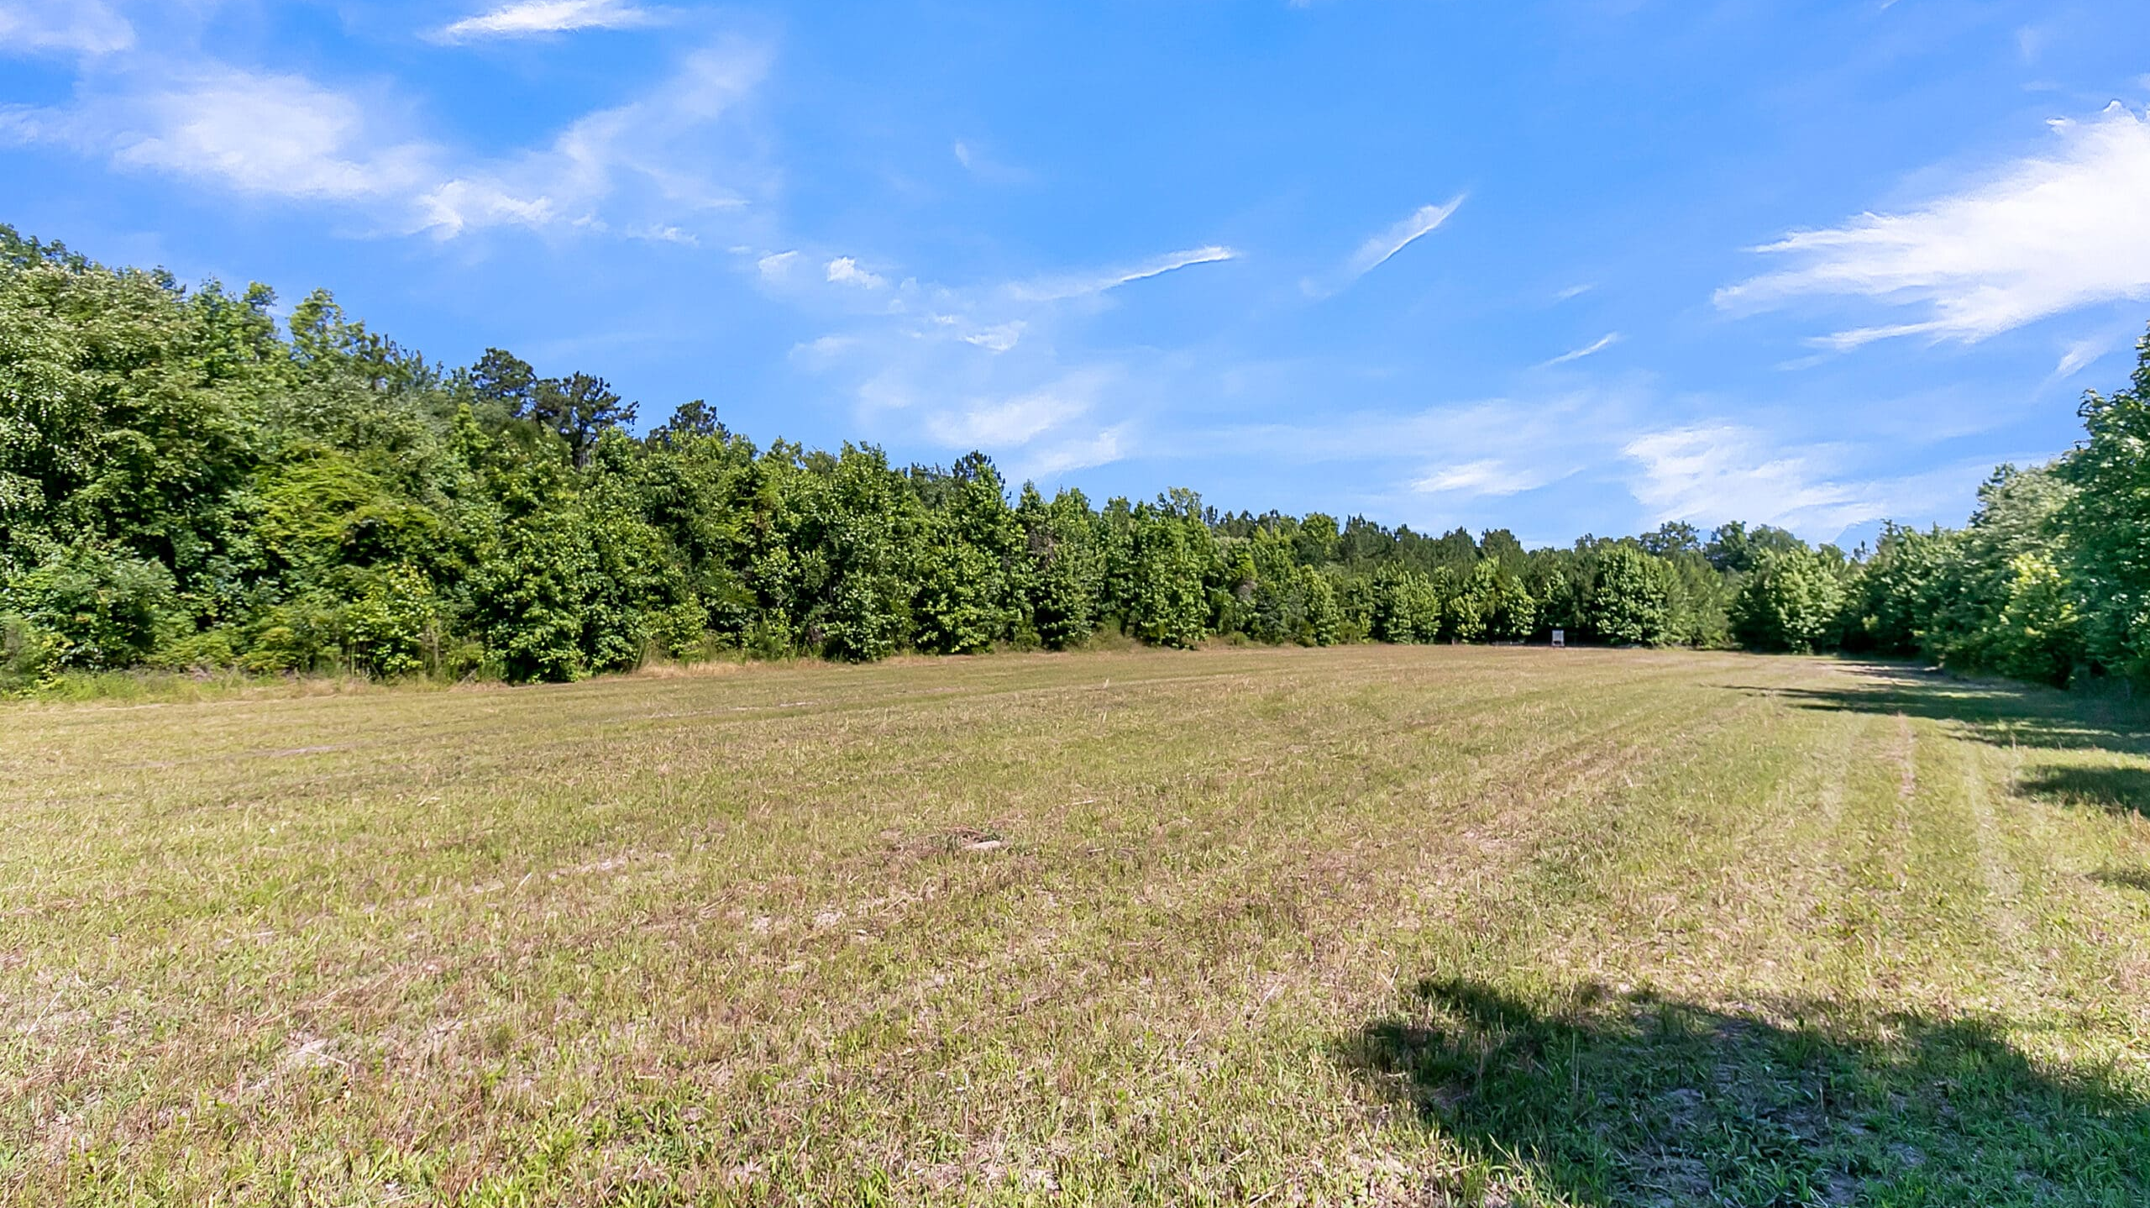
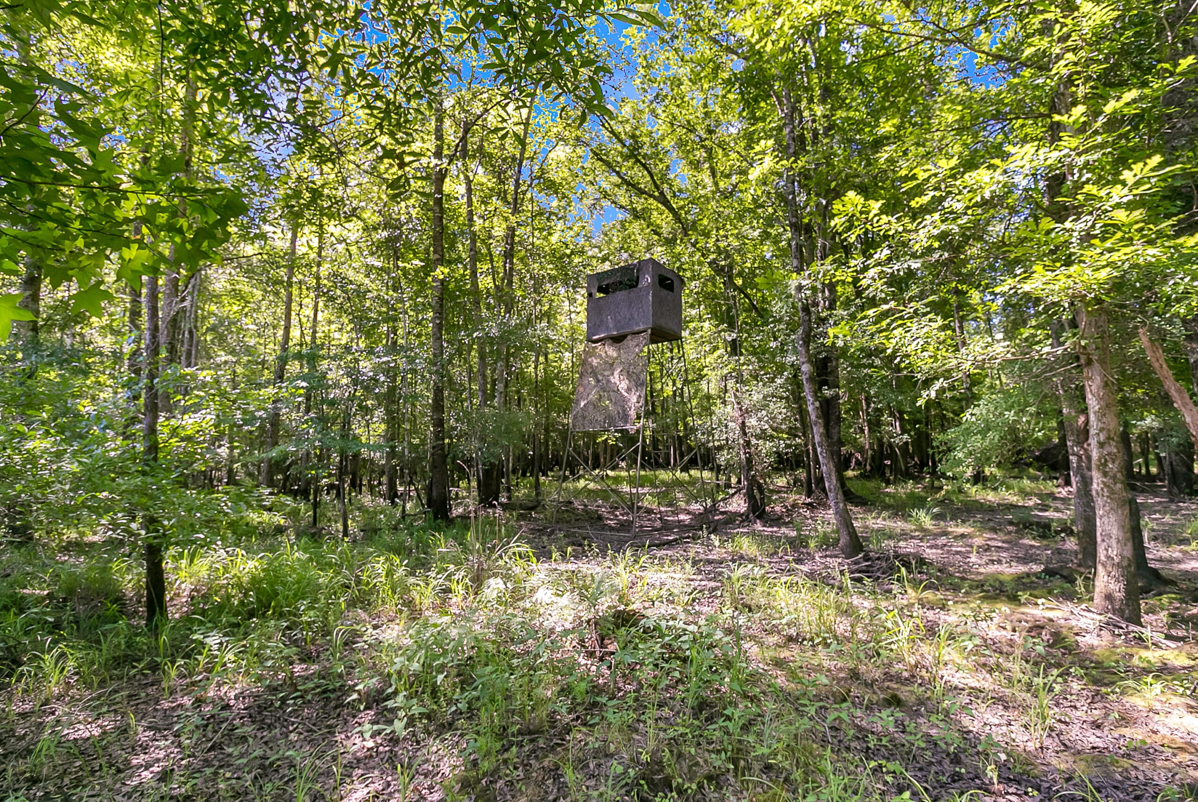
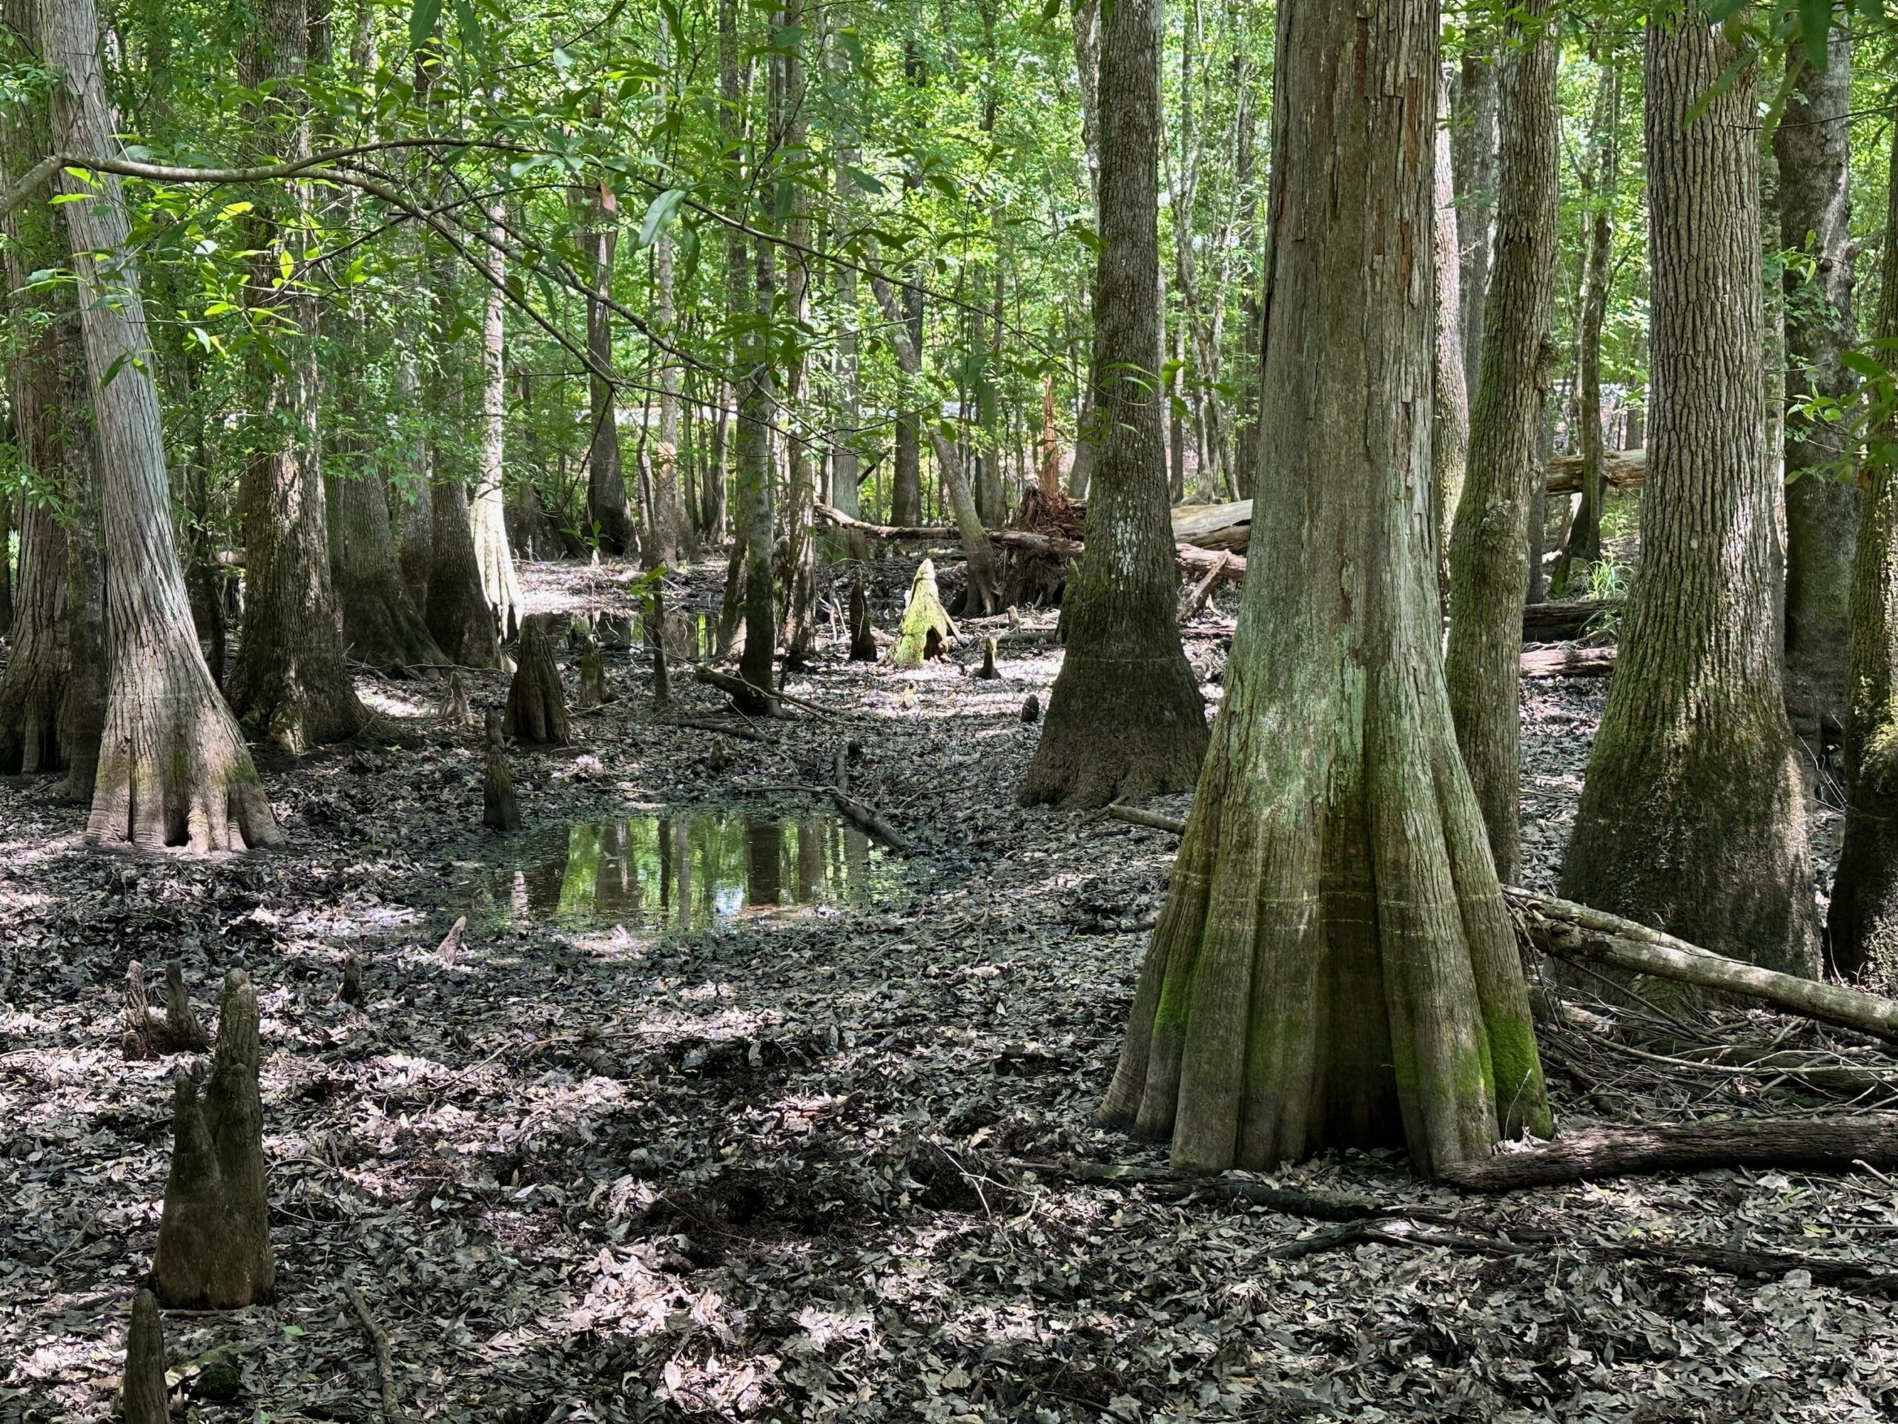
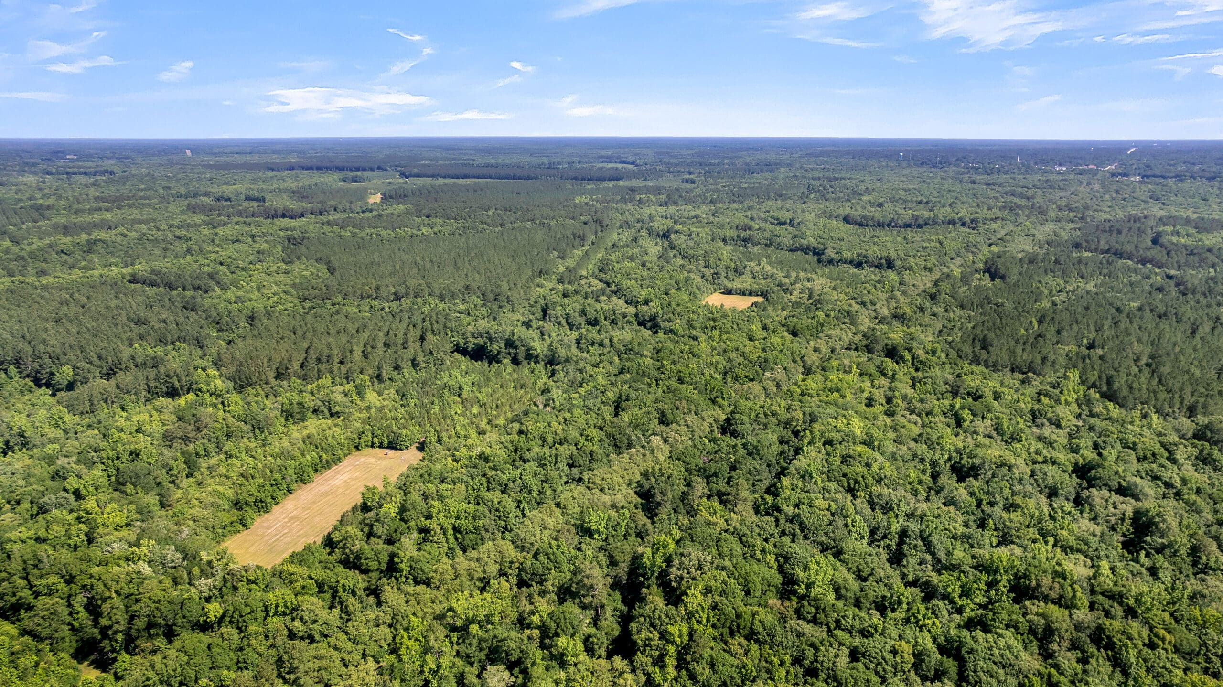
DOUGLAS CUTTING
(843) 534-3911
dcutting@bluewingproperties.com
bluewingproperties.com
New Farm
WILLIAMSBURG COUNTY, SC | $490,000
New Farm is a 114-acre Williamsburg County game haven located in the heart of the Dutch Neck Road neighborhood between Salters, Kingstree, and Black River.
The tract has three cultivated food plots with deer feeders and stands, a simple road system, multiple gated entrances, and varying aged stands of pine, hardwood, upland, and bottomland. Three huge, well-managed properties border this farm, yielding a consistent flow of quality deer and plenty of turkeys.
Approximately 1.5 hours from Charleston or the Waccamaw Neck and very close to Cooper’s Store or Kingstree, it’s a proven place for a quiet getaway that will always produce protein.
VIDEO TOUR | PROPERTY WEBSITE

