Slide 1
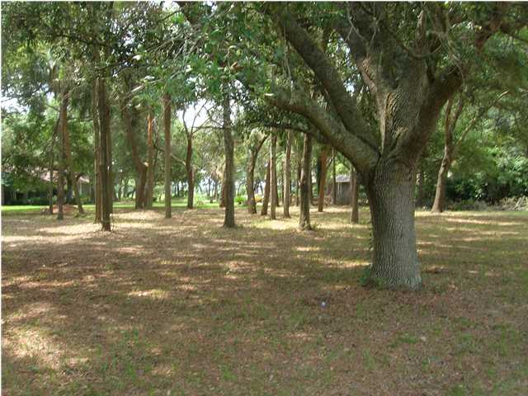
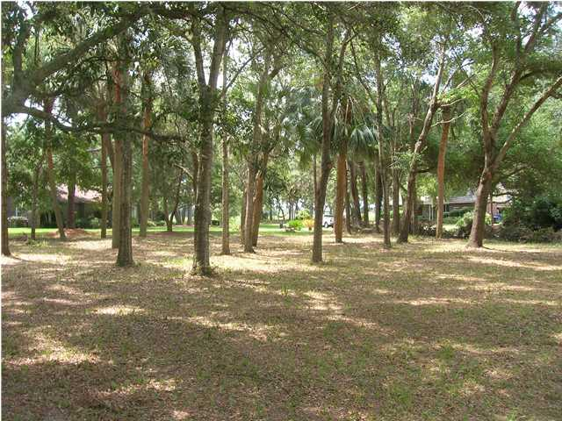
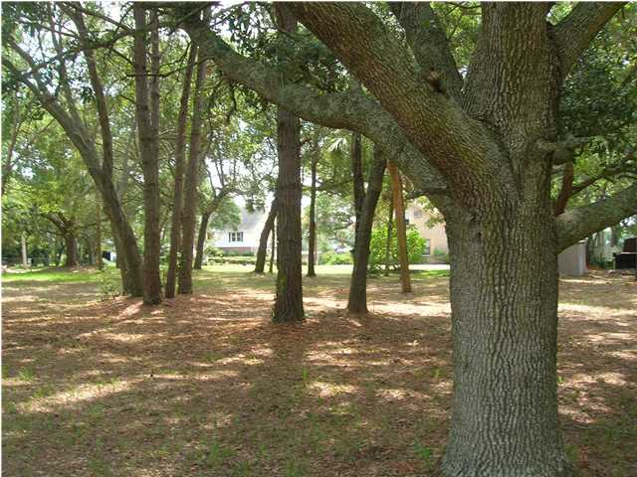
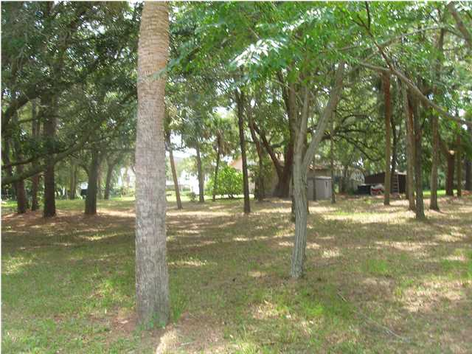
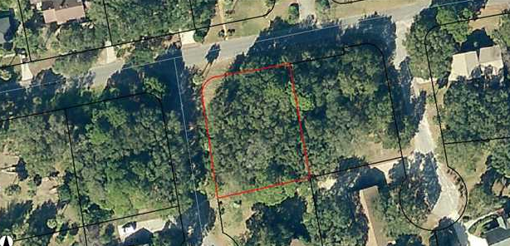
William S. Smith, Broker
Hartnett Realty Co., Inc.
134 Meeting St, Chas, SC 29401 wssmith@hartnettrealty.com
(843) 723-7222
0 Oak Island Dr - James Island, SC
$175,000 - MLS# 1320390
Oak Island Drive is parallel to and a very short drive to Folly Beach. This is a beautiful corner lot one block from the marsh facing Folly. Pastoral setting with lovely homes and ocean breezes. The owner is willing to consider some form of seller-financing for appropriate buyers.

