Slide 1


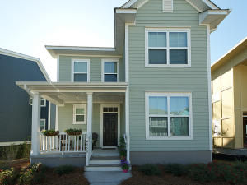

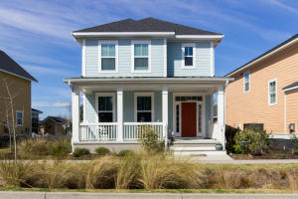

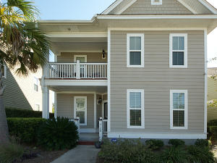

Find your Pot of Gold in Oak Terrace Preserve!! Saturday, March 11th from 12-2
Refreshments & Drinks Served At Each Home
$50 gift card drawing ~ Please RSVP by 5:00 Friday
4959 W Liberty Park Circle MLS# 17001261
$349,988
3 Bed - 2.5 Bath
Jennifer Robinson
843-442-1145
jrobinson@carolinaone.com
4904 W Liberty Park Circle MLS# 17005035
$359,500
3 Bed - 2.5 Bath
Neil Bansil
843-714-3855
neil.bansil@carolinaelitere.com
5189 E Liberty Park Circle MLS# 16028093
$328,000
4 Bed - 3 Bath
Rita Adkins
843-270-8814
yourcharlestonrealestate@gmail.com

