Slide 1
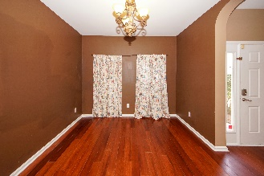
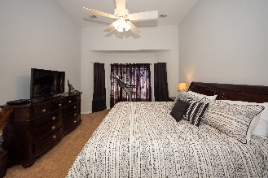
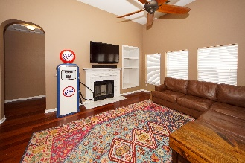
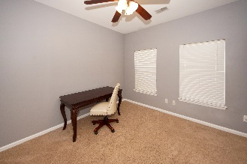
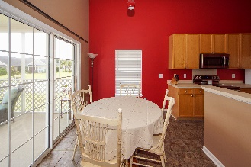
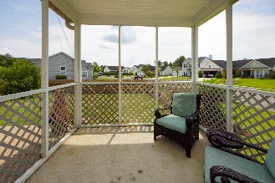
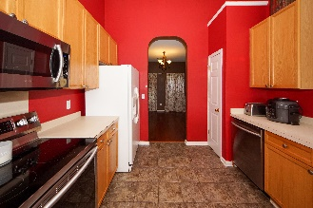
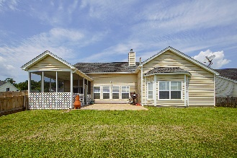
INVESTORS.... OFF MARKET OPPORTUNITY. NOT ON MLS.
Retiring investor selling 25+ unit single family residential portfolio. Portfolio comprised of 90+% single family ranch homes (most are brick) with approx 10% multifamily units. Single family homes mostly older/small brick ranch residences in the North Charleston area. Many homes have newer HVAC systems and homes have had replacement compressors or entire systems as needed. Tenants in place for all units with the exception of a couple that are having repairs/renovations done while changing out tenants. All units are rent ready but upside potential exists for the new owner interested in doing minor renovations/updating on most units. Rent rolls and other information available. Owner prefers to sell entire portfolio at a discounted rate. Owner requires the potential Buyer to propose the purchase amount after reviewing the properties in the portfolio.
Agents: You must have or be able to get a buyer agency agreement with the potential buyer and you must be working directly with the Buyer for this opportunity. This portfolio is not currently on the MLS and Buyer and Buyer's agent must complete a non-disclosure to receive the portfolio information. All units are occupied, so access will need to be scheduled. Buyer may be required to show proof of funds prior to receipt of portfolio information.
Please contact me via email jcrosby@propertyadvisorsinc.com
843-270-9407
John Crosby, Property Advisors Inc.

