Slide 1
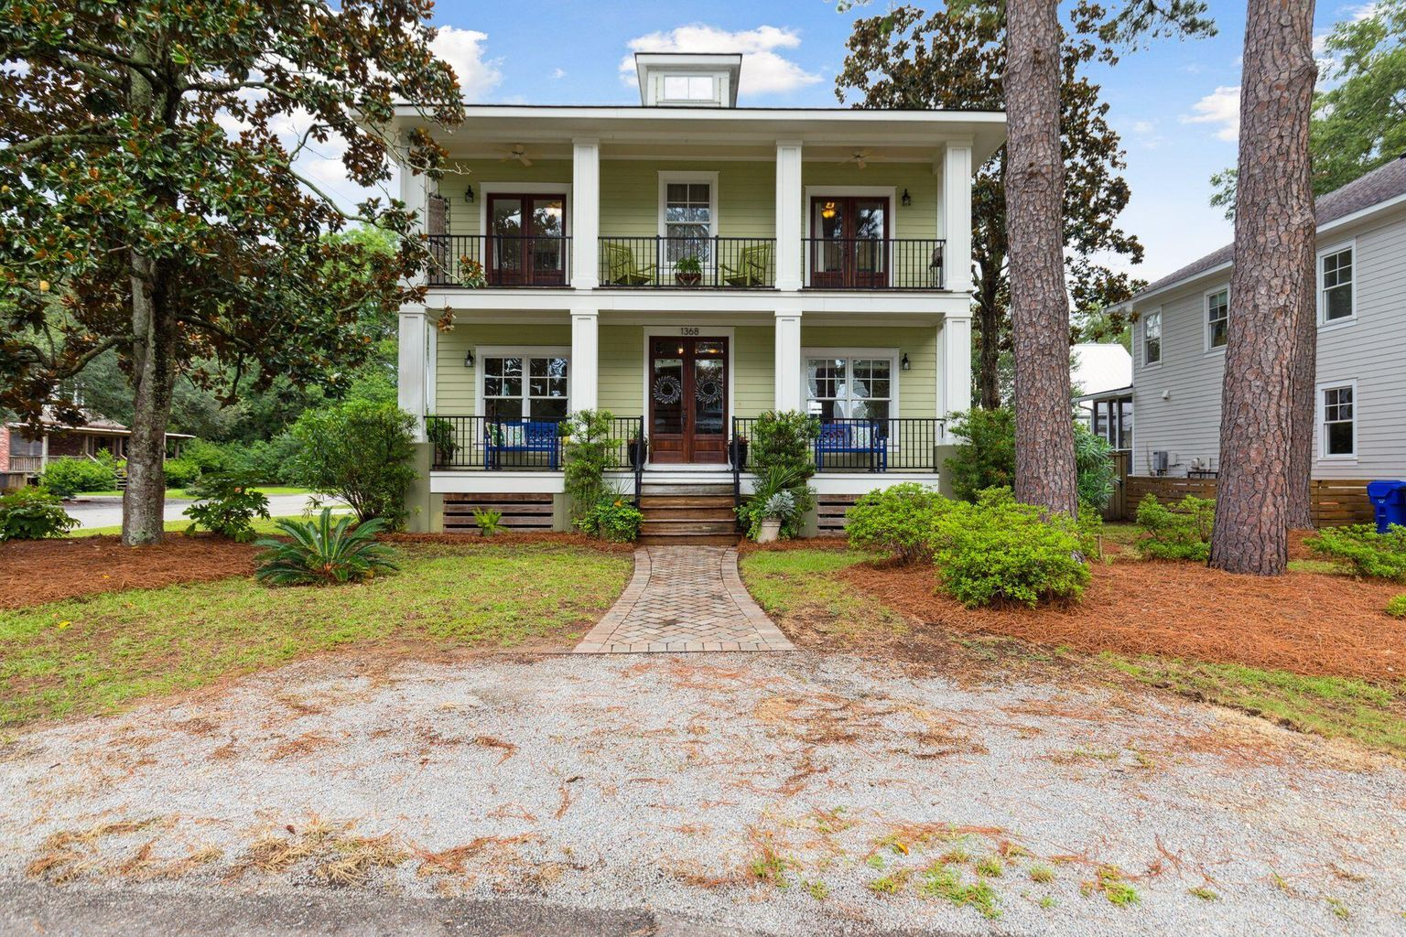
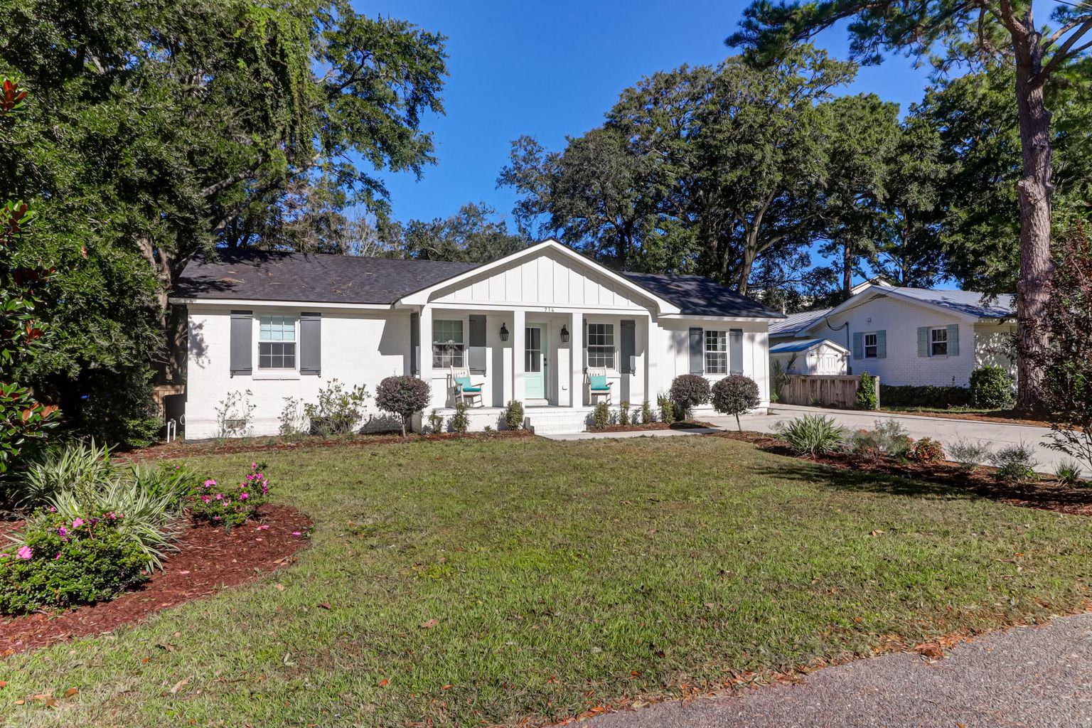
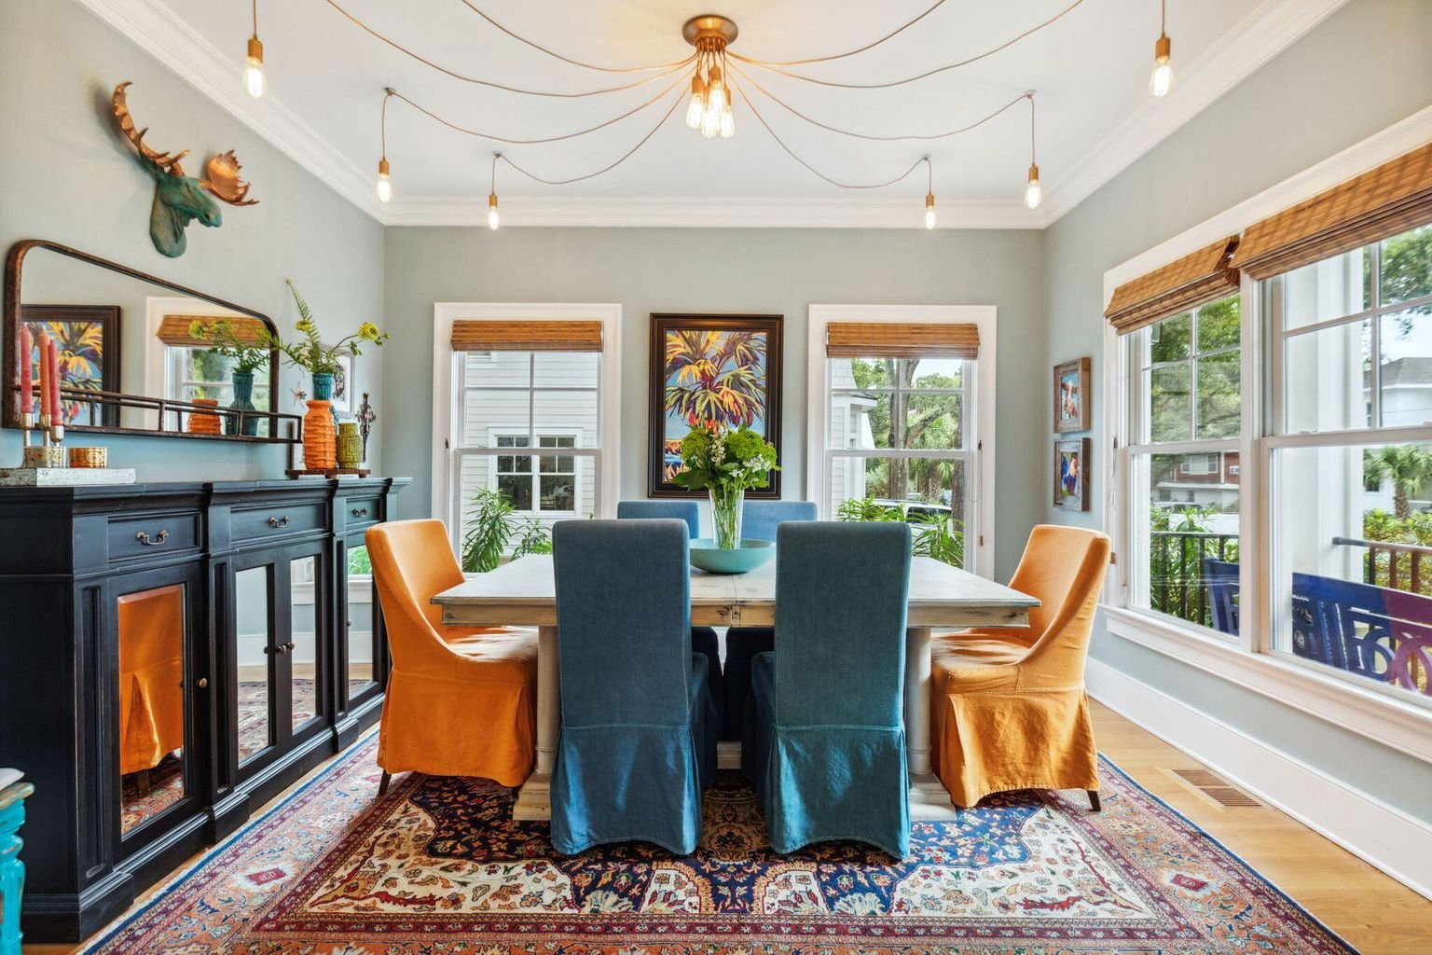
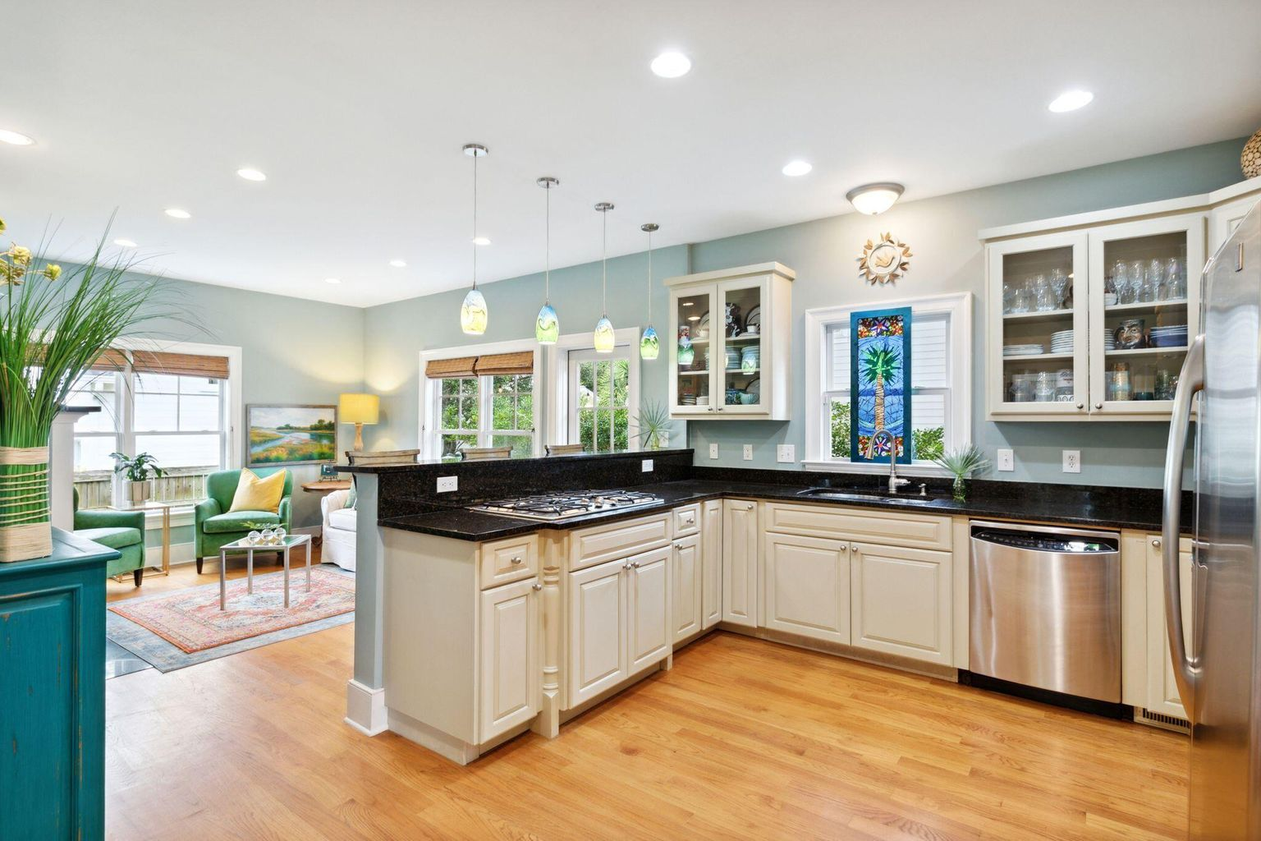
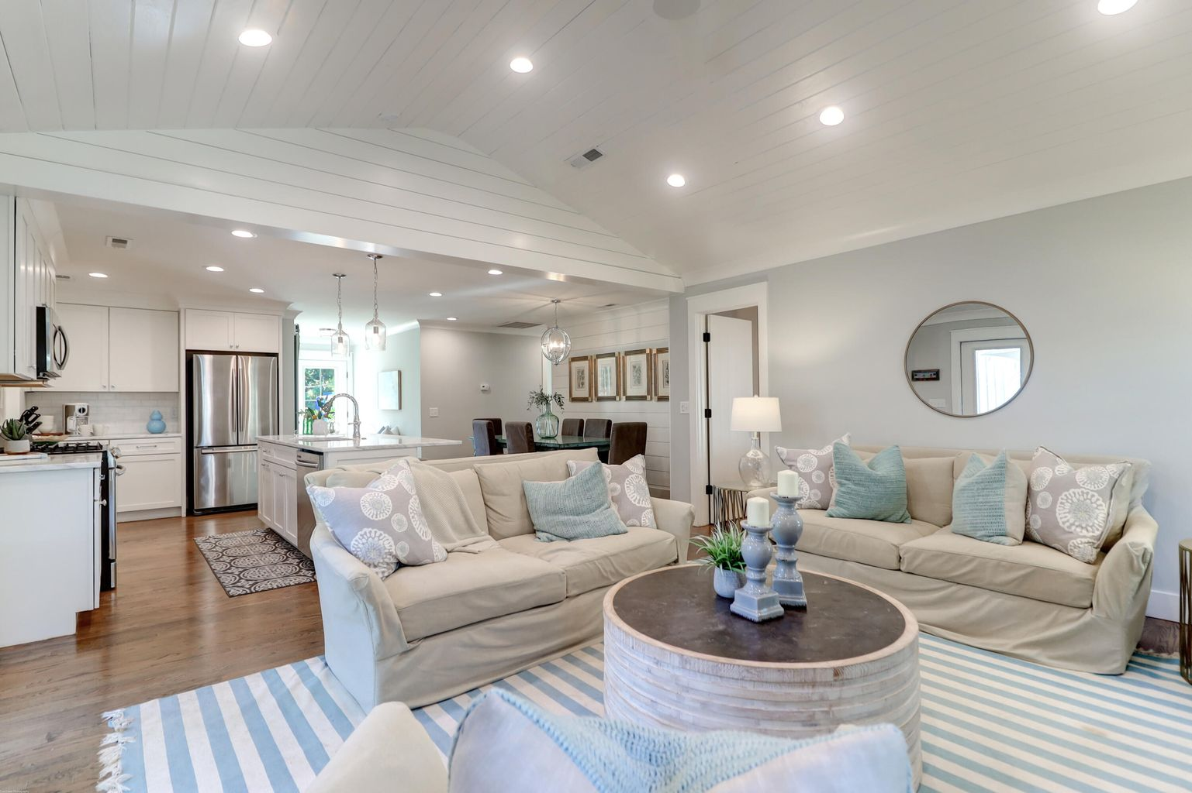
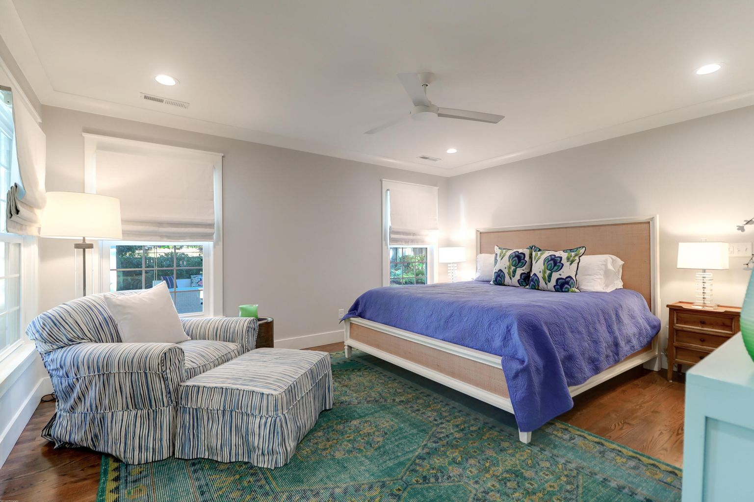
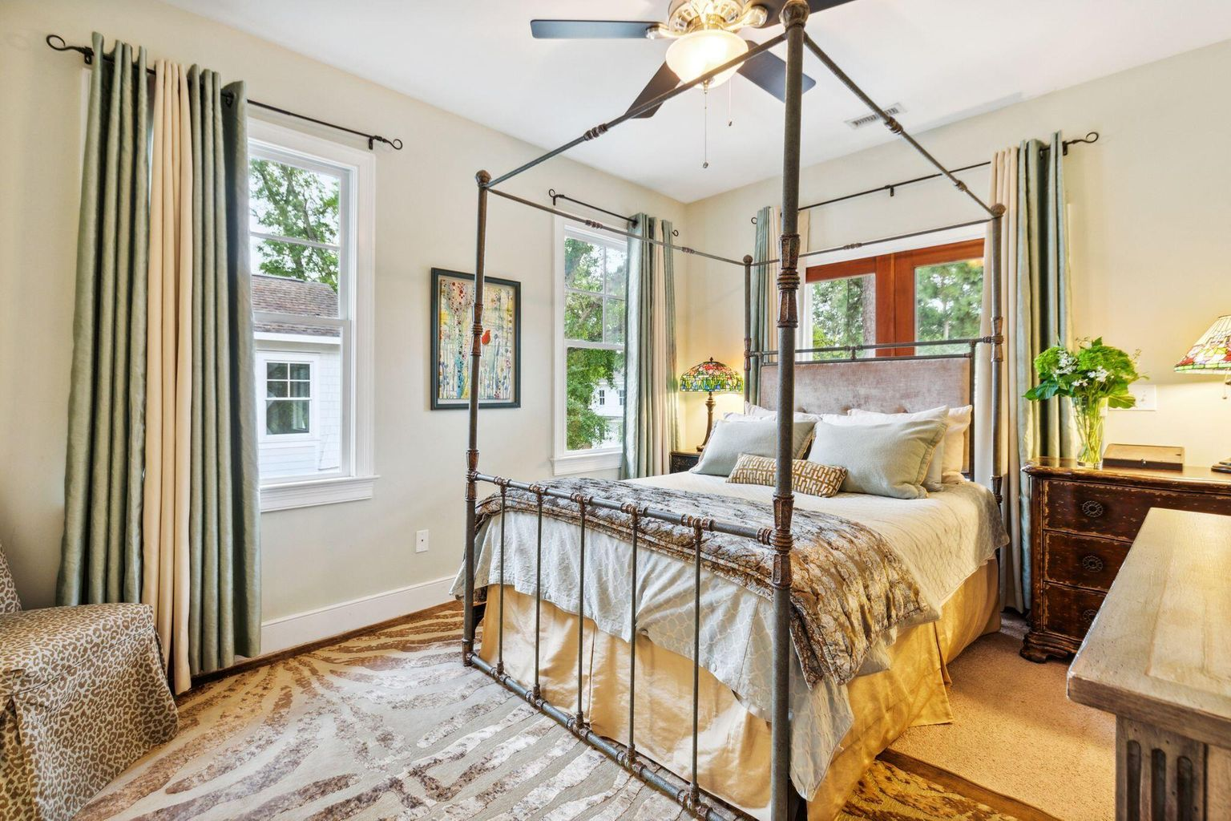
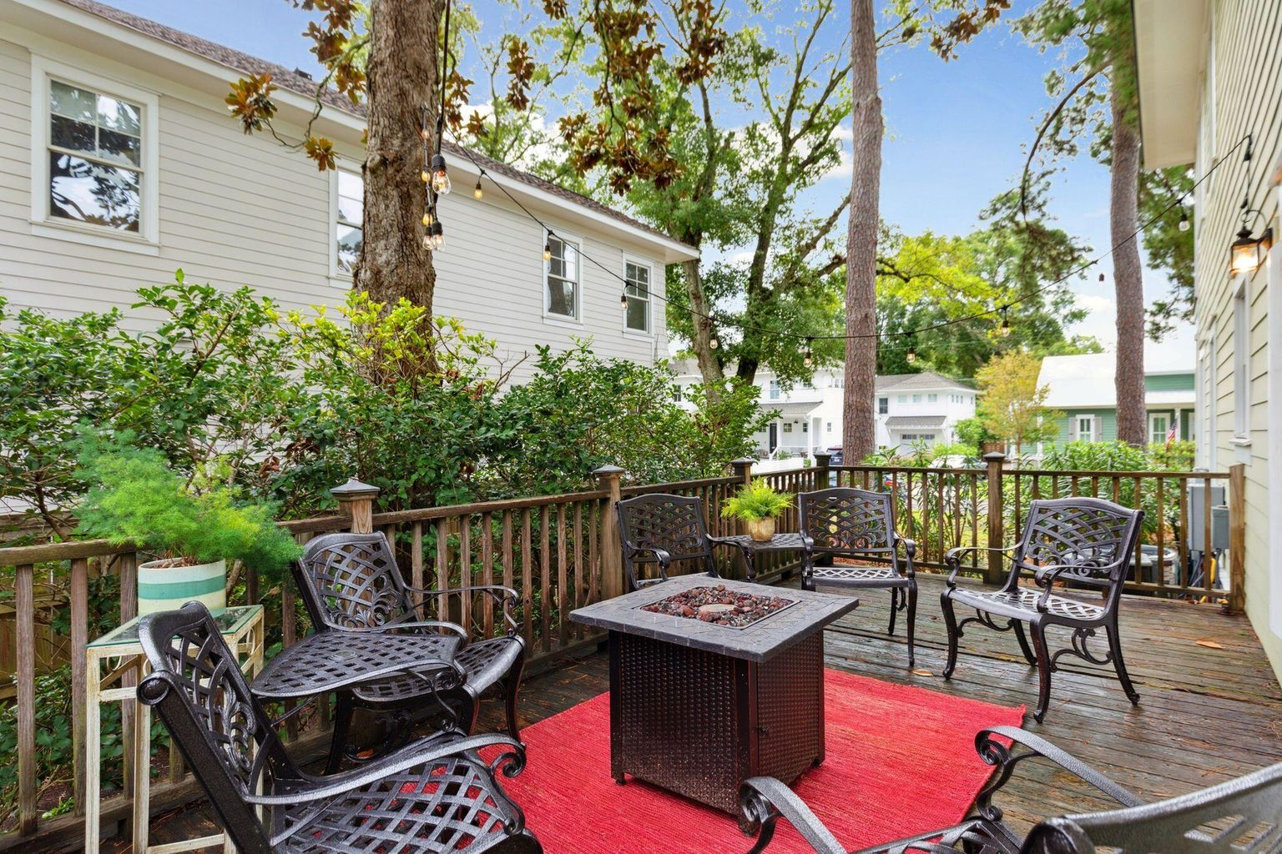
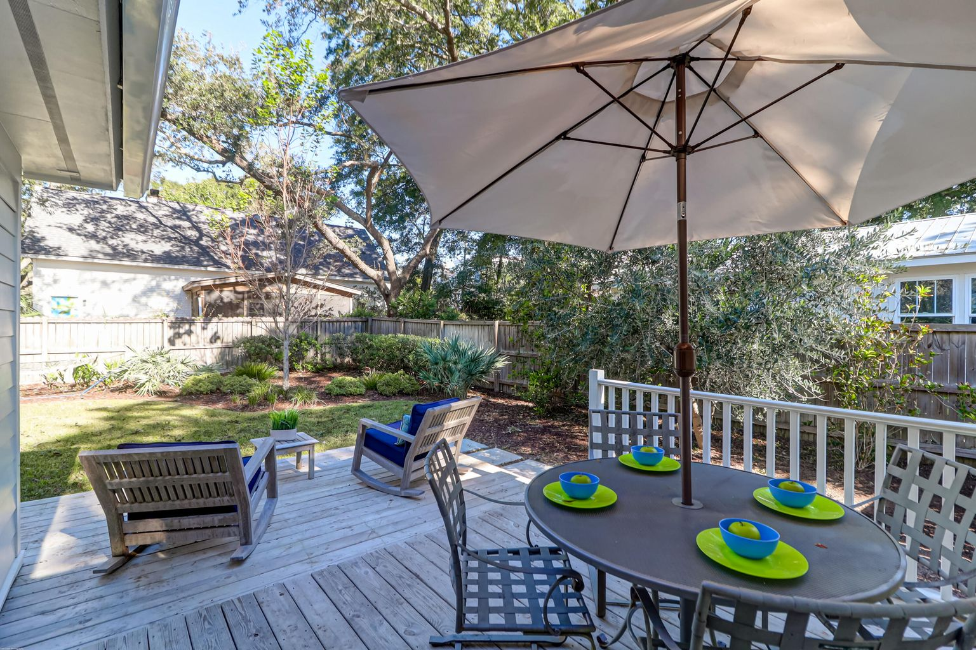
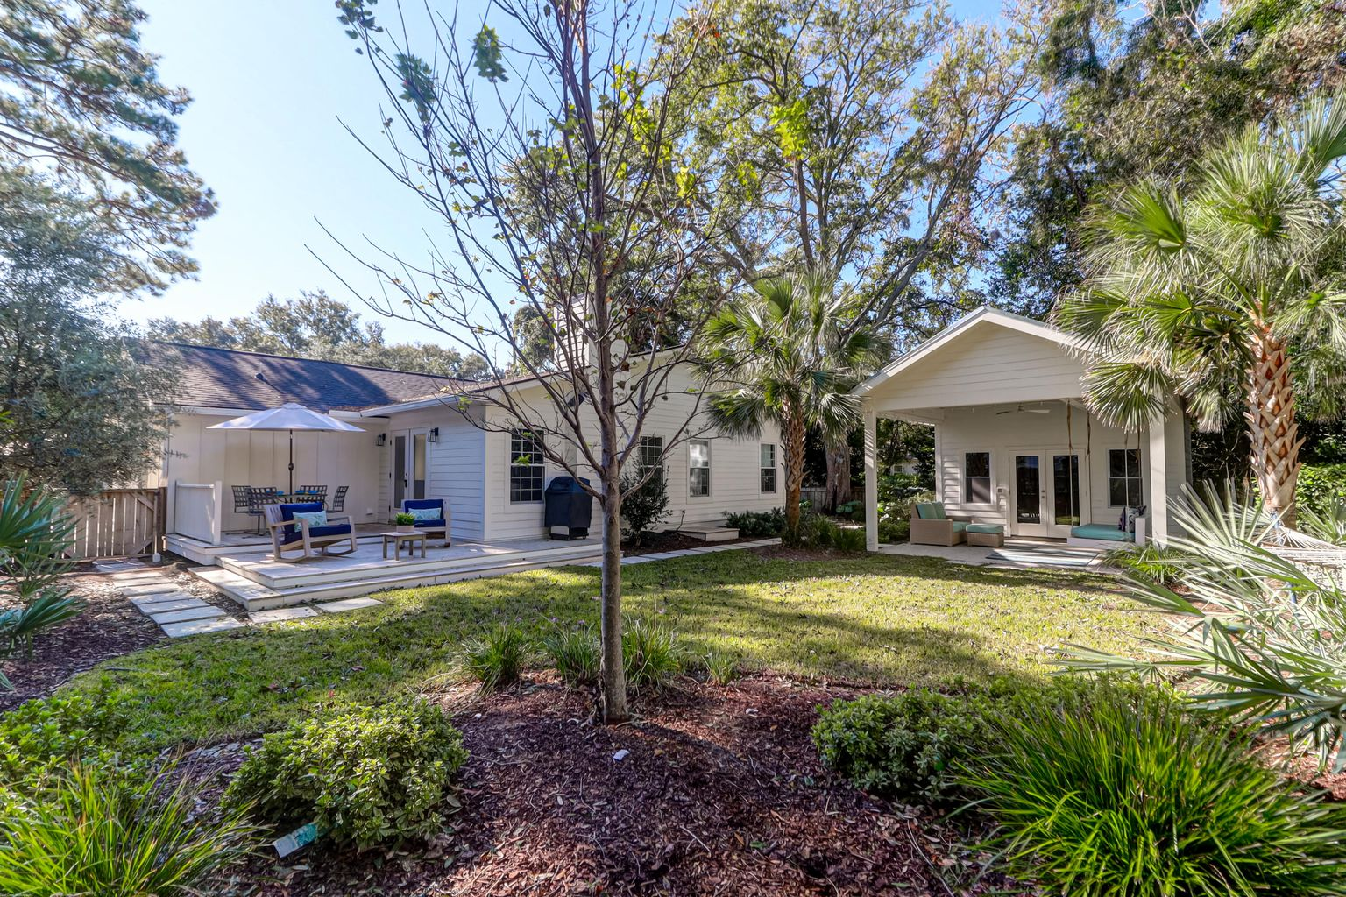





Agents & Buyers Welcome!
Old Mount Pleasant Open Houses
Thursday, October 20th 11:00-1:00
1368 Pherigo Street
MLS# 22022616
$1,350,000
714 Cherry Street
MLS# 22025756
$1,349,000
3
2½
2,258
4
3
1,844
Elise Rivers Kennedy
Carolina One Real Estate
843-452-1408
elise.kennedy@carolinaone.com
Kylene Sullivan
The Cassina Group
843-367-7238
kylene@thecassinagroup.com

